Slide 1



CMUG – Final Integration Meeting
Paris - 13th and 14th of February 2017
HOW MUCH SOIL MOISTURE CCI PRODUCT ALLOWS TO ASSESS CLIMATE MODEL RESPONSES ?
Focus on summers in Europe
Claire Magand, Jean-Louis Dufresne

Slide 2
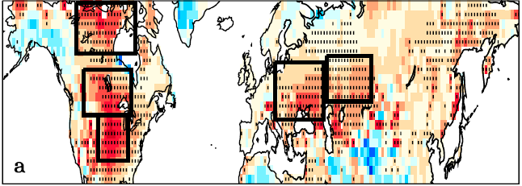
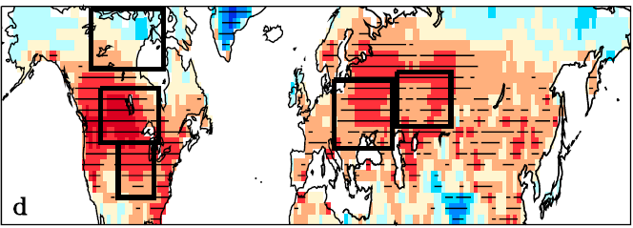
0. WHY FOCUSSING ON SOIL HUMIDITY?
(a) Multimodel mean bias of summer temperature compared to CRU data for AMIP simulations
(d) correlation between future warming and current bias of temperature T
Climate models in CMIP5 «share a strong summertime warm bias in midlatitude areas, especially in regions where the coupling between soil moisture and atmosphere is effective. [...] Over these areas, the most biased models in the present climate simulate a larger warming in response to climate change which is likely to be overestimated. »
Cheruy et al., 2014
Can surface soil moisture help to understand and constrain these biases in Europe,
and therefore improve climate change projections ?

Slide 3
1. ESACCI –SOIL MOISTURE COMBINED PRODUCT
Time evolution of the spatial coverage of SM observations
CCI provides daily observations of SM, but not every day
1 obs /month
3 obs /month
5 obs /month
10 obs /month
Caution is to be taken when using time series.
Spatial coverage depends on the time period.
Spatial coverage of SM observations >5 obs/month
5 obs min = 49 % of mean coverage over 1979-2014

Slide 4
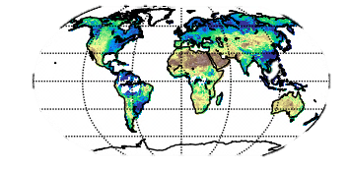

1. ESACCI –SOIL MOISTURE COMBINED PRODUCT
Mean over 1980-2009
m³/m³
Direct comparisons between observations and simulations allows to verify the broad picture but do not allow more precise comparison (trends, seasonal cycle...)
Best agreement between CCI data and simulated soil moisture integrated over the first 5 cm of the soil using the IPSL land surface model. Good agreement with SM integrated over the first 10 cm which is the standard variable in the CMIP6 experiment. (Delorme et al., in prep)
Notes:
Q° Jean-Louis :

Slide 5
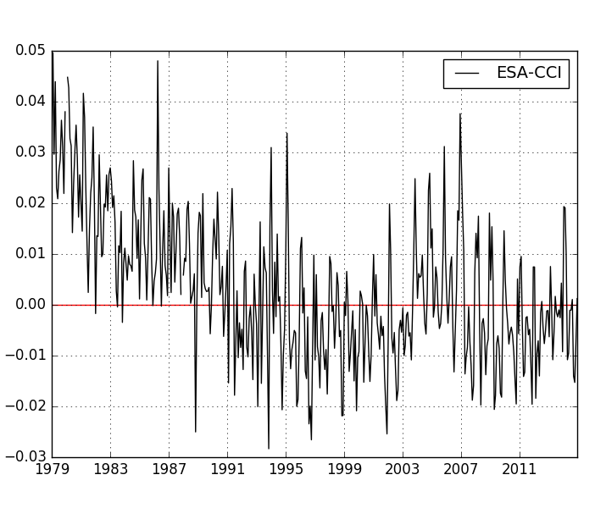
2. FOCUS ON EUROPE – Interannual values
Europe domain
Surface soil moisture anomalies – 1979-2014 - Europe
Non stationnarity of CCI data
=> Focus on the last two decades

Slide 6
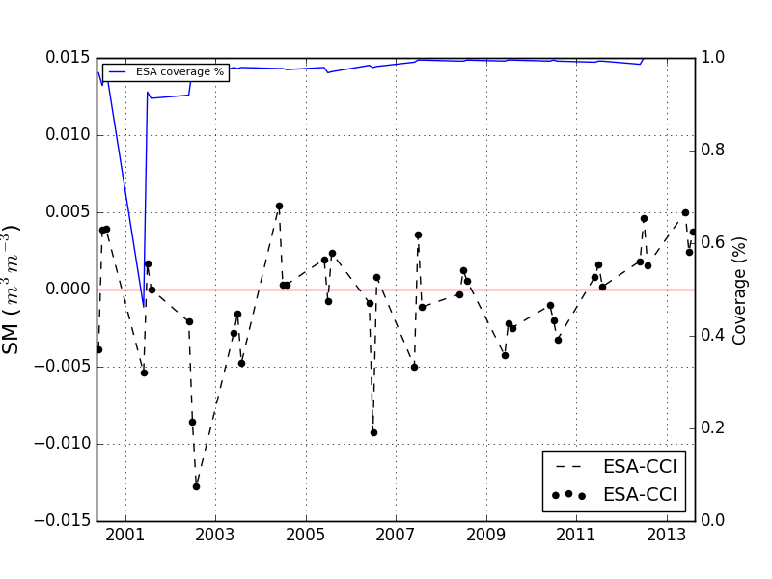
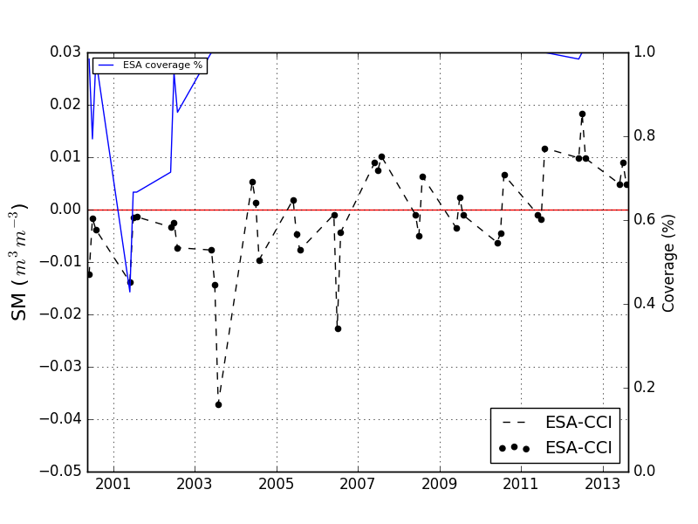
2. FOCUS ON EUROPE – Interannual values
Interannual values
Can we observed the european heat wave of 2003 characterized by very dry condtions? (e.g. Fischer et al, 2007 ;Zampieri et al., 2009 Seneviratne et al., 2010)
SSM anomalies – summer - 2000 to 2014
SSM anomlies – summer - 2000 to 2014
!
Importance
of the spatial area concerned
Europe domain
Central Europe domain

Slide 7
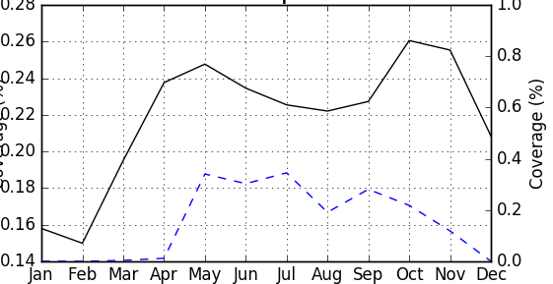
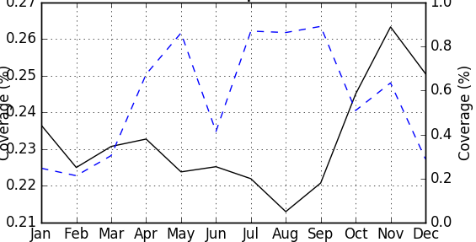
2. FOCUS ON EUROPE – Seasonal values
Seasonal cycle of the soil moisture CCI over Europe
1981-1990
2000-2014
Non stationarity of seasonal cycle – better coverage in summer
=> Focus on summers after 2000 in Europe

Slide 8
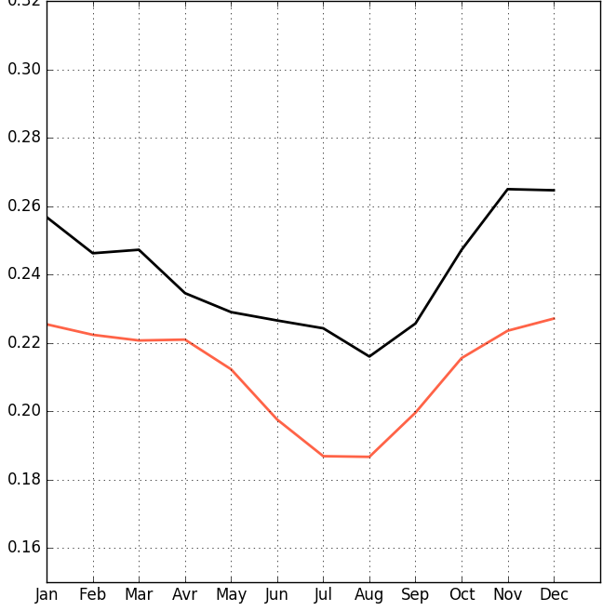
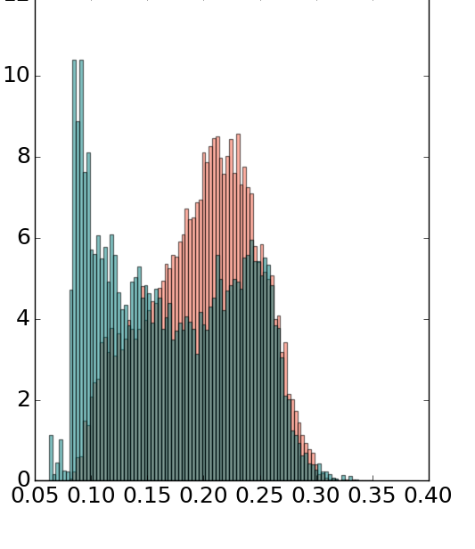
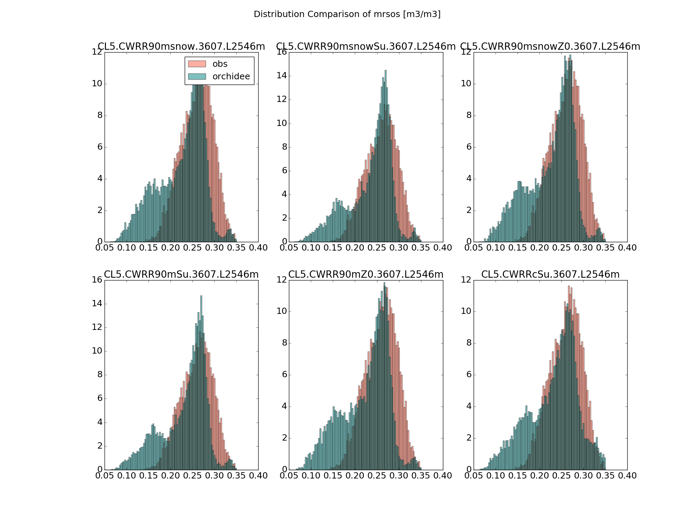
2. FOCUS ON EUROPE – Seasonal values
SSM (m³/m³)
OBS
ORCHIDEE
Seasonal climatologies of SSM
Summer histogram of SSM
Histograms shows spatial sub-domain differences besides a simple offset of means between observations and simulations in the seasonal climatologies.
Notes:
1/ le modèle simule des rayonnements plus forts que les observations
2/ le modèle évapotranspire de plus grande quantité que les observations (queue du 2ème mode de la distribution)
3/ Le sol est alors plus vite asséché que dans les observations
4/ Le modèle ne peut ensuite évapotranspirer que de petites quantités (1er mode de la distribution)

Slide 9
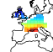
3. Relations between downward solar radiation – evapotranspiration – soil moisture
ESA-CCI-SSM
downward SW : CERES-EBAF
Evapotranspiration : ET – GLEAM
Δlat,Δlon = 1°x1°
Δt = 1 month, 2001-2010
1 nudged and coupled IPSL simulation
Δlat,Δlon = 143x144 (1.26°x2.5°)
Δt = 1 month, 1980-1990
Europe centrale
4 statistical classes of surface soil moisture
Observations (CCI)
DRY
WET
Orchidee model

Slide 10
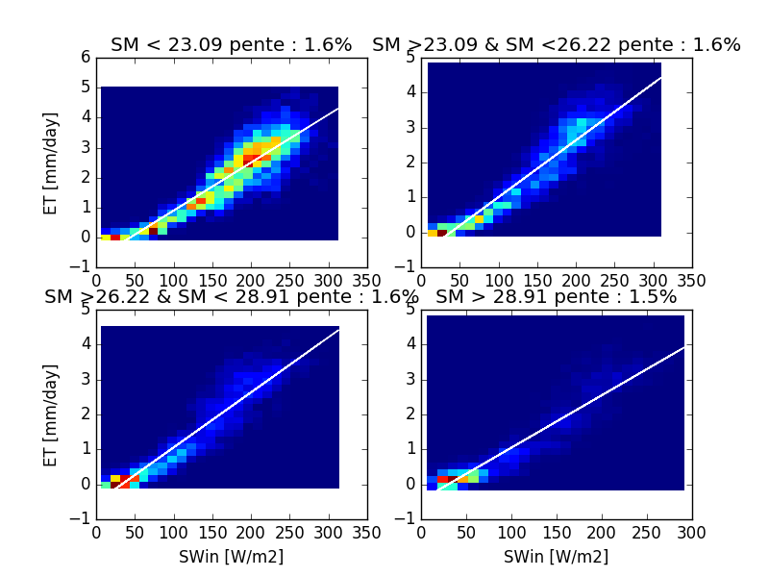
3. Relations between downward solar radiation – evapotranspiration – soil moisture
Observations 2001-2010 - 1° - monthly – Central Europe
E=f(SWin) function of SSM in kg/m2 over 10 cm.
DRY
WET
Notes:
1 – Dans le premier quartile de SM, c’est à dire quand le sol est sec, on a principalement des situations où le rayonnement est important et l’évapotranspiration aussi. Alors que dans le dernier quartile, on a des situations où on a peu de rayonnement et peu d’évapotranspiration
2 – Contrairement à ce que l’on attendait, où les pentes sont plus fortes quand il y a de l’eau que quand il n’y en a pas. Les pentes sont constantes peu importe la classe d’humidité considérée autour de 1.5%.

Slide 11
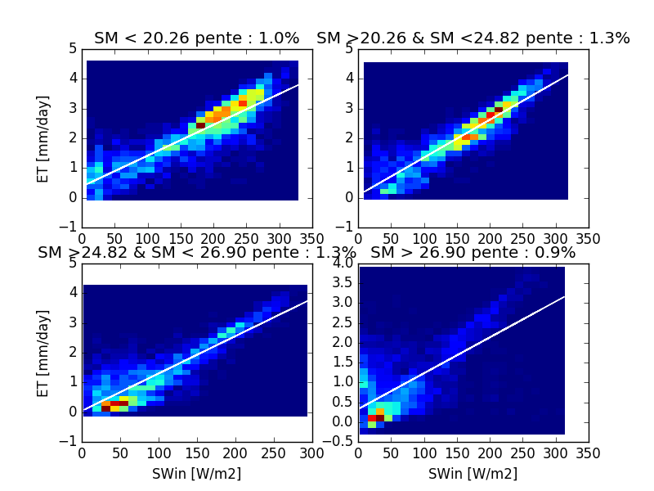
3. Relations between downward solar radiation – evapotranspiration – soil moisture
Simulations 2001-2010 - 143x144 - monthly – Central Europe
E=f(SWin) function of SSM in kg/m2 over 10 cm.
DRY
WET
Notes:
1 – Différences de situation similaires entre le 1er et le dernier quartile MAIS 2ème quartile très différent.
2 – Les pentes sont relativement constantes, on voit une légère augmentation entre le 1er et les 2ème et 3^{ème.} Elles sont légèrement plus faibles que dans les observations (1.3% vs. 1.6%). La pente du dernier quartile est plus faible mais à cause des points à l’origine. On constate que dans le modèle, on a beaucoup de situations où malgré un faible rayonnement, on a beaucoup d’évapotranspiration. C’est flagrant pour le dernier quartile mais on le voit sur toutes les autres distributions.

Slide 12
CONCLUSION
Direct comparisons between observations and simulations are difficult
Best agreement between CCI data and simulated soil moisture integrated over the first 5 cm of the soil using the IPSL land surface model. Good agreement with SM integrated over the first 10 cm which is the standard variable in the CMIP6 experiment
Important events impacting SSM such as the 2003 heat wave over Mid-Europe is highlighted
Seasonal cycle described by the CCI data is not realistic over Europe because of a lack of data in winter, but summer data are valuable
Process oriented analysis using a small set of variables allows to better use of observations to better assessment of models
The relationships between evapotranspiration, solar radiation and soil moisture exist but differ in observations and simulations. It (probably) allows to trace the origin of the problem in the model. to be continued… !

Slide 13
CMUG – Final Integration Meeting
Paris - 13th and 14th of February 2017
HOW MUCH SOIL MOISTURE CCI PRODUCT ALLOWS TO ASSESS CLIMATE MODEL RESPONSES ?
Focus on summers in Europe
Claire Magand, Jean-Louis Dufresne
Thank you for your attention !

Slide 14

1. ESACCI –SOIL MOISTURE COMBINED PRODUCT
version 2.2
released in February 2016
1979
Period available | 1979-2014
Spatial resolution | 0.25°
Temporal resolution | daily
Nimbus–7 SMMR
DMSP SMM/I
ERS-1
Passive Microwave
ERS-2
TRMM TMI
2000
AQUA AMSR-E
Active microwave
C-band
Scatterometers
Coriolis Windsat
METOP-A ASCAT
GCOM-W1 AMSR2
2014
Notes:
1/ combinée et V2 sur la période 1979-2014
2/ Au début des années 1980, un seul satellite fournit ces observations alors qu’à partir des années 2000, l’humidité du sol est fournit par plusierus statellites etleur durée de fonctionnement se recoupent. Ce qui laisse penser à une meilleure couverture spatiale et temporelle.
Instruments utilisés pour les observations d’humidité du sol v02.2 : SMMR (Nimbus-7 – NASA – 1978-1987), SMM/I (DMSP-F8/10/11/12/13/14/15 – NOAA -1987-2014), TMI (TRMM- Nasa 1998-2015), AMI-WS (ERS-1.1991-2000/ ERS-2.1995-2011 – ESA), ASCAT (Metop-A/B/C – ESA – from 2006), AMSR-E (AQUA –NASA, from 2002), Windsat (Coriolis . NRL, from 2003), AMSR2 (GCOM-W1/W2/W3 – NASA, from 2012) -> 8 satellites
Change from v02.1 : improvement of spatial and temporal coverage especially during 2002-2006 (due to a failure in ERS-AMI) filled with observations from AMSR-E.
Demander à Patricia la même chose pour le CO2 : IASI? (Metop-A/B/C, CNES/Eumetsat)

Slide 15
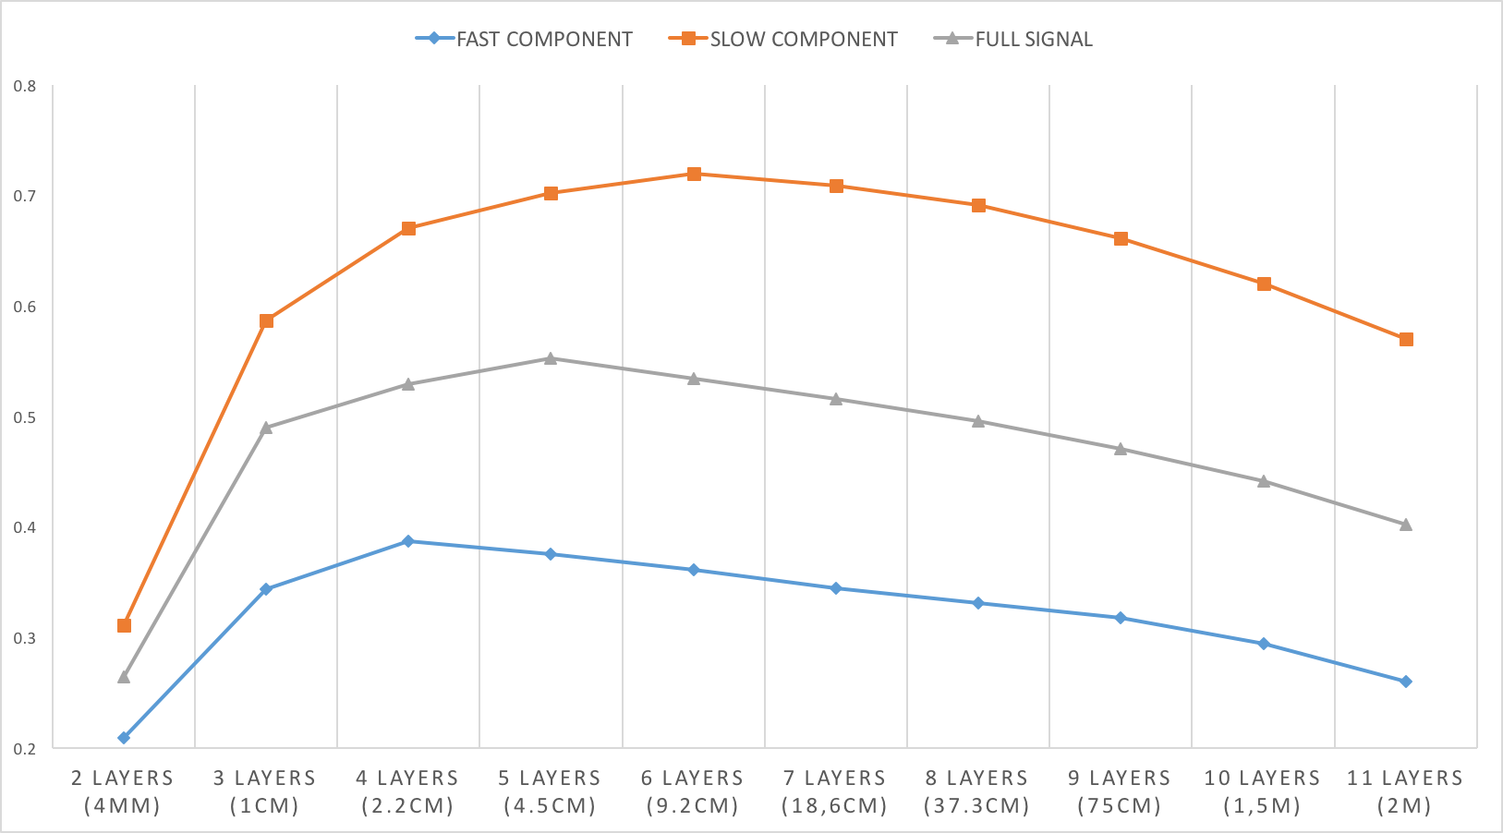





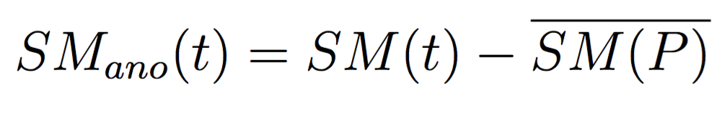
SIGNAL DEPTH ?
DECOUPLING
SHIFT
Seasonal cycle influe a lot on correlation scores
Large Gap

Slide 16
WINTER
SPRING
seasonal cycle
In winter, very few data except in the oriental part, around the black sea.
AUTUMN
ETE
A actualiser sur toute la période ou la période la plus récente
Spatial coverage of ESA CCI - summer – 1981-1990

Slide 17
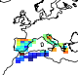
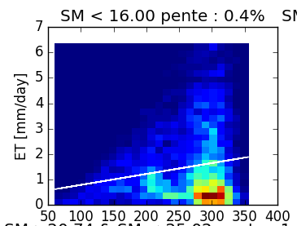
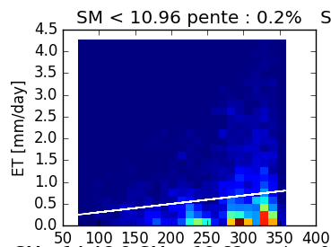
Etude sur le premier quartile
OBS – Centrale Europe
OBS – Mediterranean Europe
SIM – Centrale Europe
SIM – Mediterranean Europe
Notes:
On retrouve ce phénomène de non-linéarité dans les observations si on change de domaine spatiale et si on considère l’Europe méditerranéenne et toujours le premier quartile. Y a-t-il un seuil d’humidité du sol à partir duquel on voit apparaître la non linéarité dans les obs et dans les simulations?

Slide 18
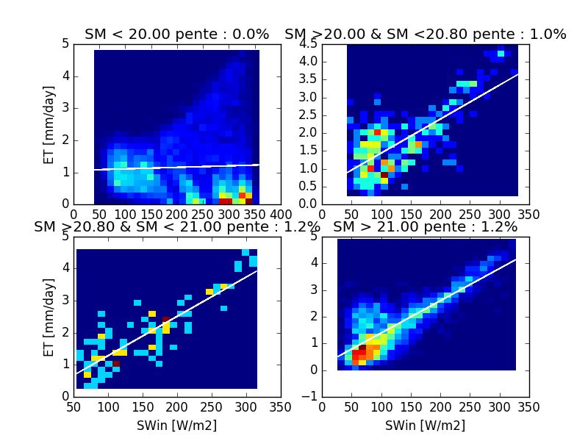
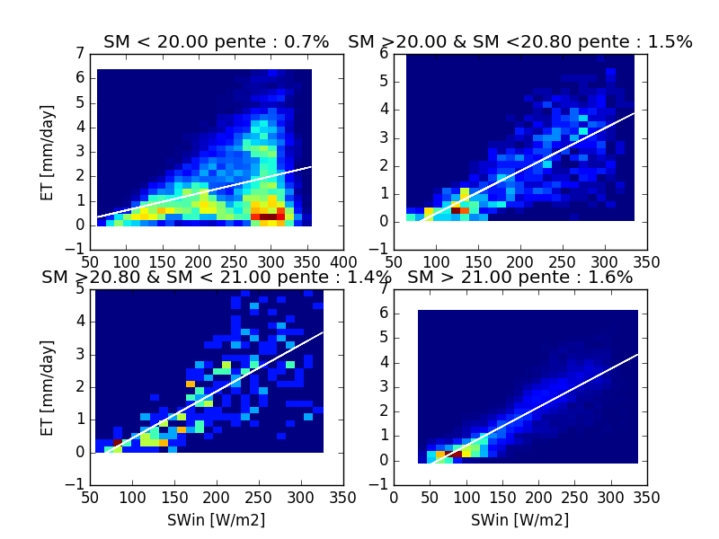
Existence d’un seuil d’humidité du sol à partir duquel on observe une non-linéarité dans la relation E=f(SWin)?
OBS – Mediterranean Europe
SIM – Mediterranean Europe
Notes:
Un seuil entre 20 et 21 kg/m2 semble apparaître dans les deux cas : obs et sim.

Slide 19
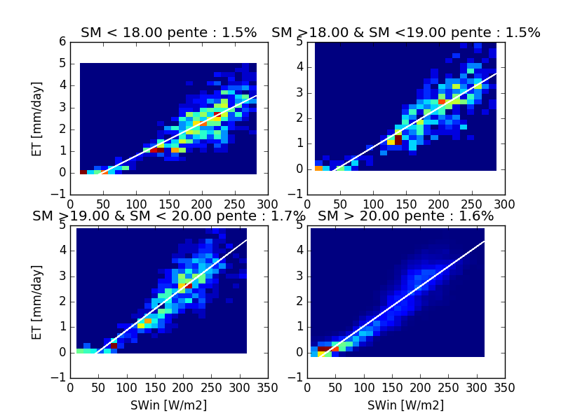
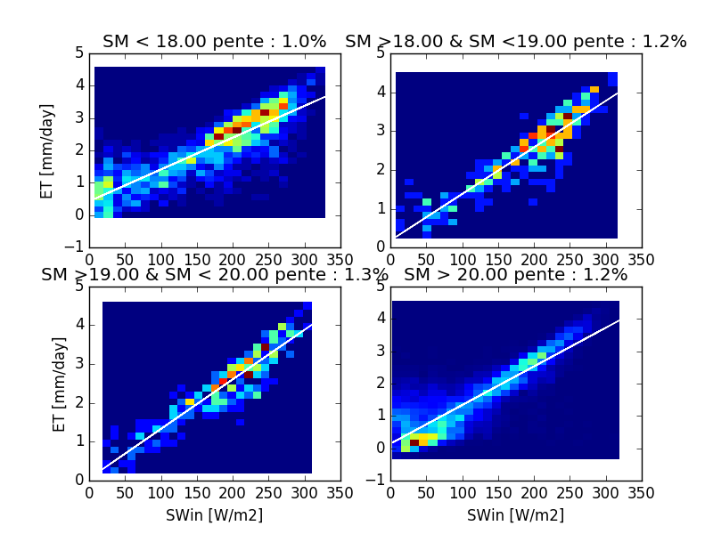
Existence d’un seuil d’humidité du sol à partir duquel on observe une non-linéarité dans la relation E=f(SWin)?
OBS – Centrale Europe
SIM – Centrale Europe
Notes:
Pas de seuil? Définir un seuil de données consécutives…?

