Slide 1






CCI CMUG Integration 6 Meeting
University of Munich (LMU), Munich, Germany
14-16 March 2016
Ozone_cci CRG
Results and Plans
M. Dameris (DLR), P. Braesicke (KIT), M. van Weele (KNMI)
Science leader: M. van Roozendael (BIRA)

Slide 2
Outline
Climate Research Data Package (CRDP)
CRG activities at DLR (M. Dameris, M. Coldewey-Egbers and D. Loyola)
  Evaluation of model data
  Ozone long-term trend and variability
CRG activities at KIT (P. Braesicke)
CRG activities at KNMI (M. van Weele)
Current plans

Slide 3
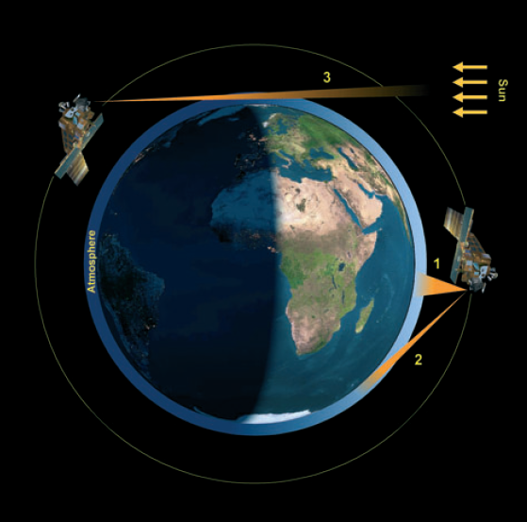
Ozone Data Products
Ozone total columns and profiles from nadir sensors in 0-50 km altitude range
Ozone profiles from limb/occultation sensors in 10-100 km altitude range (UTLS, stratosphere and mesosphere)
Tropospheric ozone products using a range of different retrieval approaches
1. Nadir, 2. Limb, 3. Occultation

Slide 4
Sensors and platforms
Agency | Satellite platform | Sensors
ESA | ERS-2 | GOME
ESA | ENVISAT | SCIAMACHY, GOMOS, MIPAS
EUMETSAT | METOP-A | GOME-2, IASI
 | METOP-B | GOME-2, IASI
NASA | NPP-Suomi | OMPS
NASA | AURA | OMI, MLS
NASA | UARS | HALOE
NASA | ERBS | SAGE-II
NASA | TIMED | SABER
SNSB CSA | ODIN | OSIRIS, SMR
CSA | SCISAT | ACE

Slide 5
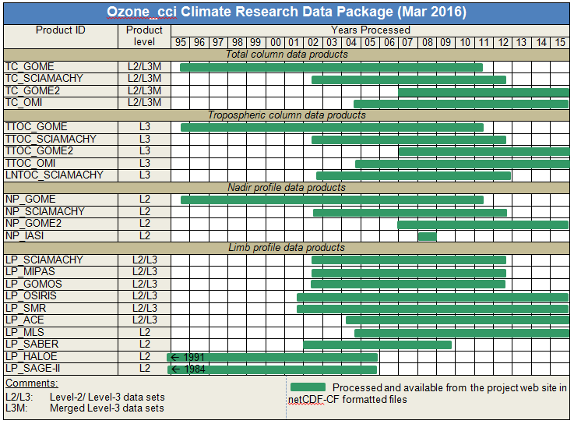
Climate Research Data Package

Slide 6
Scientific challenges
Comparison of Ozone_CCI data products with CCMs/CTMs
Trend estimates and robust prediction of ozone return date to historical levels and further evolution of the ozone layer
Improved understanding of dynamical, chemical and radiative processes in an atmosphere with enhanced greenhouse gas concentrations
Insight of stratosphere-troposphere coupling in a future climate

Slide 7
CRG activities at DLR
Chemistry-Climate Model EMAC (based on ECHAM 5),
using a full set of stratospheric and tropospheric chemistry;
the CCM can be ‘nudged’ with reanalysis data (specified dynamics) in addition to a “free-running” model configuration (‘climate mode’).
EMAC nudged set-up:
  Resolution: T42/L90 (T42: 2.8°x2.8°, L90: 0-80 km).
  Forcing: 6 hourly ERA-Interim with vertically varying relaxation time constants.
  Middle and upper stratosphere (>30 km) free running.
  Strategy: 1950-1979 free running model (whole atmosphere), 1980-today ‘nudged’ integration.

Slide 8
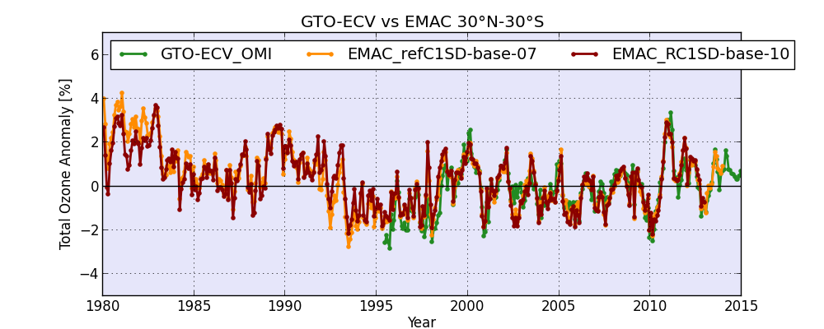
Evaluation of CCM EMAC
Global Ozone Monitoring Experiment (GOME)-type total ozone-essential climate variable
(GTO-ECV) has been compiled from European satellite sensors GOME, SCIAMACHY, GOME-2, and (new) OMI (total: 1995-2014).

Slide 9
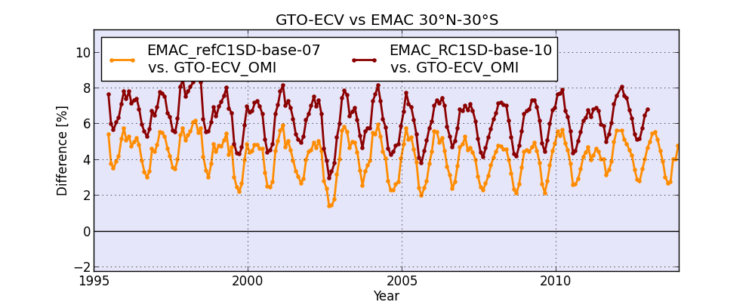
Evaluation of CCM EMAC
Global Ozone Monitoring Experiment (GOME)-type total ozone-essential climate variable
(GTO-ECV) has been compiled from European satellite sensors GOME, SCIAMACHY, GOME-2, and (new) OMI (total: 1995-2014).

Slide 10
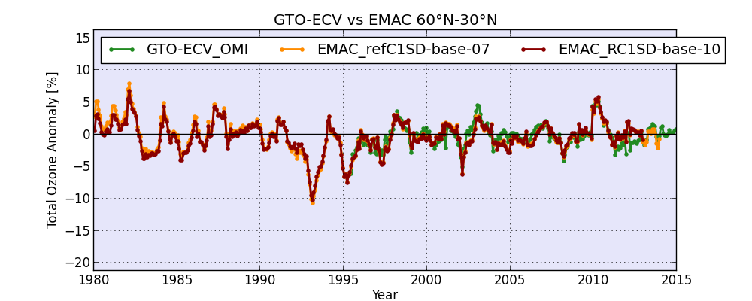
Evaluation of CCM EMAC
Global Ozone Monitoring Experiment (GOME)-type total ozone-essential climate variable
(GTO-ECV) has been compiled from European satellite sensors GOME, SCIAMACHY, GOME-2, and (new) OMI (total: 1995-2014).

Slide 11
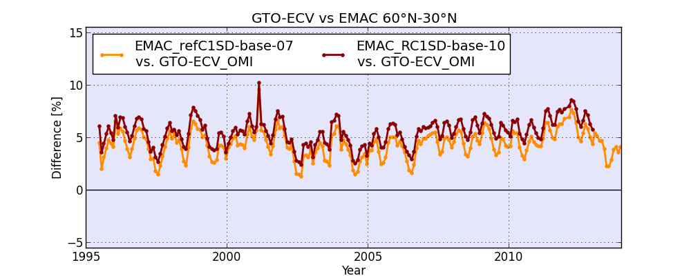
Evaluation of CCM EMAC
Global Ozone Monitoring Experiment (GOME)-type total ozone-essential climate variable
(GTO-ECV) has been compiled from European satellite sensors GOME, SCIAMACHY, GOME-2, and (new) OMI (total: 1995-2014).

Slide 12
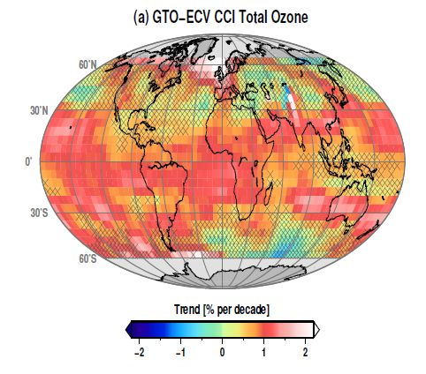
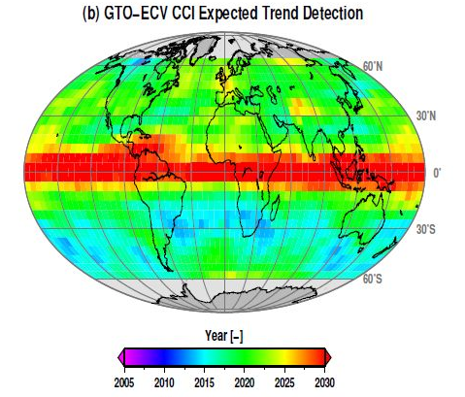
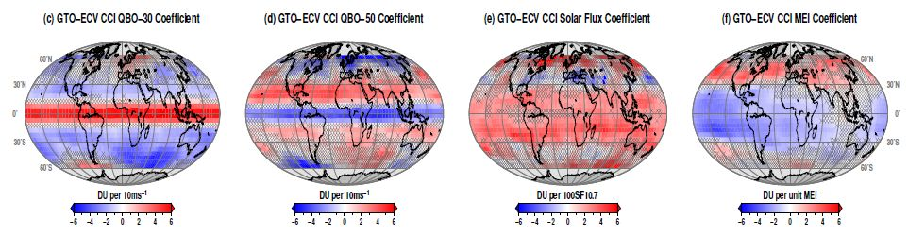
Ozone trend and variability 1995-2013
Multiple linear regression model:
O₃(m) = A + B₀·m
+ C·SF(m)
+ D·QBO30(m)
+ E·QBO50(m)
+ F·MEI(m)
+ X(m)
Coldewey-Egbers et al., 2014 (GRL)

Slide 13
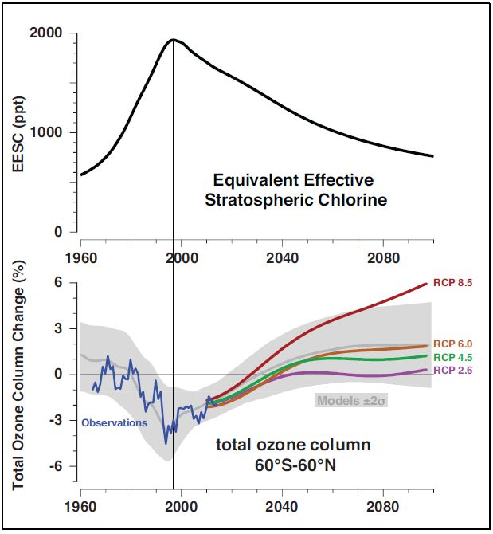
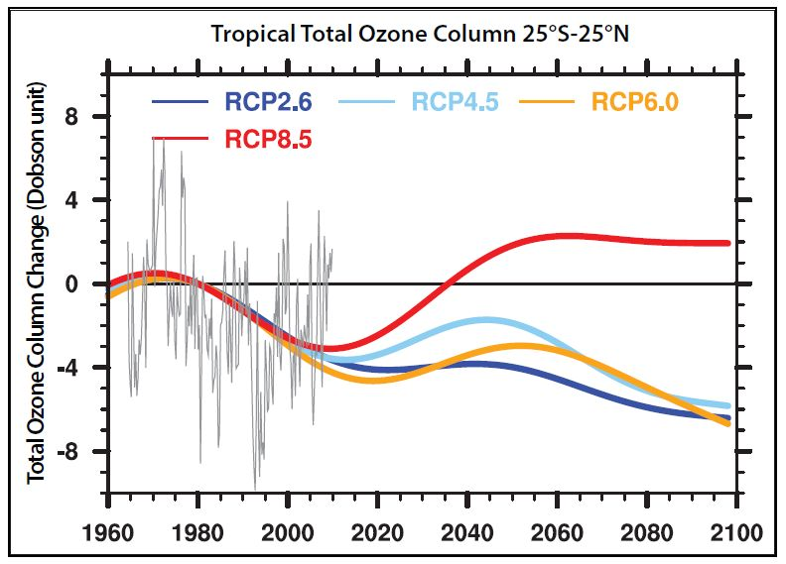
Evolution of the ozone layer
Variation of EESC in mid-latitudes from 1960 to 2100
WMO, 2014

Slide 14
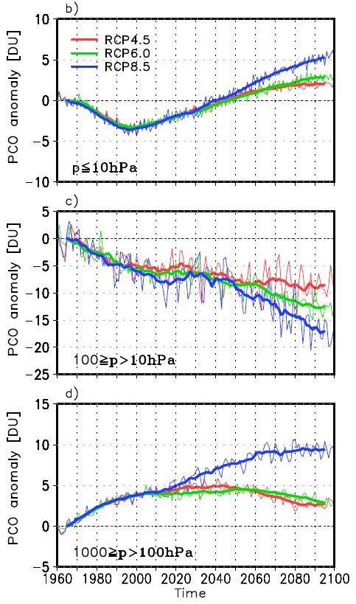
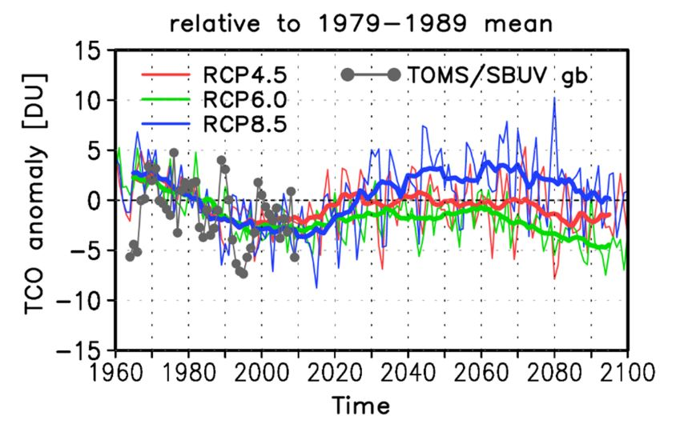
Tropical ozone trend (DLR together with FU Berlin)
WMO, 2014
a)
Meul et al., 2016 (GRL)

Slide 15
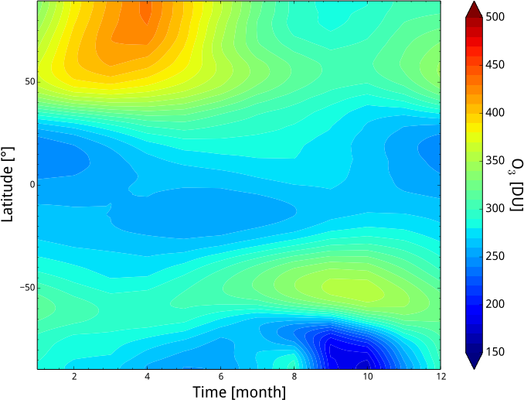
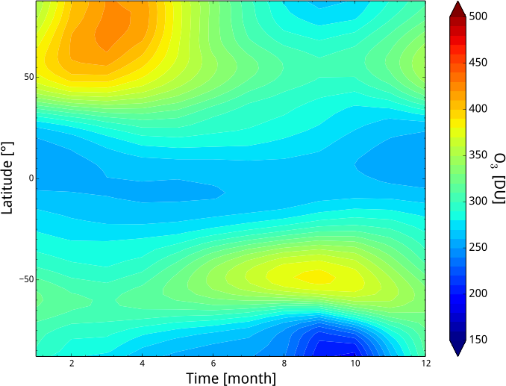
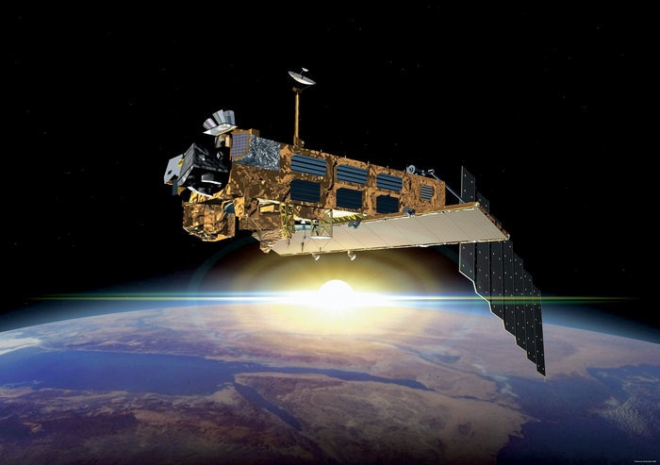
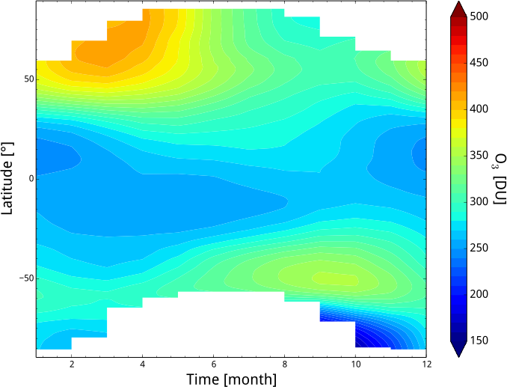
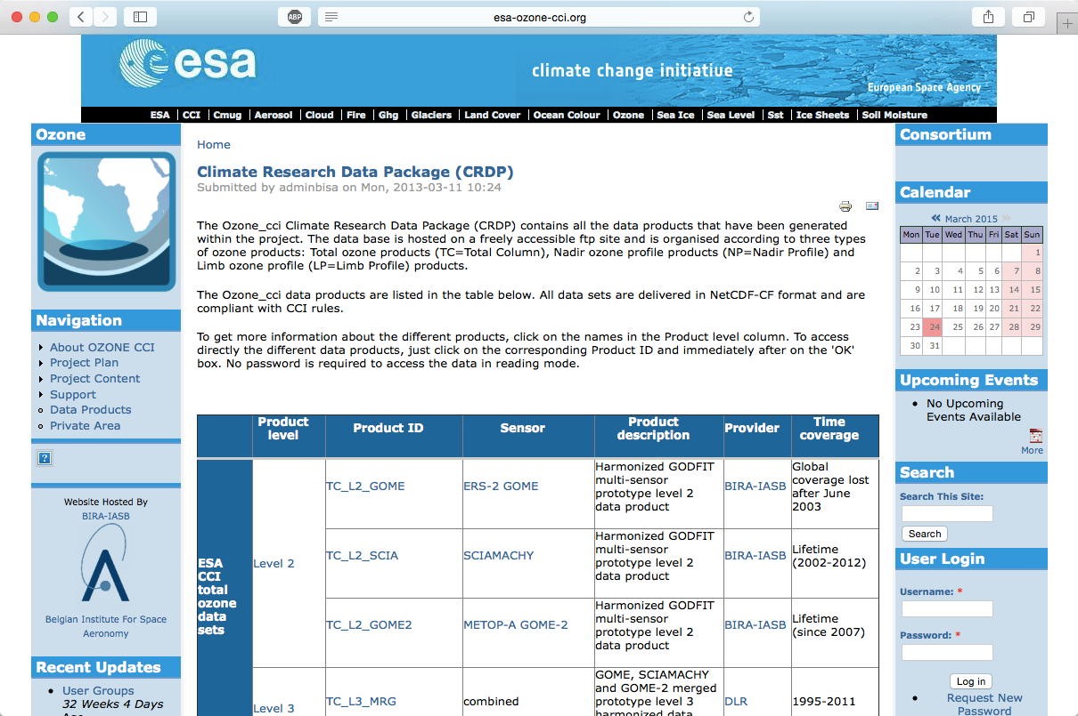
Annual cycle of total ozone
ERA interim
EMAC
Image: ESA
ESA ozone CCI
Observational Data from the ESA Ozone CCI
Observations from many sensors and satellite instruments
Image: ESA/Eumetsat

Slide 16
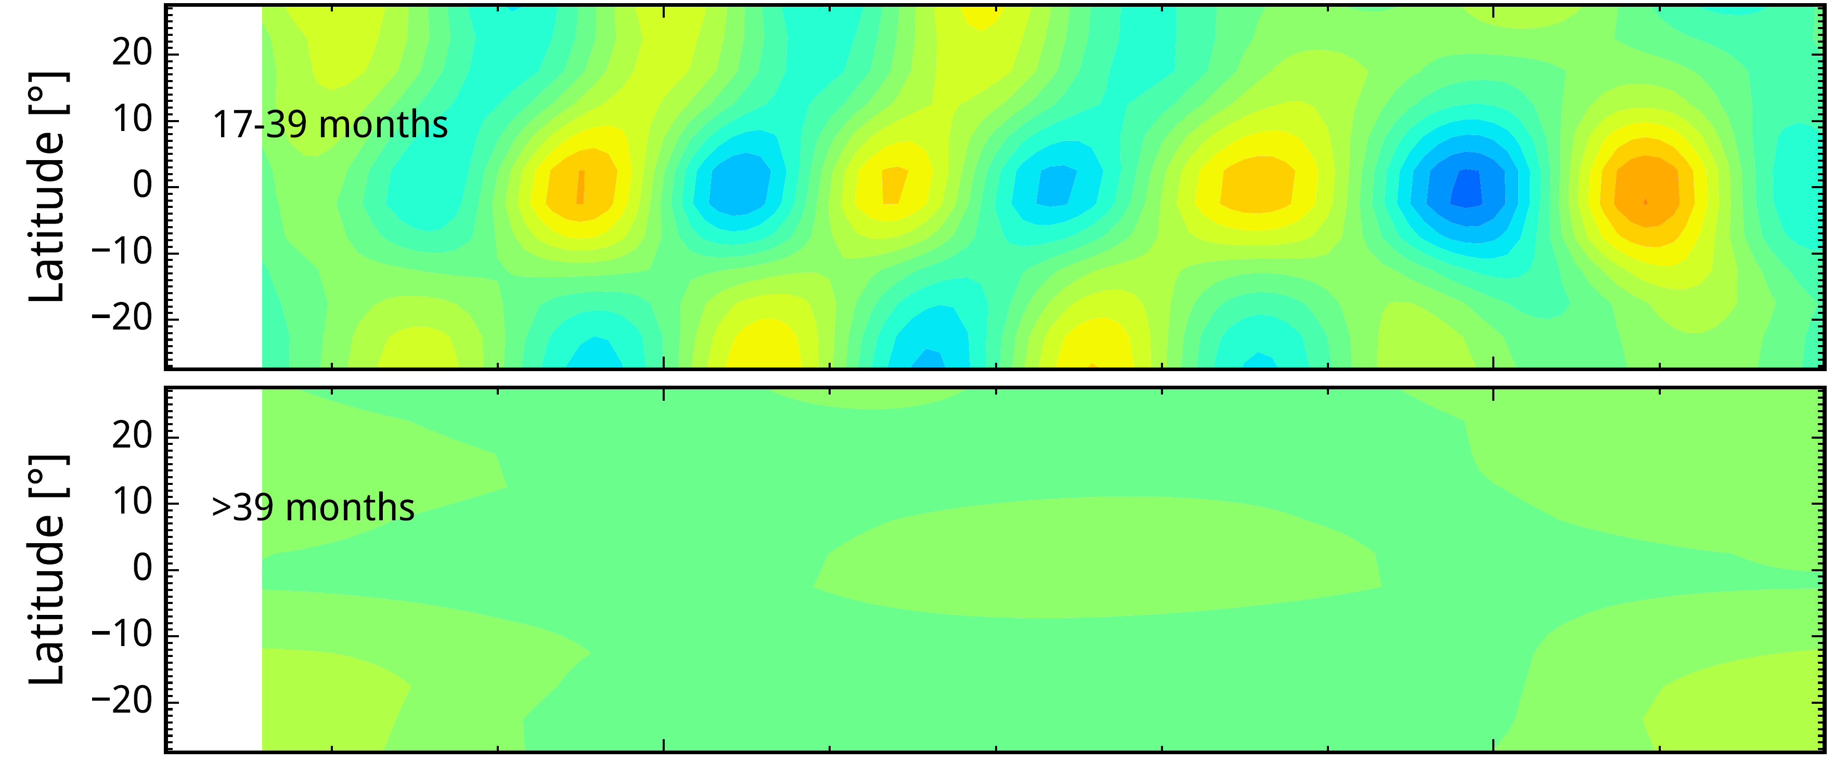
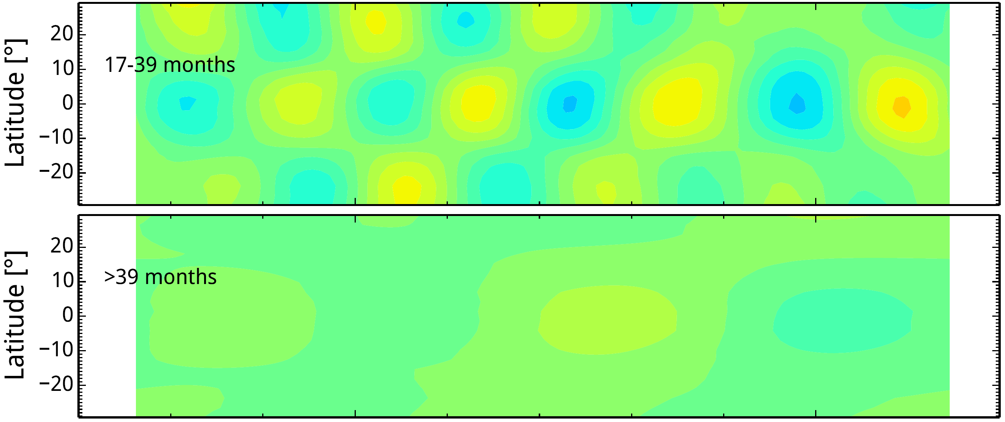
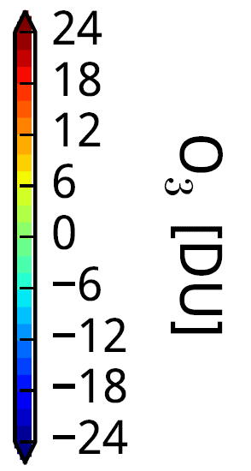
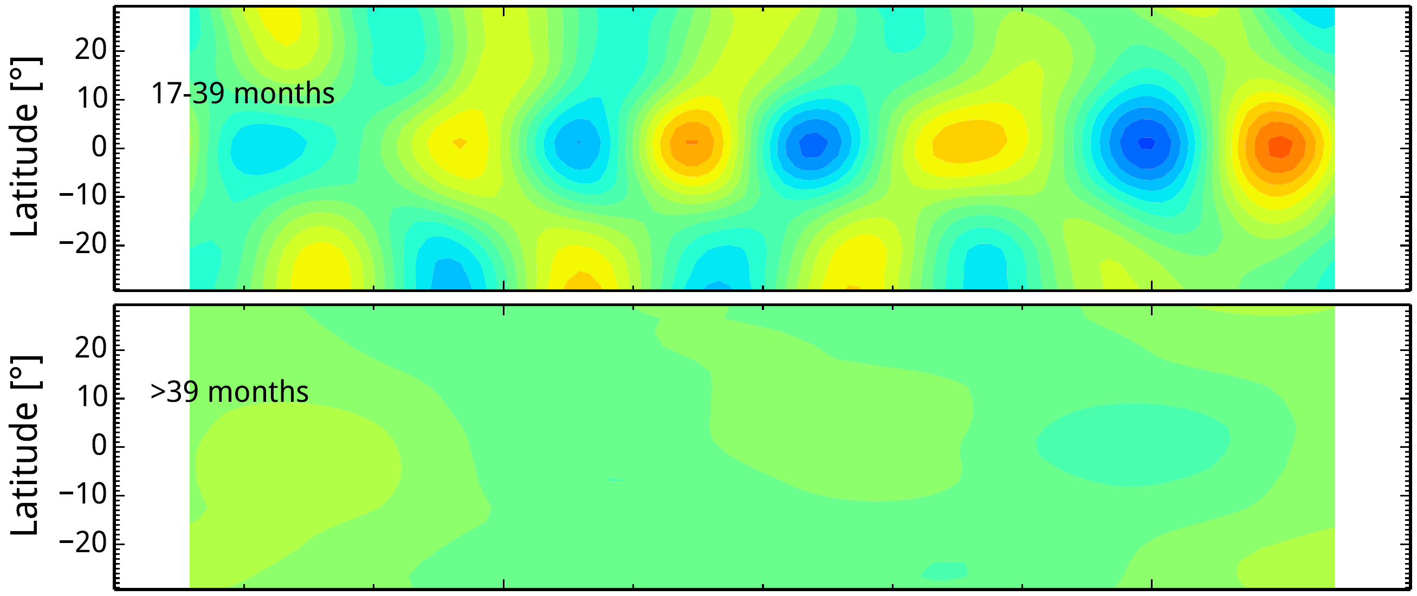
Quasi-biennial oscillation (QBO)
SCIAMACHY
Time series of filtered (QBO and >39 months) ΔTO3 for data from SCIAMACHY (Ozone CCI) and simulation results from EMAC (free running and nudged)
[Escimo consortium]
Escimo free-running
Escimo nudged
Comparison of SCIAMACHY data with the EMAC Escimo data shows that the strength of the QBO is fairly well captured by the nudged version of the EMAC run.

Slide 17
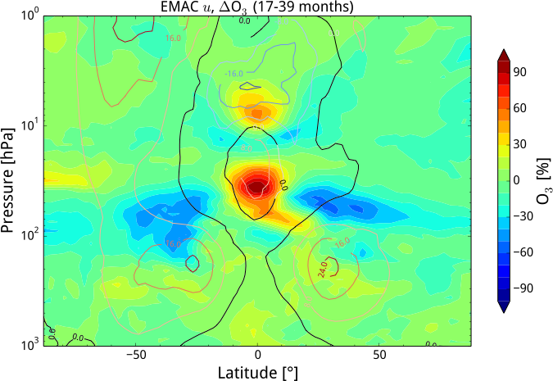
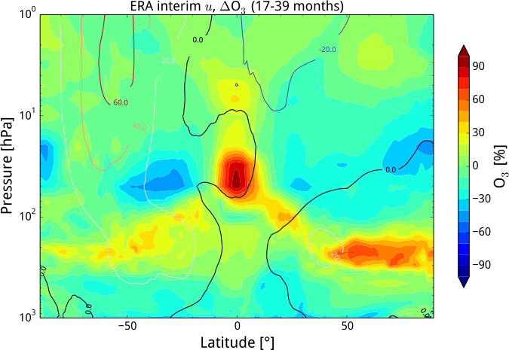
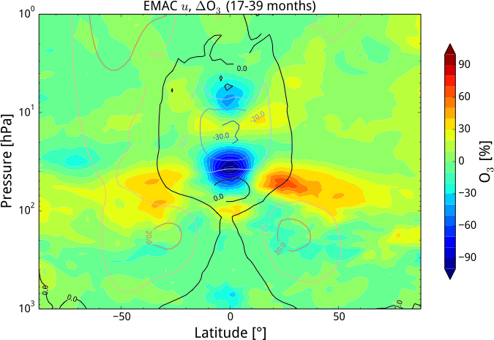
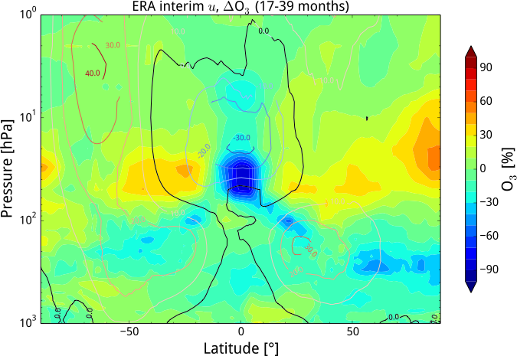
Troposphere and Tropopause Working Group (TTWG)
Composites of EMAC (left) and ERA interim (right) O3 QBO max (top) and min (bottom)

Slide 18
CRG activities at KNMI
The ‘Operoz’ study (Oct 2014 – Feb 2015)
OPERational OZone observations using limb geometry
Objectives:
To further establish user requirements for an operational mission targeting ozone profiles at high vertical resolution
To identify the observational gaps w.r.t. user needs taking into account planned operational (nadir) missions and ground networks
Perform a reality check on the observational requirements and identify options for a small to medium size satellite mission
  Based on proven concepts and present-day knowledge of potentially available measurement techniques
  Detailing GMES-Pure recommendations to EU for the evolution of the Copernicus Space Segment w.r.t. ozone profile monitoring needs

Slide 19
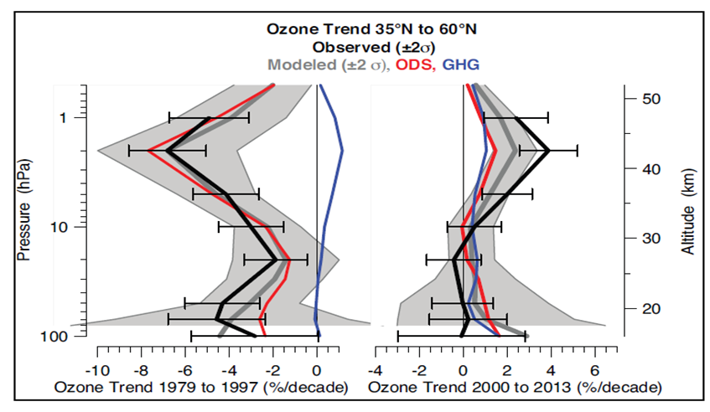
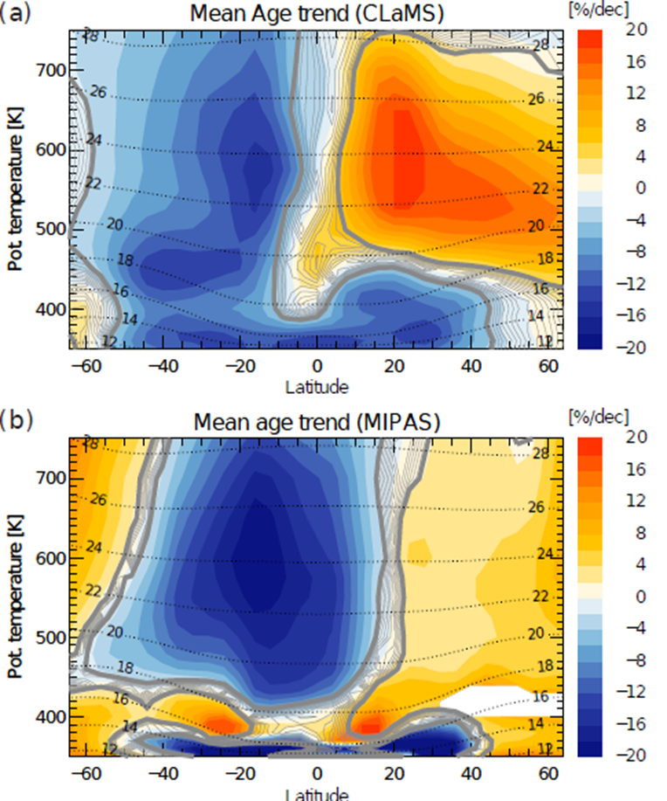
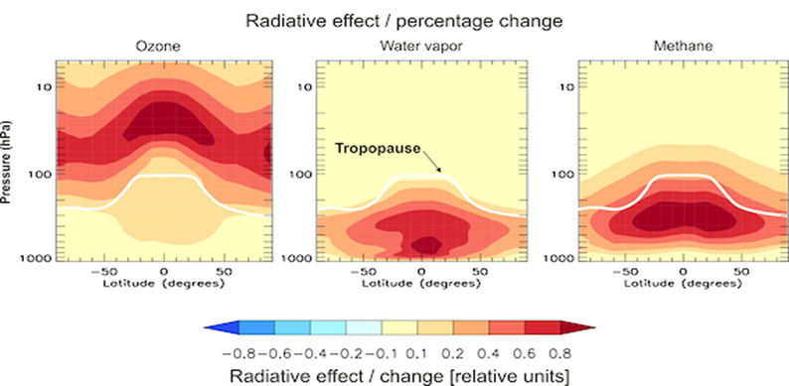
Long-term monitoring (Operoz)
WMO, 2014
Riese et al., 2012 (JGR) Ploeger et al., 2015 (JGR)

Slide 20
Long-term ozone requirements
Minimum operational limb mission
An ozone-only limb mission in support of operational services and long-term monitoring with:
  Global coverage, including polar night, on a daily basis,
  Dense spatial sampling,
  Covering the entire stratosphere from stratopause to tropopause,
  Stringent stability requirements on decadal time scales, and
  Near-real time availability

Slide 21
Summary

Slide 22
Plans in ESA_cci Ozone
Spectrum of variability as a constraint for Earth-System Models
  Look at spectra of variability – are models and satellites seeing the same amount of variance at key frequencies? How are the different key frequencies linked?
Extreme ends of the spectrum
  Trends: latitude and altitude dependencies.
  Diurnal cycle: use models to better understand its importance for trend estimates.
Data from archive will be complemented with case studies
Links to international activities
  WCRP Coupled Model Intercomparison Project Phase 6 (CMIP6)
  IPCC assessment report
  SPARC/IGAC Chemistry-Climate Model Initiative (CCMI)
  UNEP/WMO Scientific Assessment of Ozone Depletion 2018

Slide 23
Plans in ESA_cci Ozone
Contribution of CRG to establish consistent ECVs:
Provision of different, consistent ECV-data sets derived from individual model studies
  Climate Models (e.g. CMIP6 activity).
  Chemistry-Climate Models (e.g. CCMI).
  Chemical Transport Models.
Use of ECV-data products
  as boundary (initial) conditions for climate model simulations,
  for evaluation purposes (assessment of uncertainties),
  in scientific projects (e.g., the EC StratoClim project; project in the EC “Aerosols and Climate” cluster), and
  for outreach and dissemination.
Address inter-consistency between ECV-data products in broader way:
  confrontation of multiple ECV parameters to the output of the models operated by the Ozone_cci CRG;
  study possible interlinks between ECVs connected by chemical, radiative or dynamical effects.

Slide 24
Thank you !

