Slide 1
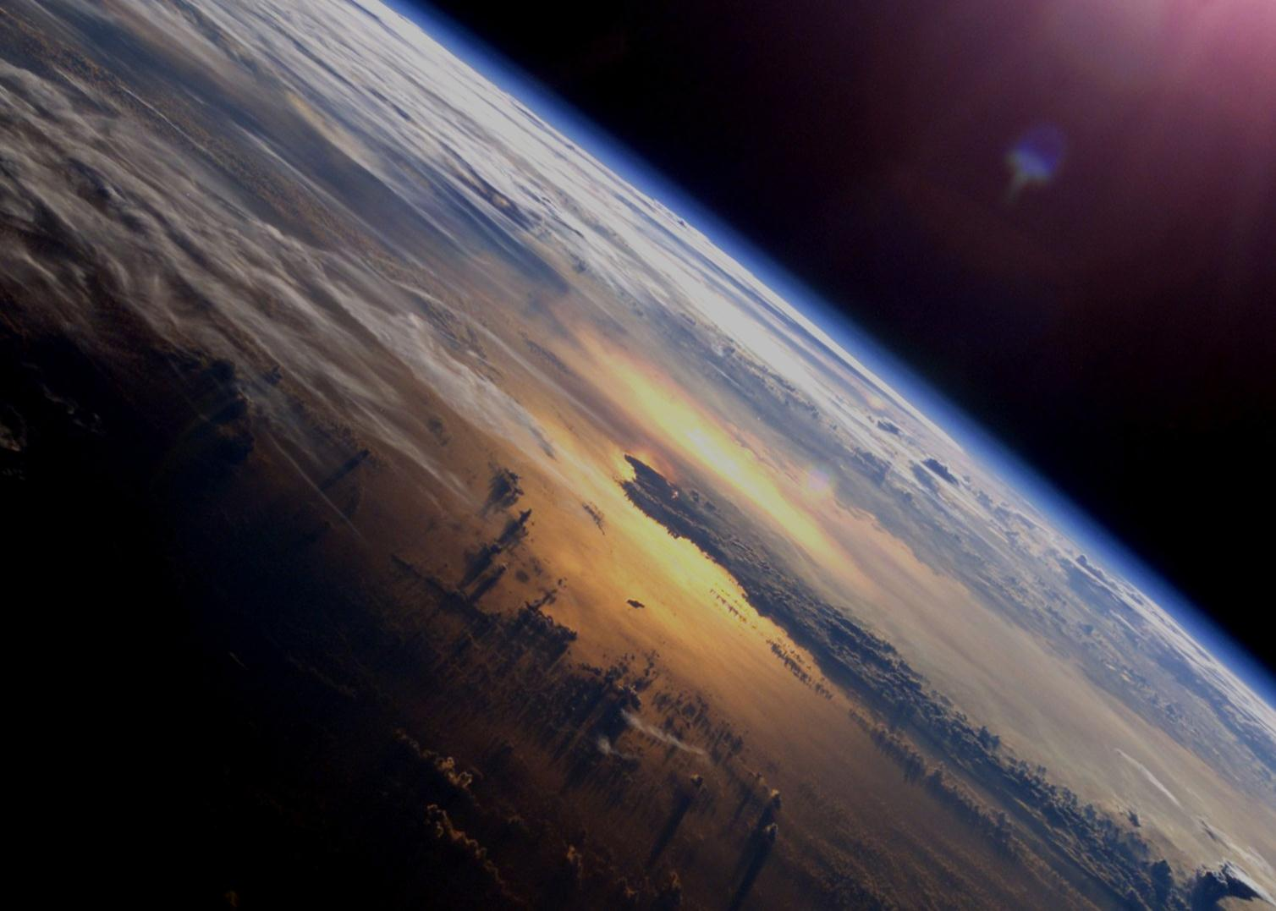

ESA Climate Change Initiative
Status and
Future Evolution
CMUG Interaction meeting
May 26th, 2015

Slide 2
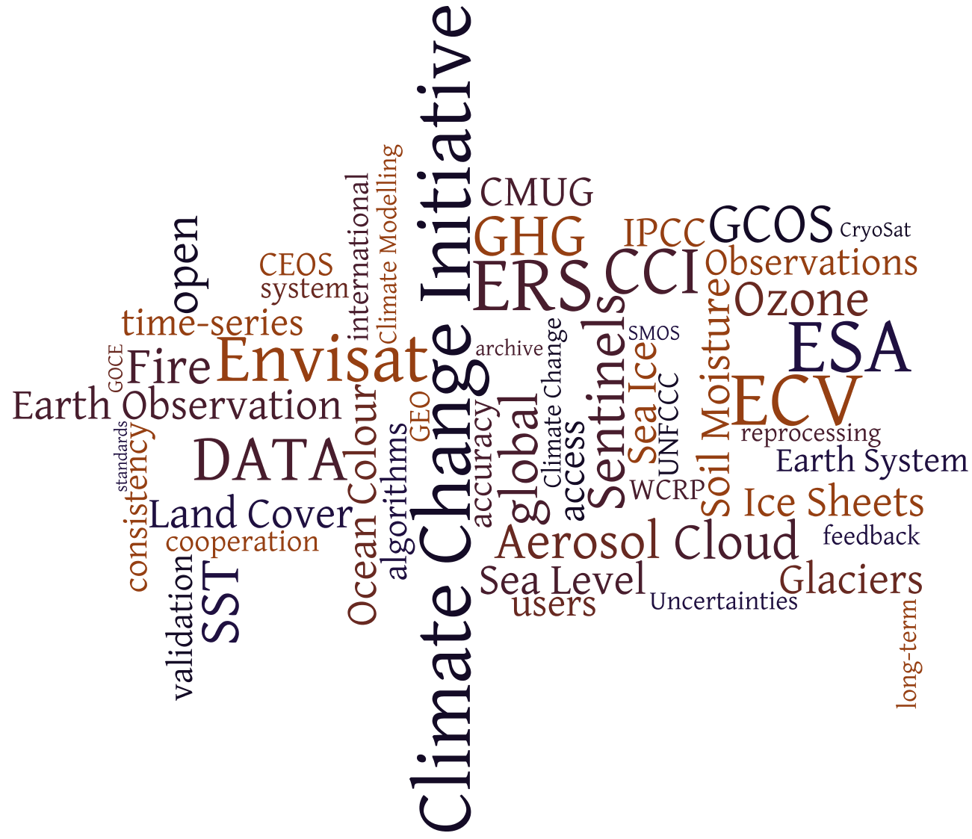

Slide 3
CCI Implementation
2008 – Presented at CMIN 08
  Proposal for 21 ECVs – 170 M€ requested
  Was allocated 75.5 M€
  Decision to implement 11 ECVs + CMUG
2010 – Programme successfully initiated (3-year CCI Phase 1)
  Another 11.5 M€ was added in the programme at CMIN 12.
  Additional 4 M€ was added through the StrIn
  Decision to implement another 3 new ECVs
2013 – Decision to continue the programme as already implemented
2014 – All activities are continued (3-year CCI Phase 2)
  Implementation of Support activities
  Another 1 M€ was added in the programme at CMIN 14.
2015 – Proposal for a Cross-ECV project
  Implementation of a project on Global Sea Level Budget Closure
Proposal for a programme Extension CCI+

Slide 4
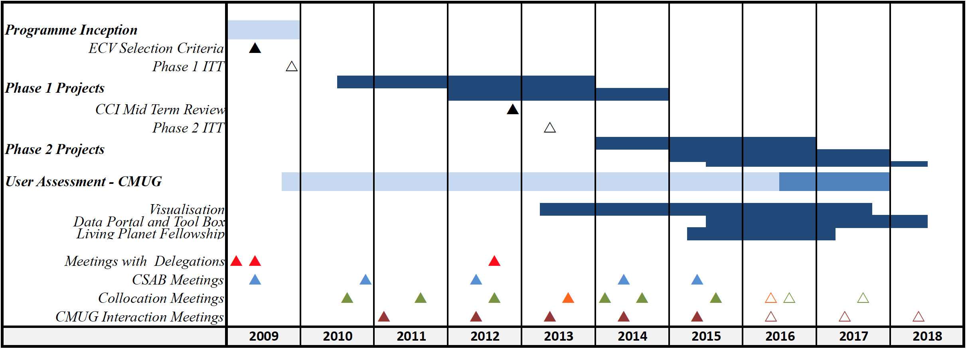
CCI Master Schedule
Phase 1
Phase 2

Slide 5
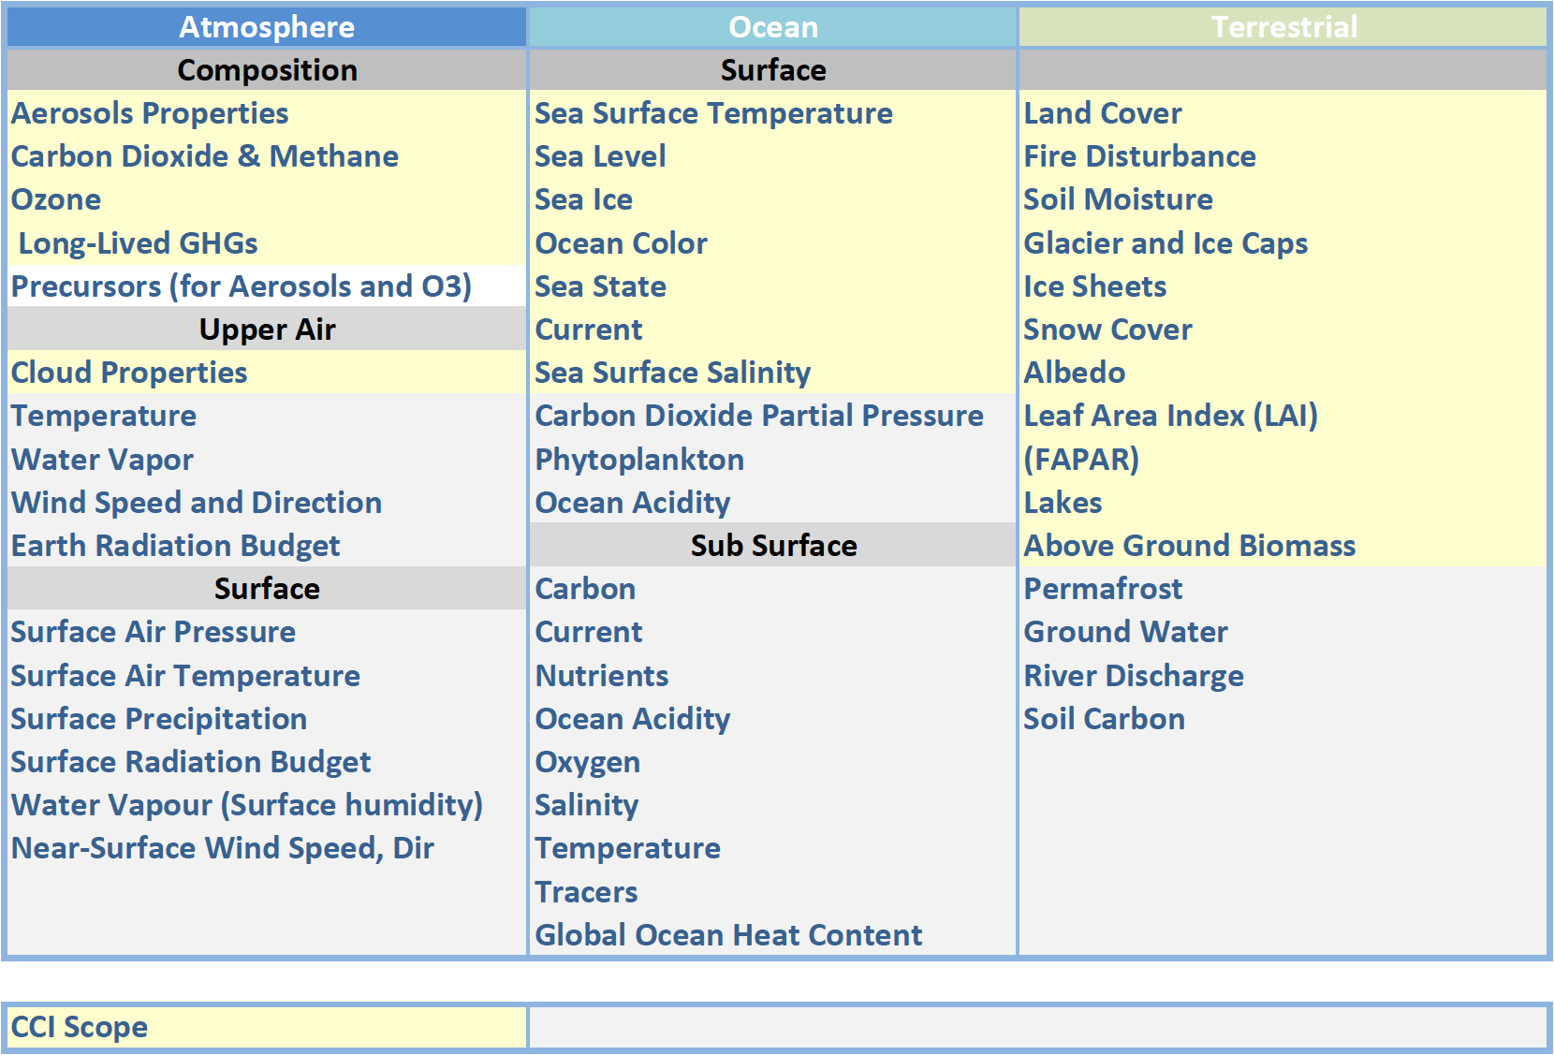
Within the scope of the CCI as presented in 2009

Slide 6
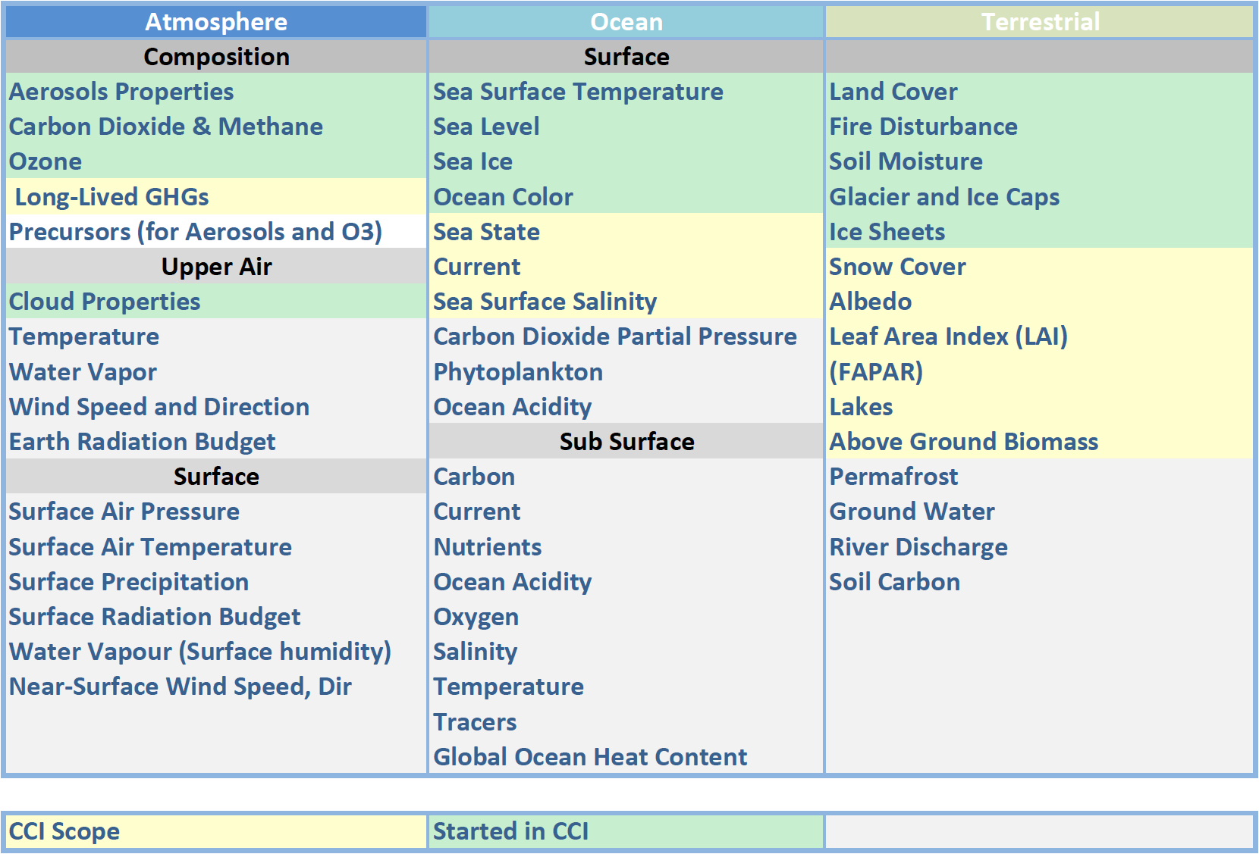
Implemented by the CCI

Slide 7


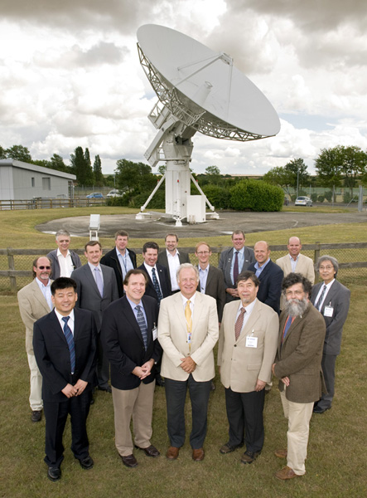
Committee on Earth Observing Satellites
NEW - Working Group on Climate
Chair John Bates (NOAA/NCDC)
Vice-Chair
Pascal Lecomte
(ESA)
CEOS, World Meteorological Organization and
Coordination Group for Meteorological Satellites
www.ceos.org; www.wmo.int/sat; http://www.cgms-info.org/
CEOS’ climate working group planning session
European Space Agency’s Climate Office,
Harwell UK July 2010
Notes:
The Transatlantic success - US EU leadership on the G7 Committee on Earth Observing Satellites (established in 1984) Working Group Climate (established in 2010)
The Mission of the Working Group Climate (WGClimate) is to facilitate the implementation and exploitation of Essential Climate Variable (ECV) time-series through coordination of the existing and substantial activities undertaking be CEOS member agencies. This includes the numerous iterative steps involved in the creation of ECVs and ensuring ECV life cycle information is gathered, organized, and preserved for future generations.
WG Climate representation from Europe and North America includes NASA, NOAA, USGS, CSA (North America) ESA, EUMETSAT, European Commission, CNES, DLR, UKSA, ASI (Europe)
M. Dowell, P. Lecomte, R. Husband, J. Schulz, T. Mohr, Y. Tahara, R. Eckman, E. Lindstrom, C. Wooldridge, S. Hilding, J.Bates, B. Ryan, J. Lafeuille, and S. Bojinski, 2013: Strategy Towards an Architecture for Climate Monitoring from Space. Pp. 39. This report is available from: www.ceos.org; www.wmo.int/sat; http://www.cgms-info.org/

Slide 8
Activities in WGClimate
From Nov 2015 to Nov 2017
  ESA Chair – EUMETSAT Vice-Chair
The ECV Inventory as the backbone of the CEOS-CGMS WGClimate work related to the Architecture Implementation
WGClimate also reports for CEOS to SBSTA & GCOS.
The ESA and USGS are active in consolidating the ECV Inventory (in particular for CCI ECVs)
  So far we focussed on Aerosol and Sea-Ice.
  To be extended to all the other ECVs

Slide 9
CCI Results of Phase 1
10 CCI projects have been completed end 2013
  Data are available via the CCI Web site (www.esa-cci.org)
  Climate Assessment Reports have been produced
  The Fire project delayed mostly because of system engineering aspects finished its Phase 1 in September 2014.
CMUG has terminated its phase 1 activities on 30 June 2014
3 CCI projects (which started in January 2012) terminated end 2014
  Ice sheet
    will be split into two projects, Greenland and Antarctica, for phase 2.
  Sea-Ice
  Soil Moisture

Slide 10
CCI Products Time Coverage
Phase 1
Cloud
Ozone
Aerosol
GHG
Sea Ice
Sea Level
SST
Ocean Colour
Glaciers
Ice Sheet
Land Cover
Fire
Soil Moisture
 |  | 1980s | 1990s | 2000s | 2010s
8
3
3
2
OSISAF
2
2
1
2
2-3 measurements per glaciers over the period
4
2
1
1

Slide 11
CCI Status of Phase 2
9 CCI projects have been started beginning 2014
CMUG has started its phase 2 activities on July 1st, 2014
The Four later projects (Ice Sheet being divided in Greenland and Antarctica) have been kicked off early 2015.
  Soil-Moisture
  Sea-Ice
  Ice-Sheet Greenland
  Ice-Sheet Antarctica
The Proposal for the Fire project Phase 2 has been received.

Slide 12
CCI Products Time Coverage
Phase 2
Cloud
Ozone
Aerosol
GHG
Sea Ice
Sea Level
SST
Ocean Colour
Glaciers
Ice Sheet
Land Cover
Fire
Soil Moisture
 |  | 1980s | 1990s | 2000s | 2010s
8
3
3
2
OSISAF
2
2
1
2
2-3 measurements per glaciers over the period
4
2
1
1

Slide 13
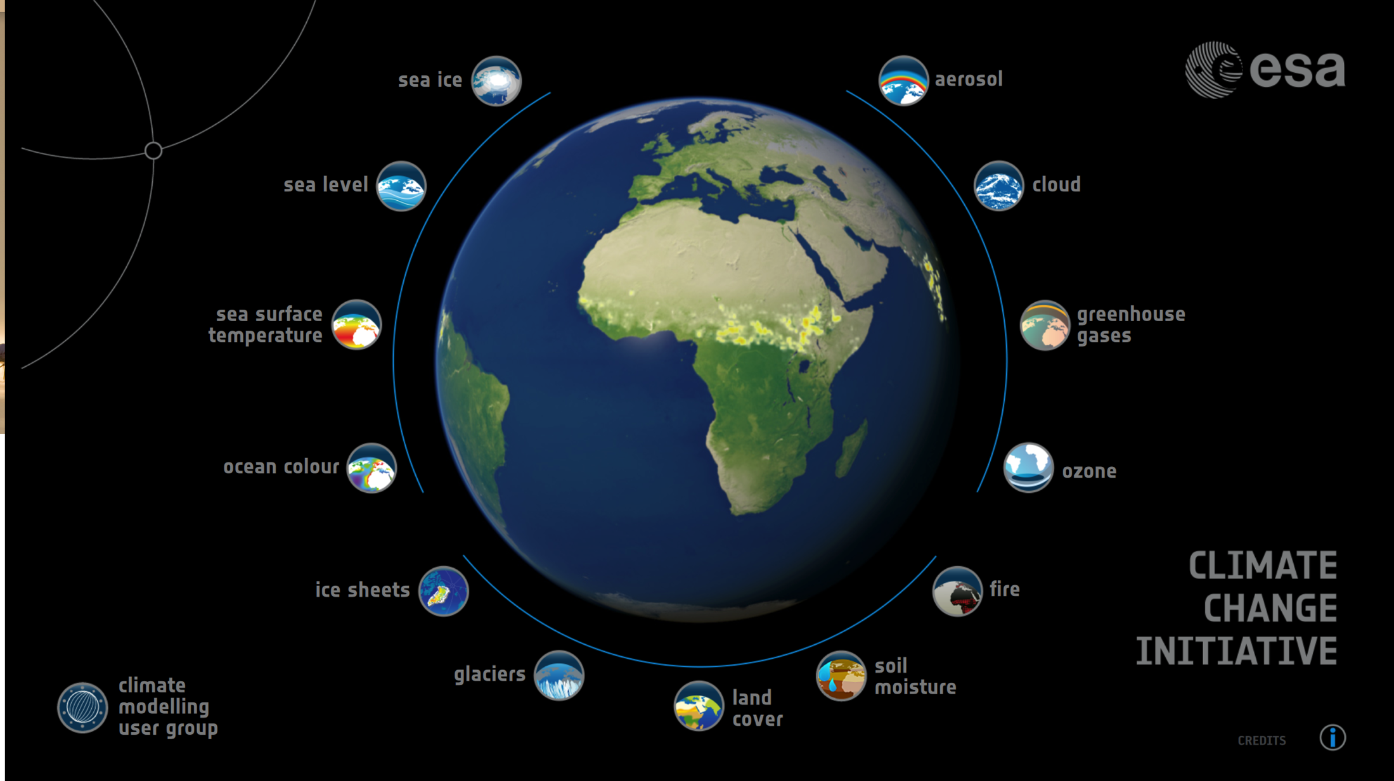
CCI ECVs

Slide 14
CCI Portal and Tool Box
The CCI portal has been kicked off,
  To be an uncomplicated web-based interface acting as the single dedicated point-of-access for all CCI data products and for all ESA Climate Change enquiries
  To incorporate search and data discovery tools for CCI data products and to facilitate efficient and expedient data access, including multiple ECV download
  To perform a central coordinating role by providing a comprehensive depository for information on the CCI and also housing a user forum for queries / discussion / feedback
  To interoperate with the Earth System Grid Federation (ESGF) as a services layer and to be based on Open Source to allow adaption and evolution (Obs4MIPS)
  To act as the physical host for a CCI toolbox dedicated to the discovery, interrogation and analysis of CCI data products
Proposals for the CCI Tool Box have been received
  To incorporate generic functions applicable to all ECV data products in order to simplify handling, inspection and analysis
  To provide functionality to analytically discover and interrogate CCI data products
  To incorporate specialist functions for use with CCI data products, e.g.:
    for detailed expert analysis,
    for exploitation & propagation of uncertainty estimates,
    to support combination & interrogation across ECVs, etc.
    to facilitate data conversion (format & transform),
    to check conformity of CCI data products in terms of format
  To follow an Open Source software approach so that users can potentially add in their own functions

Slide 15
CCI Postdoctoral Scheme
Living Planet Fellowship
Support for 9 2-year postdoctoral positions to undertake research activities relevant to the Climate Change Initiative (esa.cci.int).
Focus on projects dedicated to:
  Exploiting Essential Climate Variable (ECV) products from CCI for improved understanding of the Earth System;
  Examining Cross-ECV consistency and multiple ECV use (those under the CCI Programme in particular).
  Enhancing interactions between CCI members and other Earth science laboratories, research centres and universities.
Funding available: 40kEuro/year for two years
In view of the success a new call will be made for another 5 positions

Slide 16

C3S and CCI
Coordination with C3S (EC/ECMWF)
  C3S Mission
    Authoritative source of climate information for Europe covering past climate and trends, current state of the climate and projections of possible scenarios of future climate.
    Building upon national and international existing efforts
    Supporting the market for climate services in Europe
  Continuous exchanges between ESA, ECMWF and the EC on CCI-C3S interactions and complementarity
  ECMWF organises workshops with stake holders, data providers, potential users …
    Active participation from ESA
C3S= Copernicus Climate Change Service

Slide 17
Outreach
June Le Bourget
June C3S Workshop
July Our Common Future Under Climate Change
July IGARSS (Milan Italy)
September Collocation meeting
November COP-21 (two events)
November CCI+ Programme Proposal
  CCI Achievements presented to delegates in September
Material
  The CCI Visualisation Tool (many flavours)
  A new set of News Letters
  Updated Fact Sheets (in English and in French)

Slide 18
ESA Climate Change Initiative
Status and
Future Evolution
CMUG Interaction Meeting
May 26th, 2015

Slide 19
Programme Extension
CCI +
In the current context (role of ESA, of EUMETSAT and of Services developed by EC)
  The role of ESA is to focus on Research and Development
The main strategic line consist in:
  Propose new ECV.
  Propose projects using many ECVs.
Take into account CSAB recommendations
Take into account requests from delegations

Slide 20
Implemented by the CCI

Slide 21
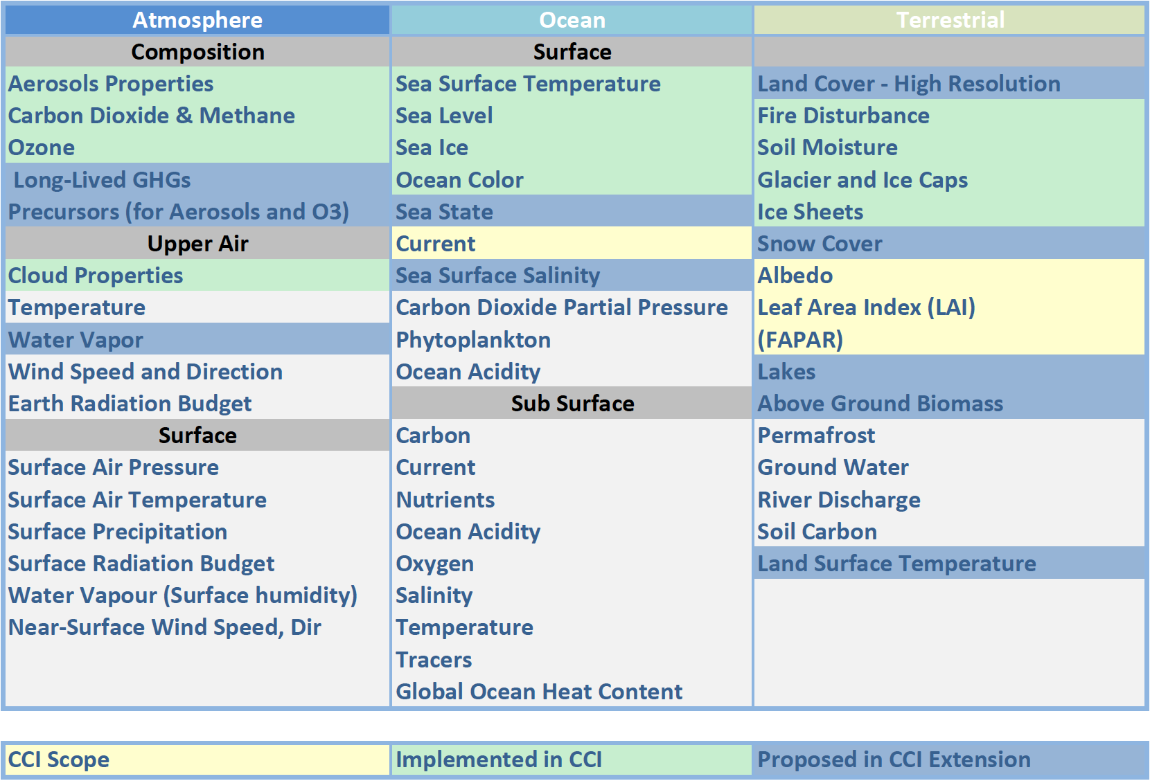
Proposed within CCI Extension

Slide 22
Other potentially valuable activities
Extra products from existing CCI ECVs, e.g.:
  Sea ice drift
  Cloud heights from O2A and O2-O2 band
  Aerosol absorption properties
  Ocean colour in highly-productive coastal Case-2
  Improved accuracies and improved error estimation
Adaptation of CCI processing chains to new Sentinel data
  New instrument capabilities
  e.g. new spectral bands, higher resolution, different observing geometry
  Time series consistency between different instruments
  e.g. ATSR-1, ATSR-2, AATSR, SLSTR
Cross-ECV Exploitation, e.g.:
  Ice-sheet mass balance, Global Water Cycle, ...
  Fluxes (air/sea, land/sea, energy, water, gases, aerosols)
  Permafrost
  International LAI/FAPAR reconciliation
  Hiatus, El Nino, ...

Slide 23
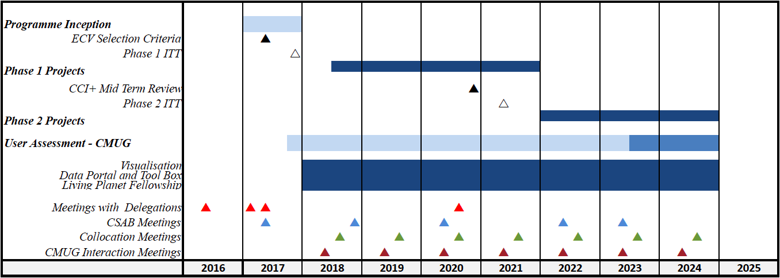
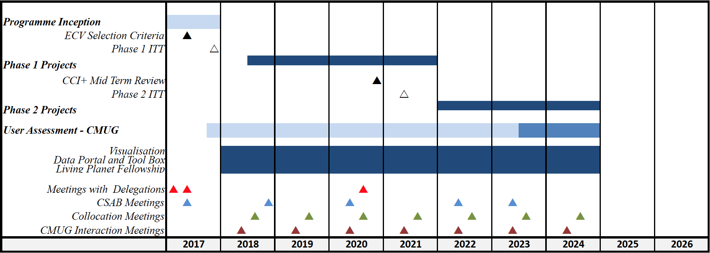
CCI+ Schedule
CMIN16
Phase 1
Phase 2

Slide 24


Slide 25
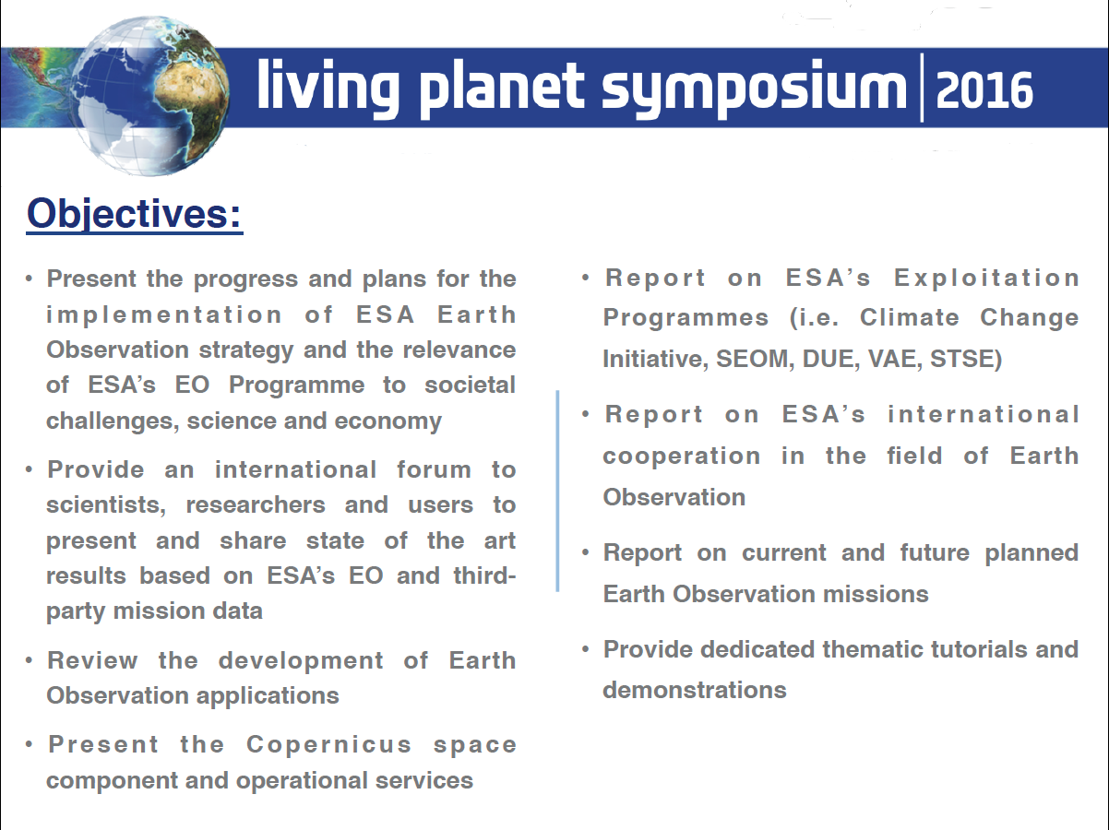

Slide 26
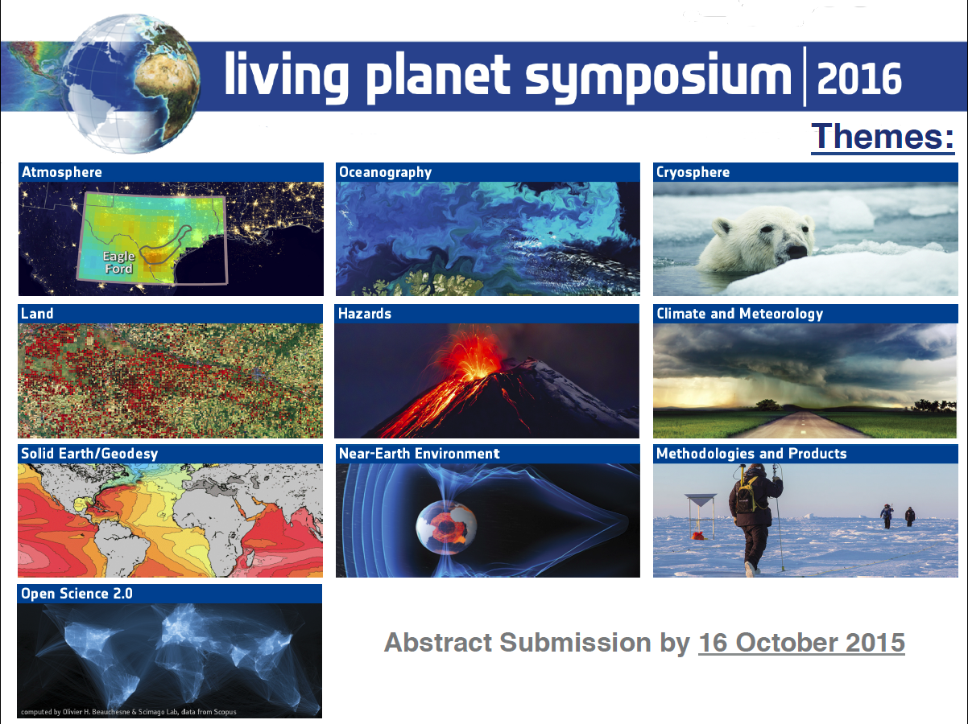

Slide 27
Questions
Discussion

Slide 28
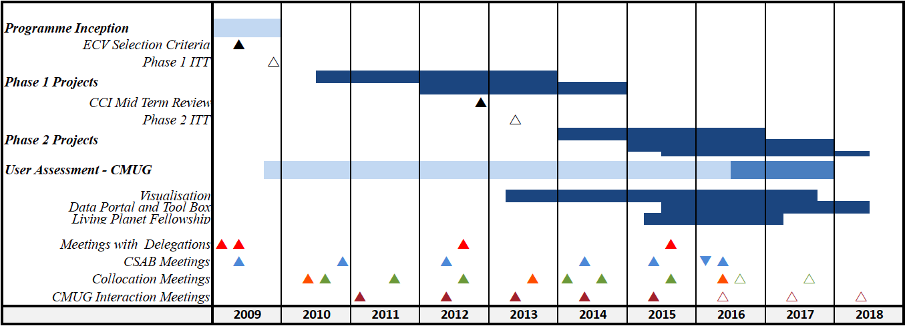
Schedule
CCI
CCI+

