Slide 1

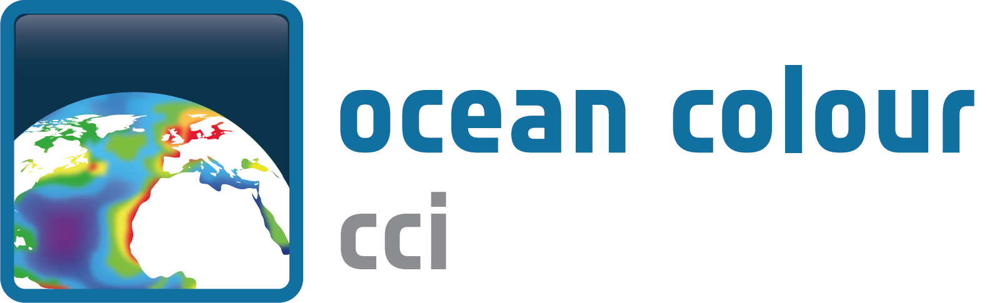
Ocean Colour ECV
ESA
Shubha Sathyendranath, Science Lead, PML, UK
John Swinton, Project Manager, TPZ Vega, UK
EO Science Team
European
R. Brewin, PML, UK
C. Brockmann, BC, Germany
R. Doerffer, BC, Germany
S. Groom, PML, UK
H. Krasemann, HZG, Germany
F. Mélin, JRC, EU
D. Müller, HZG, Germany
M. Peters, BC, Germany
D. Ramon, HYGEOS, France
L. Santoleri, CNR, Italy
T. Storm, BC, Germany
T. Platt, PML, UK
F. Steinmetz, HYGEOS, France
P.-Y. Deschamps, HYGEOS, France
M. Dowell, Observer, JRC, Italy
Non-European
E. Devred, LU, Canada
G. Feldman, NASA, USA
B. Franz, NASA, USA
Z.-P. Lee, BU, USA
T. Hirata, HU, Japan
T. Moore, UNH, USA
M. Wang, NOAA, USA
Climate Research Group
I. Allen, PML, UK
L. Bertino, NERSC, Norway
W. Gregg, NASA, USA
T. Hirata, HU, Japan
C. Le Quéré, UEA, UK
E. Simon, NERSC, Norway
H. Von Storch, HZG, Germany
System Engineering
M. Boettcher, BC, Germany
N. Formferra, BC, Germany
M. Grant, PML, UK
A. Horseman, PML, UK
J. Swinton, TPZ Vega, UK

Slide 2
User Consultation
UCD: Forward-looking document – addressed additional aspects than strictly required by GCOS
First of its kind
Set the goal for the rest of the activities
Clearly identified the need for multiple ocean-colour products
Partition of the sampled population by location
Area of research interest from climate modellers

Slide 3
ECV Product Tables
ECV Product Name: Biogeophysical Products
Parameter | Sensors | Spatial coverage | Spatial grid | Temporal coverage | Temporal resolution | Total Data Volume | Explanatory Text
Phytoplankton Chlorophyll-a concentration (Chl-a) [mg m⁻³] GCOS Climate Variable | MERIS, MODIS, SeaWiFS | Global | 4x4km | 1997-2012 | daily | 2 TB | These are level 3 binned, multi-sensor merged, daily composites (primary product, others not listed). Uncertainty layers are also included. This is one of the main OC products.
Water-leaving Radiance at six wavelengths GCOS Climate Variable | MERIS, MODIS, SeaWiFS | Global | 4x4km | 1997-2012 | daily | 12 TB | These are level 3 binned, multi-sensor merged, daily composites (primary product, others not listed). Uncertainty layers are also included.
Spectral attenuation coefficient for downwelling irradiance (K_{d}) [m⁻¹] | MERIS, MODIS, SeaWiFS | Global | 4x4km | 1997-2012 | daily | 2 TB | These are level 3 binned, multi-sensor merged, daily composites (primary product, others not listed). Uncertainty layers are also included.
Total absorption (a) and backscattering coefficients (b_{b}) [m⁻¹] at six wavelengths | MERIS, MODIS, SeaWiFS | Global | 4x4km | 1997-2012 | daily | 48 TB | These are level 3 binned, multi-sensor merged, daily composites (primary product, others not listed). Uncertainty layers are also included. This is one of the main OC products.
Coloured dissolved organic matter absorption (a_{CDOM}) [m⁻¹] | MERIS, MODIS, SeaWiFS | Global | 4x4km | 1997-2012 | daily | 2TB | These are level 3 binned, multi-sensor merged, daily composites (primary product, others not listed).

Slide 4
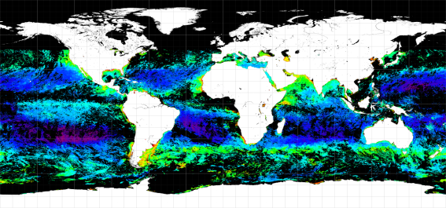
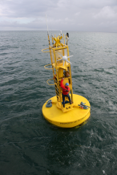
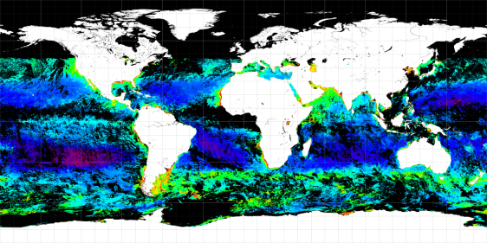
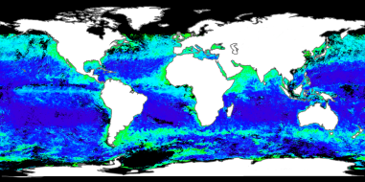
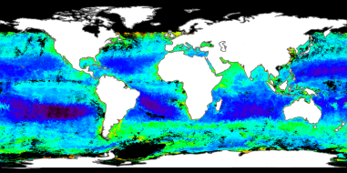
System Prototype
MERIS
SeaWiFS
Atmospheric Correction using best algorithms from round-robin comparison
Global In-situ database
MODIS
Merging, Bias Correction
Ocean products using best algorithms from round-robin comparisons
Quality Control and Scientific Analysis
Unified multi-sensor
Products
Uncertainty characterisation
Modellers
User Community
Oceanographic Scientists
Earth Observation Scientists

Slide 5
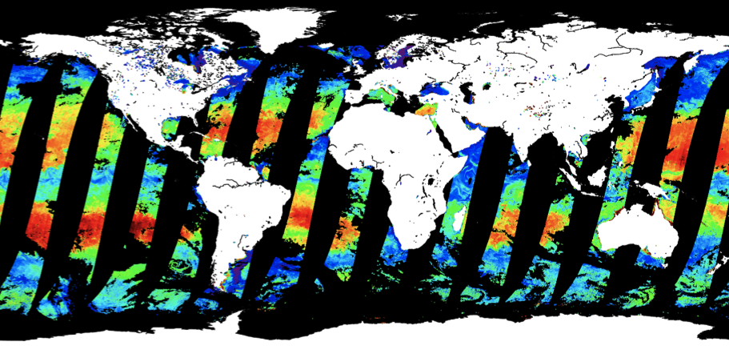
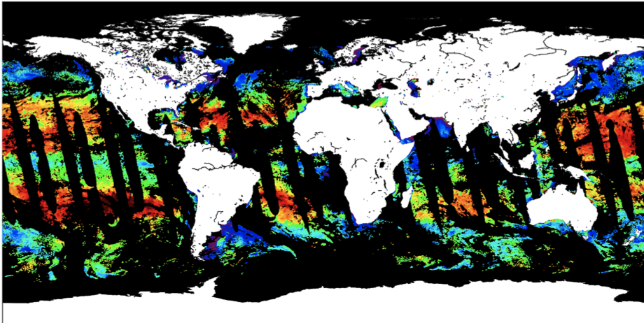
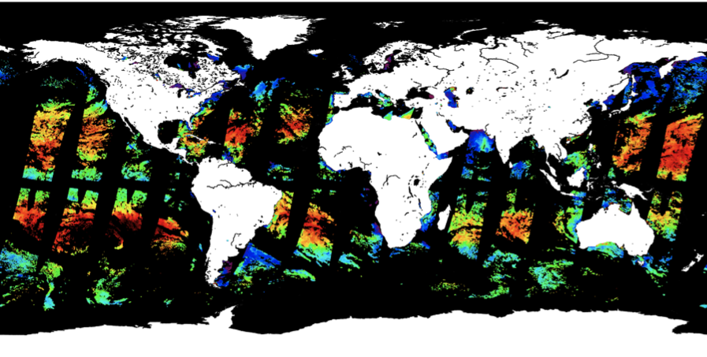
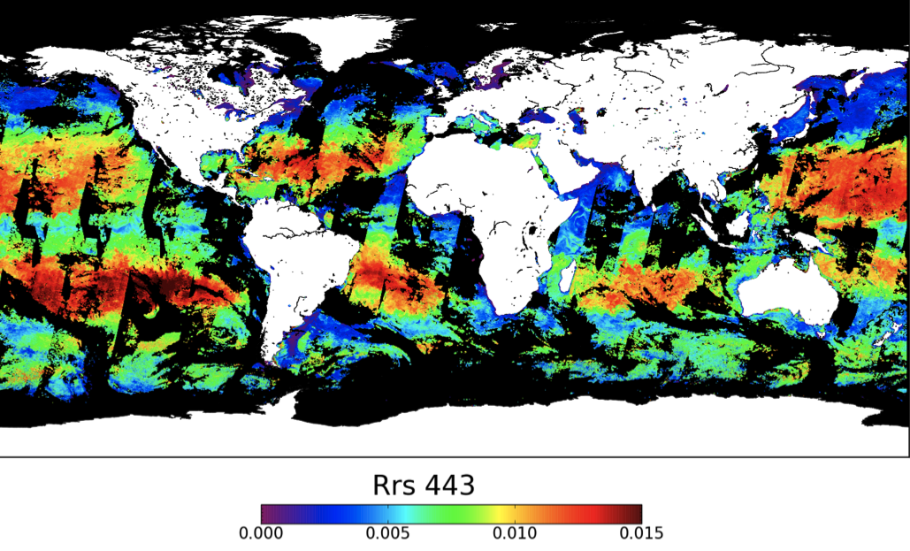
The Merged Product
MERIS Radiance
MODIS-A Radiance
Band-shifting, bias correction,
Merged product
SeaWiFS Radiance

Slide 6
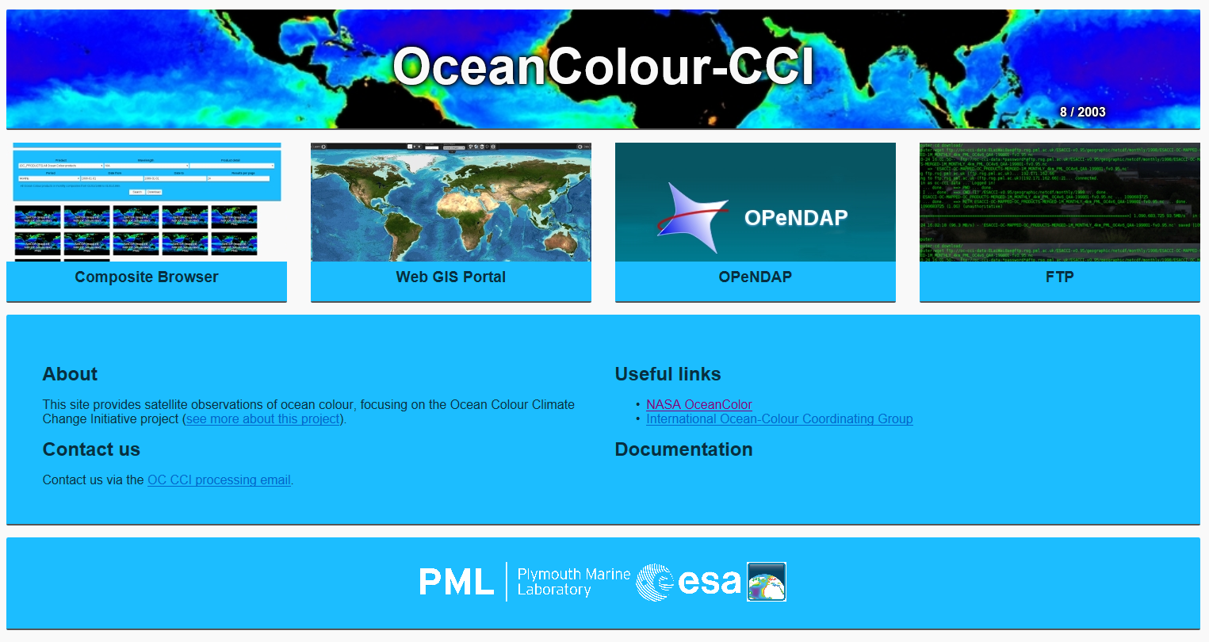
Data Dissemination
http://oceancolour.org/
Portfolio of access modes:
for discovery, subsetting,
download, analysis…
ftp
directory
structure
OPeNDAP
web browser (composites)
Open Geospatial Consortium
web map & functionalities

Slide 7
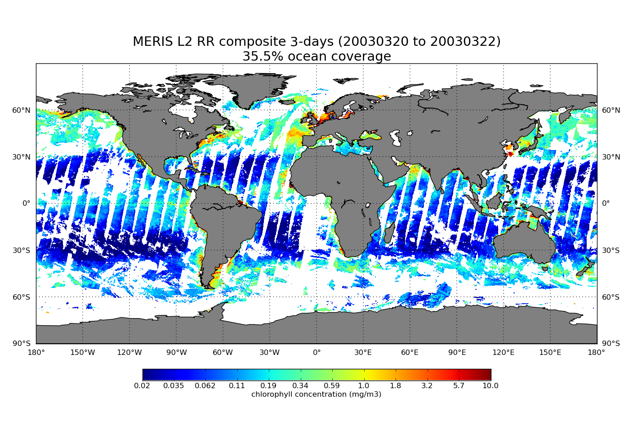
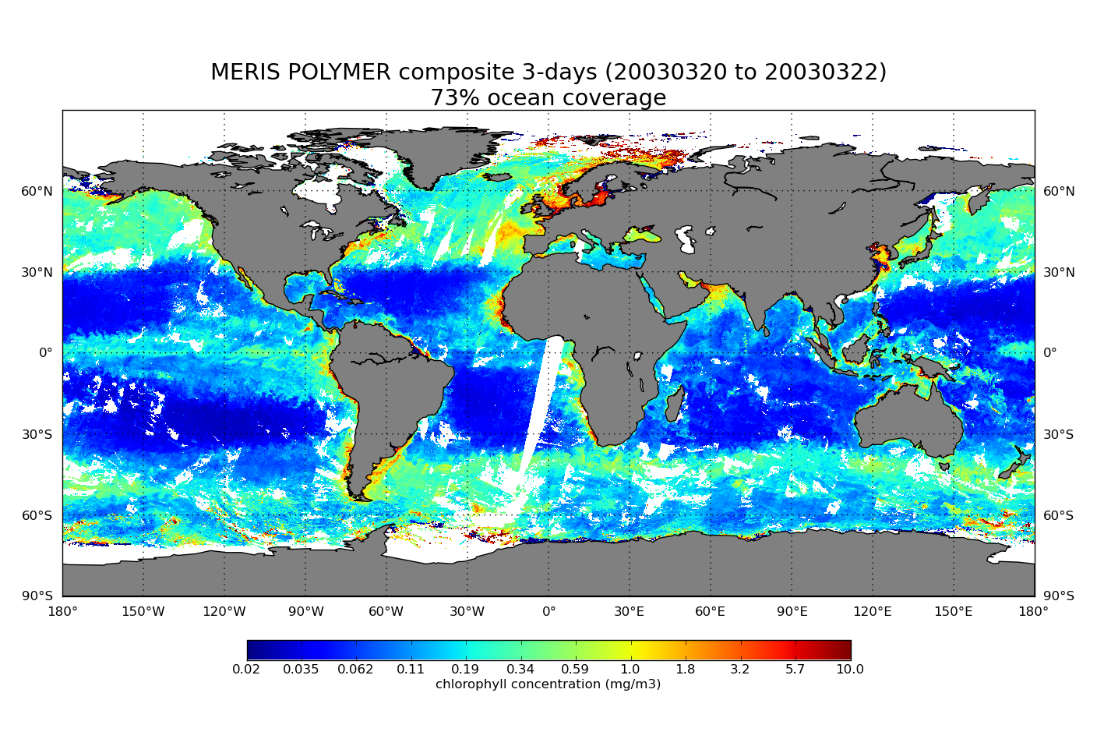
Atmospheric correction algorithm
POLYMER:
Selected Atmospheric Correction Algorithm for MERIS
One of the advantages: Improved spatial coverage (User Requirement)
Note: MyOcean will be using OC-CCI products as standard products
Directly applicable to Sentinel-3 OLCI
Chlorophyll concentration (mg m⁻³)
MEGS ocean coverage:35.5%
POLYMER ocean coverage: 73%
Example: Three-day composite
Chlorophyll concentration
(20-03-2003 to 22-03-2003)
Note: Verification on-going. For example, are all high-latitude values reliable?
Chlorophyll concentration (mg m⁻³)

Slide 8
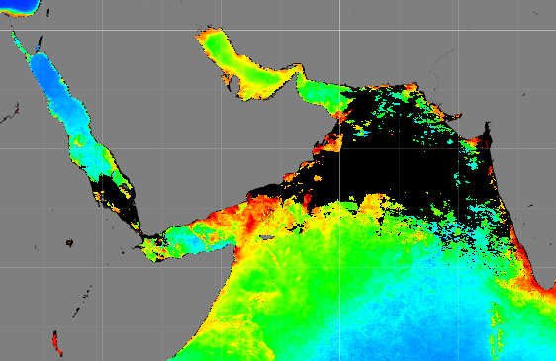
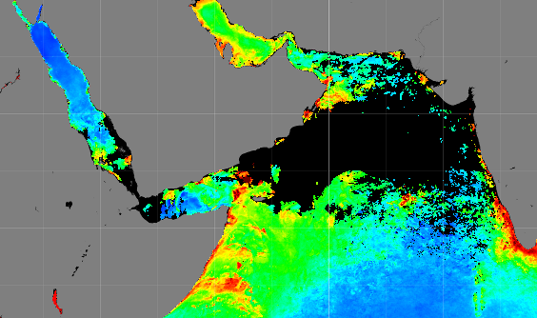
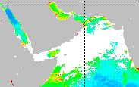
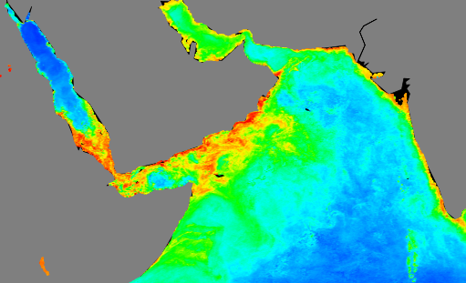
Spatial Coverage: Ex. of the Arabian Sea
Jul. CLIM
Jul. CLIM
SeaWiFS
MODIS
Jul. 2003
Jul. 2003
OC-CCI
GlobColour

Slide 9
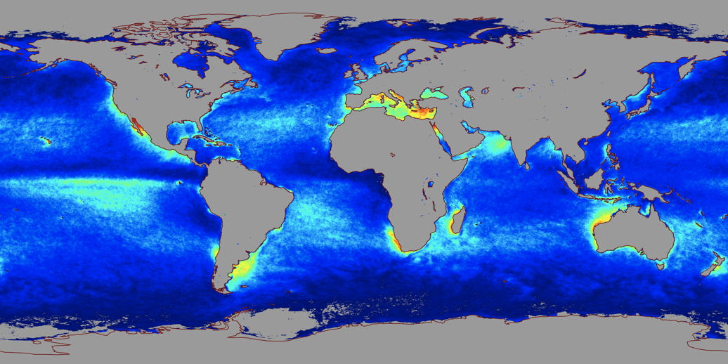
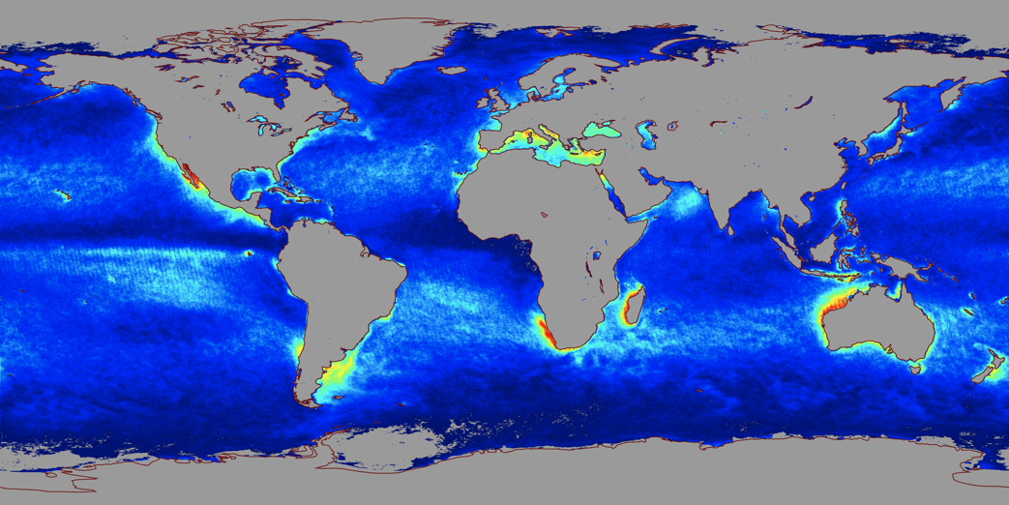
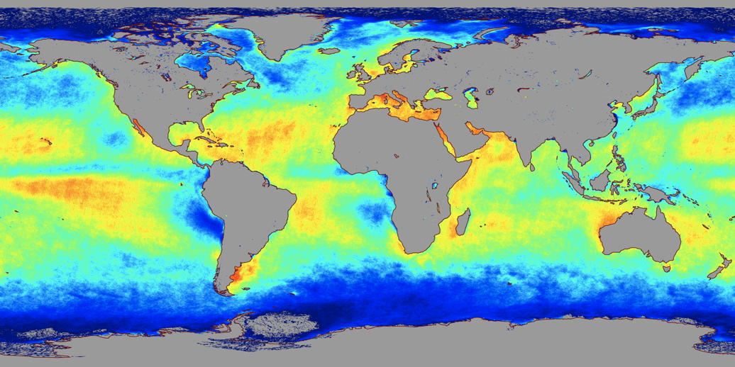
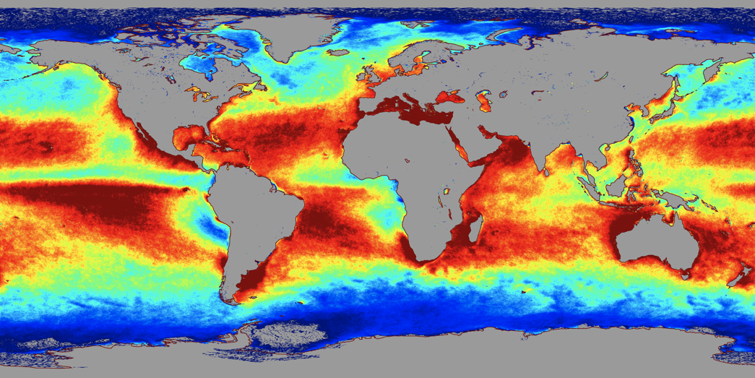
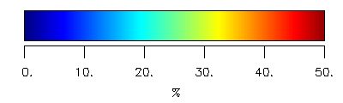
Geographic distribution of
frequency of coverage of retrieved data
SeaWiFS-SeaDAS
Modis Aqua-SeaDAS
MERIS-POLYMER
Merged Data
Inter-sensor bias corrected prior to merging, to avoid spurious trends in merged data
Band-shifted to produce consistency in data across sensors
Enhanced contribution from MERIS due to POLYMER capability to deal with sun glint and thin clouds
Daily coverage in %

Slide 10
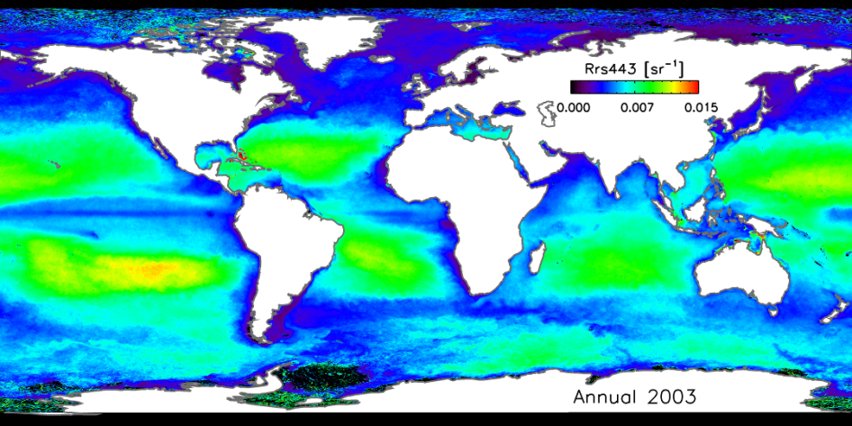
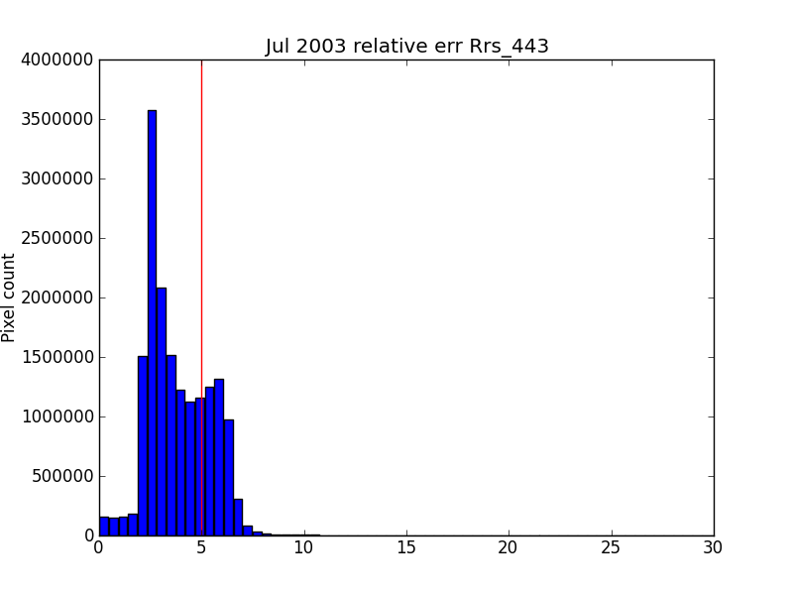
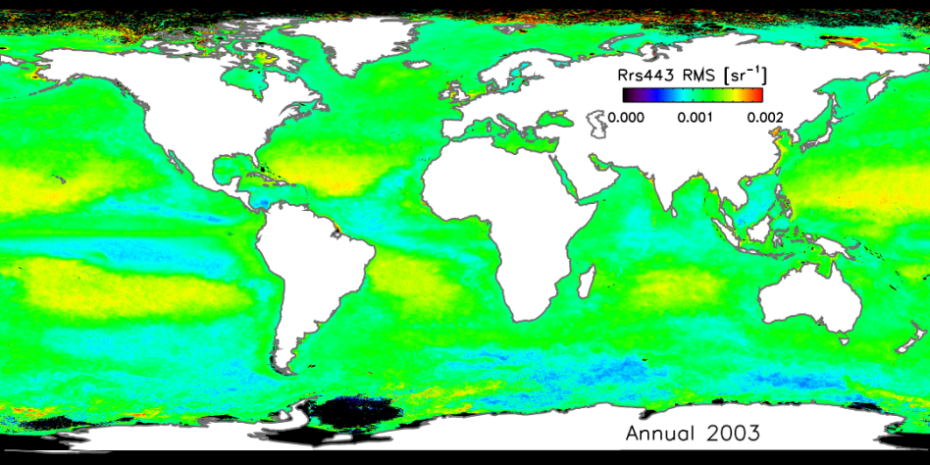
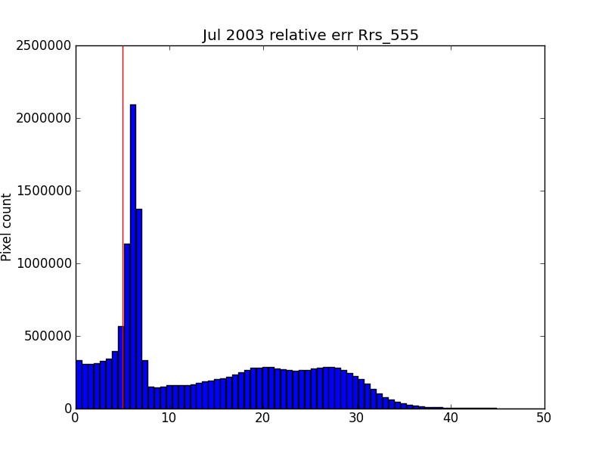
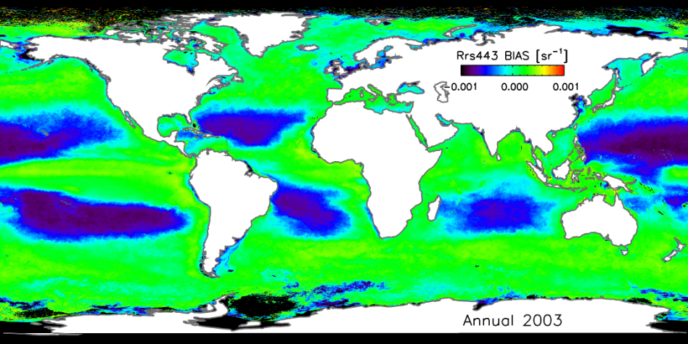
GCOS Requirements
First of its kind, based on user feedback, according to a method based on optical water classification (Moore et al. 2009). Initial results, to be confirmed.
GCOS Accuracy requirement=5%

Slide 11
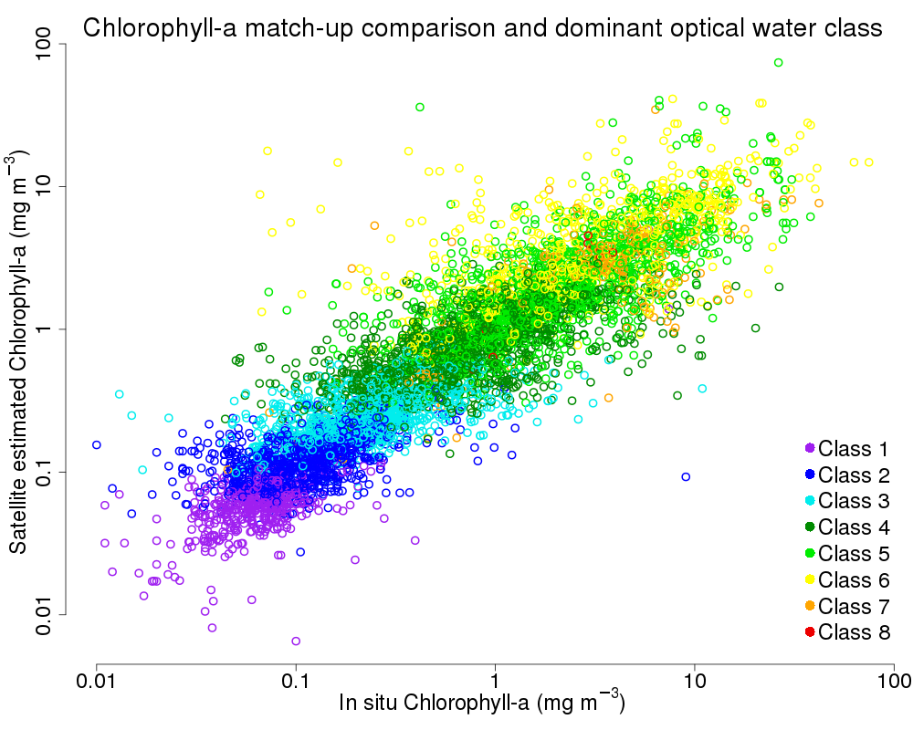
RMSD on log chl 0.303
Bias on log chl -0.019

Slide 12
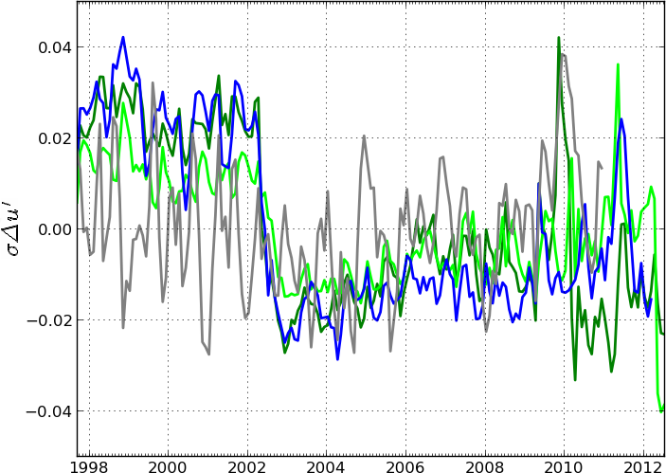
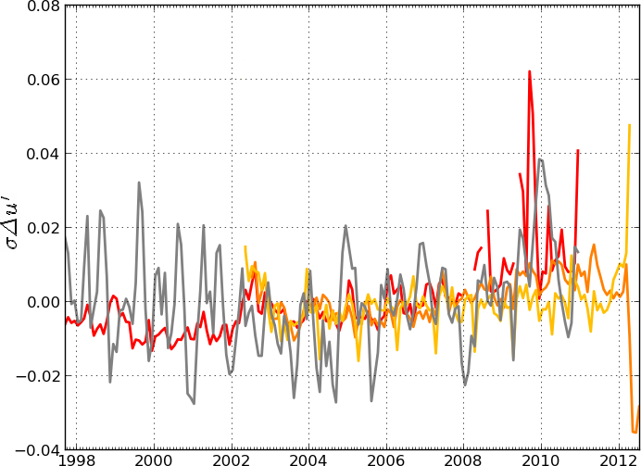
Time series of RMS difference between OC-CCI chlorophyll product (after log transformation) and corresponding percursor datasets
Merged Products
Blue: MEaSURES
Green: GlobColour
Green: GlobColour
Grey: SST
Individual Sensors
Red: SeaWiFS
Orange: MODIS-Aqua
MERIS: Yellow
Grey: SST
Andre Bel Couto and colleagues
Notes:
Time series of σΔu’ between September 1997 to June 2012, after removing the annual cycle, when comparing (a) OC-CCI with single mission records, i.e., SeaWiFS (red), MODIS-Aqua (orange) and MERIS-OC (yellow), and, (b) OC-CCI with multi-mission records, i.e., GC-AVW (light green), GC-GSM (green), and, MEaSUREs (blue). In both panels the comparison between SST (and ocean colour independent measurement) and OC-CCI (both were standardized before the comparison) is represented in grey.

Slide 13
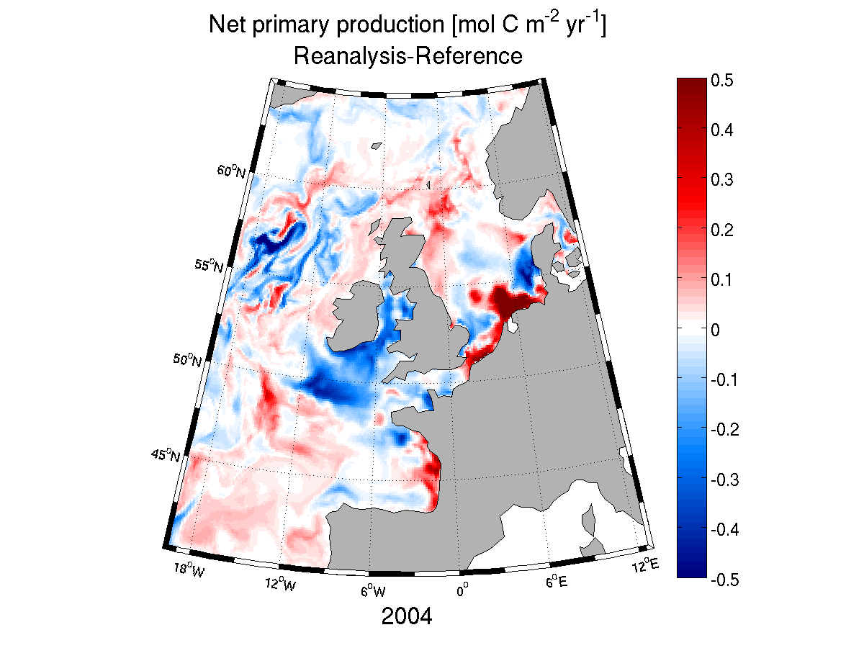
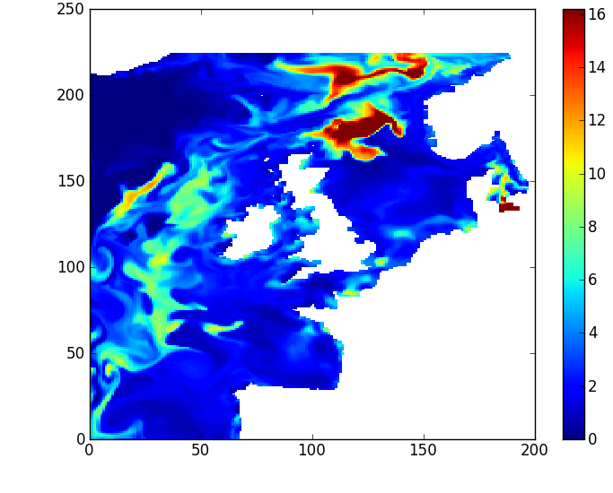
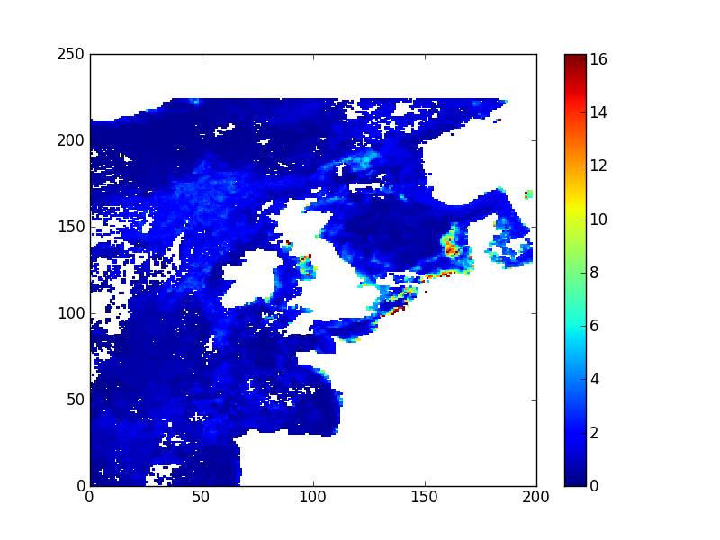

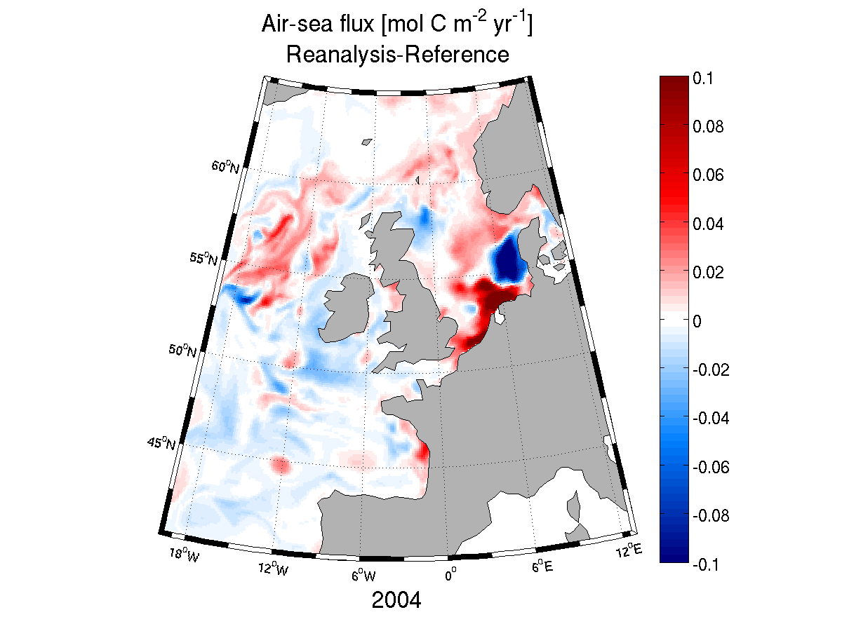
Data assimilation of OC-CCI data in marine ecosystem models
Reanalysis of carbon fluxes in the North East Atlantic
Chlorophyll [mg m⁻³ ]
30 Apr. 2004
Changes in simulated C fluxes, May 2004
Net PP [mol C m⁻² month⁻¹]
Model without data assimilation
OC- CCI data (V1)
Air-sea flux [mol C m⁻² month⁻¹]
Model with data assimilation
after Ciavatta et al. JGR 2011

Slide 14
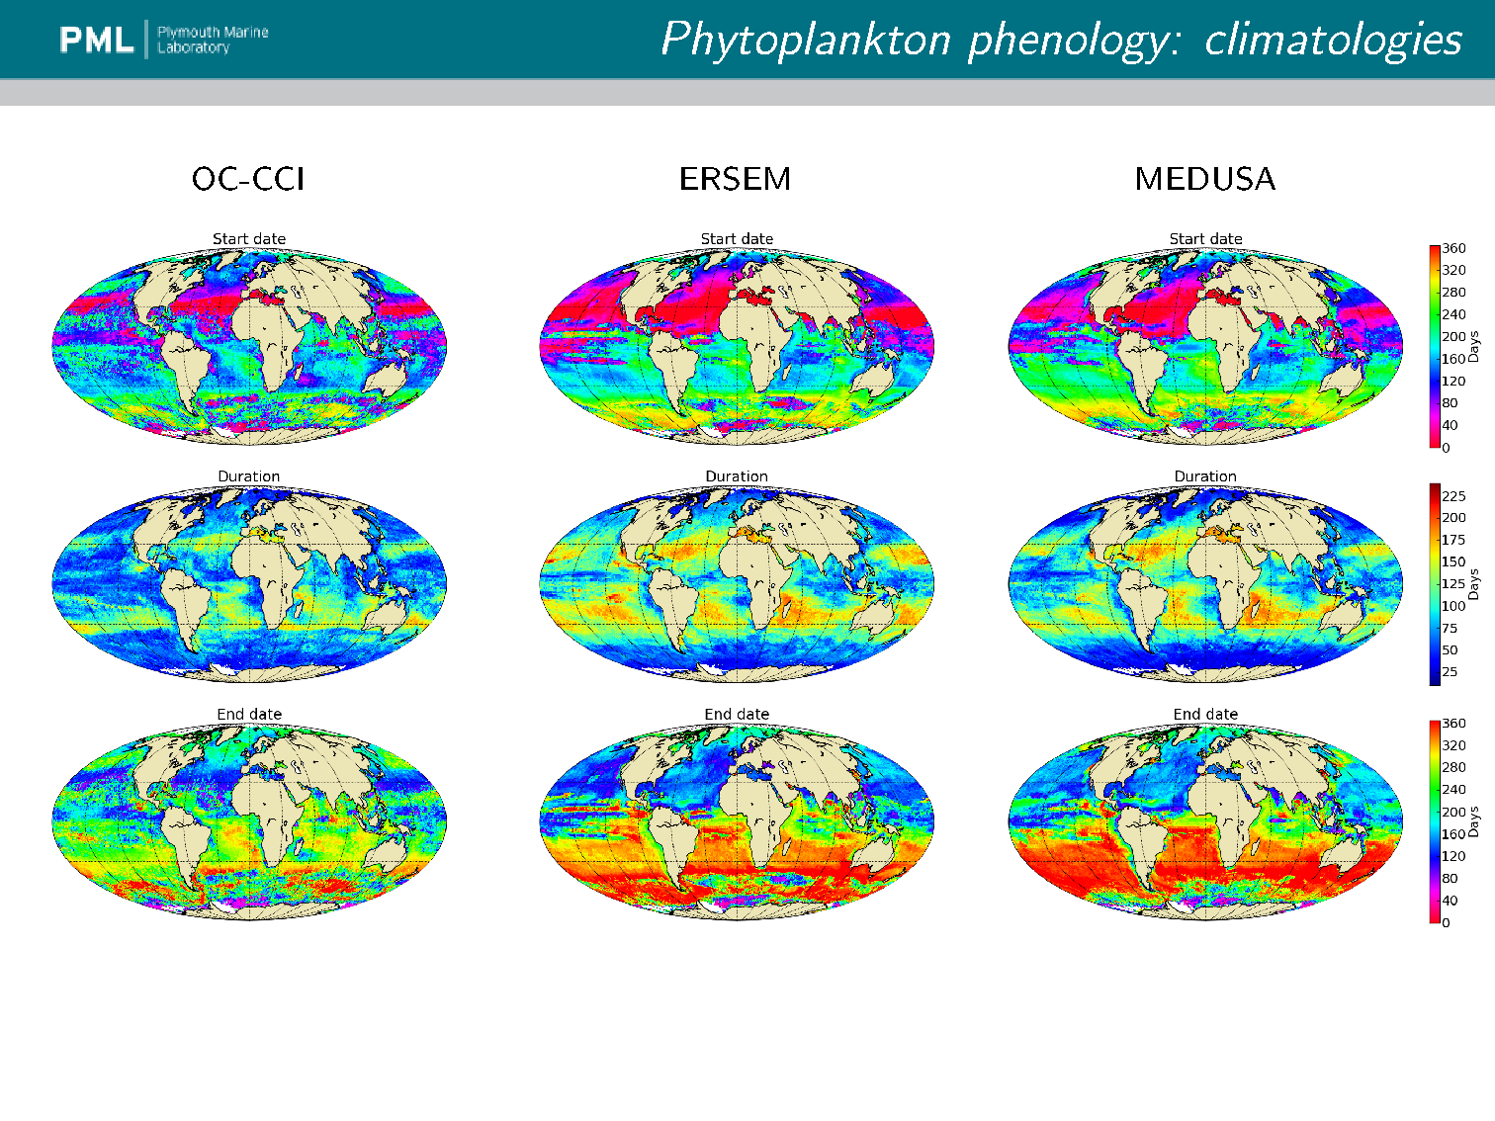
Models / Satellite Comparisons
Saux-Picart et al.

Slide 15
In conclusion
Looking back:
Study of the merged time-series products has revealed the importance of MERIS data.
The data reveal high level of consistency with previous products, but bring added values (enhanced coverage, error-characterised fields, time series corrected for inter-sensor bias).
A key to success was an open, inclusive approach, and many contributions from non-team members are gratefully acknowledged.
Development of objective, quantitative methodologies for the various steps (e.g. algorithm selection) was at least as important as the products themselves.
Investment in developing a system capable of rapid and complete processing was important.
A very productive period (12 presentations at LPS; some 15 papers published/submitted).
Looking forward:
The products continue to be evaluated internally.
The loss of MERIS and the delays with Sentinel-3 is felt acutely.
Strength of CCI is that it brings together multiple ECVs and modellers under a single umbrella: golden opportunity to explore the Earth System perspective.
Cyclical approach to progress is very important: an integral part of Phase 2

Slide 16
Planned Phase 2 Activities
Extension of OC-CCI products to Case-2 (optically-complex coastal) waters
Improved auxiliary data incorporation in processing chain (atmospheric correction)
Harmonise atmospheric-correction algorithms across all sensors
Extend time frame through use of Sentinel-3 and other sensors, notably VIIRS and possibly OCM-2
Invoke iterative loop in algorithm selection chain, to ensure CCI products keep abreast of new developments in field
Improve error characterisation in each of the major optical classes through incorporation of additional in situ data, especially in poorly-represented classes
Develop and exploit synergy with other CCI ECVs to address climate issues (options)

Slide 17
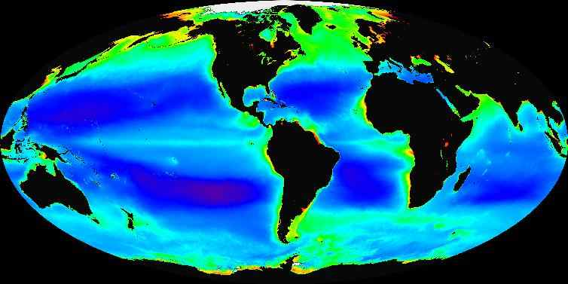
OC_CCI data inputs and time periods
Coverage: Global
Projected
Sensors and Periods
In-situ Reference Data
MERMAID (MERIS Match up in-situ Data: 2007 - Present
MOBY (Marine Optical Buoy program):1996 - Present
NOMAD (NASA bio-Optical Marine Algorithm Data): 1997 – 2007
SeaBASS (SeaWiFS Bio-optical Archive and Storage System):1997 – 2012
AMT (Atlantic Meridional Transect):1995 – Present
AERONET-OC: 2001 – Present
Bedford Institute of Oceanography Bio-optical Database:1997 – Present
Boussole (Buoy for the Acquisition of Long Term Optical Time Series): 2005 - Present
ECMWF (European Centre for Medium-Range Weather Forecasts):1979 - Present

Slide 18
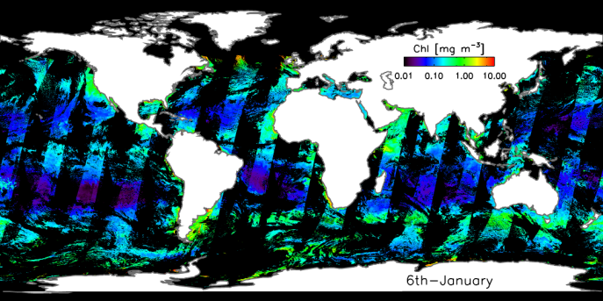
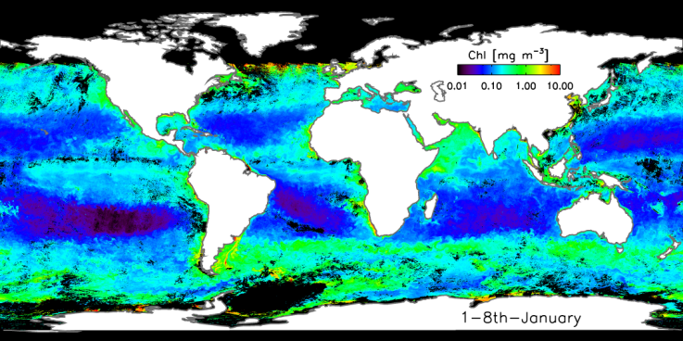
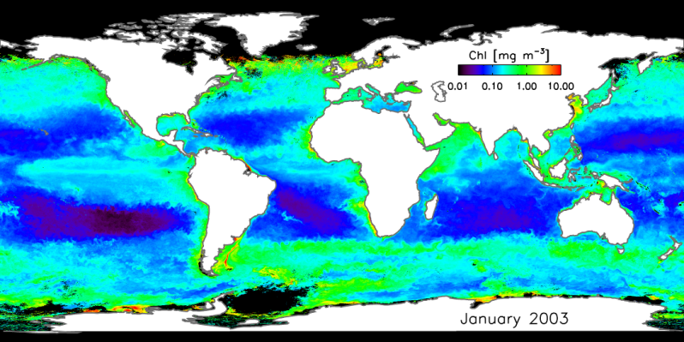
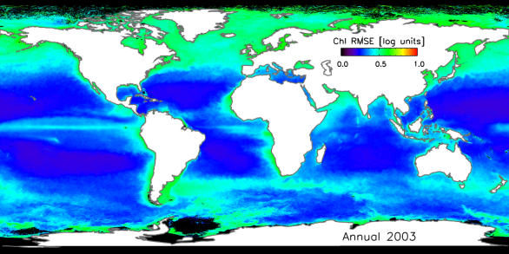
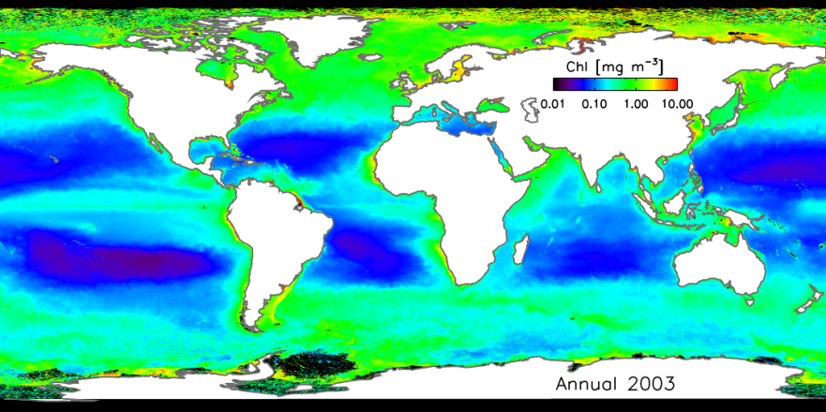
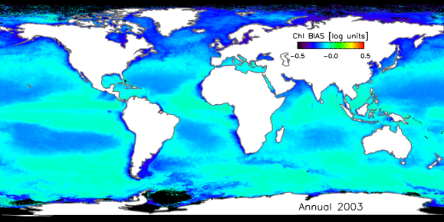
Ocean Colour CCI Products
Daily
Error specification (RMSE and bias) based on comparison with match-up in situ data & extrapolation to global ocean
Weekly
Improved spatial coverage, even at weekly scale
Monthly
Annual
Error-characterisation

