Slide 1
CCI CMUG 4th Integration Meeting
Met Office, Exeter, UK
2-4 June 2014
Ozone_cci CRG
Phase-1 results and Phase-2 plans
M. Coldewey-Egbers (DLR)
on behalf of the Ozone_cci CRG
M. Dameris (DLR), P. Braesicke (UCAM/KIT), M. van Weele (KNMI)
Science leader: M. van Roozendael (BIRA)

Slide 2
Outline
Climate Research Data Package (CRDP)
CRG activities at DLR (M. Dameris)
Ozone long-term trend and variability (M. Coldewey-Egbers and D. Loyola)
CRG activities at UCAM / KIT (P. Braesicke)
CRG activities at KNMI (M. van Weele)
Outlook for Phase-2

Slide 3
CRDP total ozone
Total ozone
Level-2 | Full reprocessing using GODFIT multi-sensor prototype algorithm | GOME (1996-2011) SCIAMACHY (2002-2012) GOME-2 (2007-2012)
Level-3 | Monthly-averaged data set, residual inter-sensor bias corrected using GOME as a reference | GOME, SCIAMACHY, GOME-2 (1996-2011)
Courtesy of M. van Roozendael

Slide 4
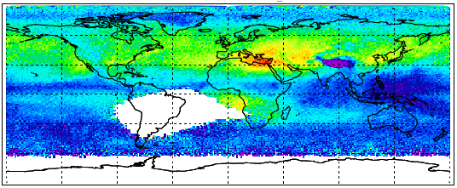
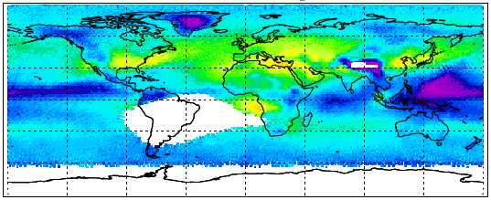
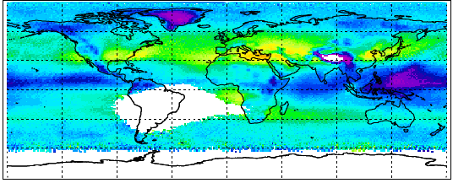
CRDP nadir ozone profiles
Nadir Ozone Profiles
Level-2 | Demonstration CCI algorithm, with profiles on fixed pressure levels common to limb products | GOME (1997) GOME-2 (2007-2008)
Level-3 | Monthly mean gridded data | GOME (1997) GOME-2 (2007-2008)
Level-4 | Assimilated ozone profiles on 6 hourly global fields | GOME (1997) GOME-2 (2007-2008)
GOME2
TOMCAT
TOMCAT (GOME2 AKs)
Courtesy of M. van Roozendael

Slide 5
CRDP limb ozone profiles
Limb Ozone Profiles
Level-2 | Harmonized Single Instrument (HARMOZ): individual profiles with a common pressure grid and concentration unit | SCIAMACHY, GOMOS, MIPAS, OSIRIS, SMR, ACE (all lifetime)
Level-3 | Single Instrument Monthly Mean Zonal Mean (MZM) | SCIAMACHY, GOMOS, MIPAS, OSIRIS, SMR, ACE (all lifetime)
 | Merged Monthly Zonal Mean (MMZM) | SCIAMACHY, GOMOS, MIPAS, OSIRIS, SMR, ACE (2007-2008 demonstration)
 | Merged Bi-Weekly data set (20° longitude, 10° latitude) (MBW) | SCIAMACHY, GOMOS, MIPAS, OSIRIS, SMR, ACE (2007-2008 demonstration)
 | Single Instrument Fine-Resolution gridded data set (5°x5°, 3 day time step) | SCIAMACHY, GOMOS, MIPAS, OSIRIS, SMR (2007-2008 demonstration)
Moved to Phase-II
Courtesy of M. van Roozendael

Slide 6
CRG activities at DLR (M.Dameris)
Chemistry-Climate Model EMAC (based on ECHAM 5)
using a full set of stratospheric and tropospheric chemistry
the CCM can be ‘nudged’ with reanalysis data (specified dynamics) in addition to a “free-running” model configuration (‘climate mode’)
EMAC nudged set-up:
Resolution: T42/L90 (T42: 2.8°x2.8°, L90: 0-80 km).
Forcing: 6 hourly ERA-Interim with vertically varying relaxation time constants
Upper stratosphere free running
Strategy: 1950-1979 free running model (whole atmosphere), 1980-2012 ‘nudged’ integration

Slide 7
Scientific challenges (DLR)
Comparison of Ozone-CCI data and with models
Trend estimates and robust prediction of ozone return date to historical levels and further evolution of the ozone layer
Improved understanding of dynamical, chemical and radiative processes in an atmosphere with enhanced greenhouse gas concentrations
Insight of stratosphere-troposphere coupling in a future climate

Slide 8
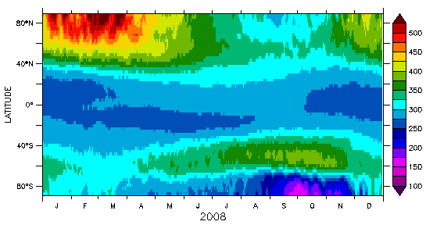
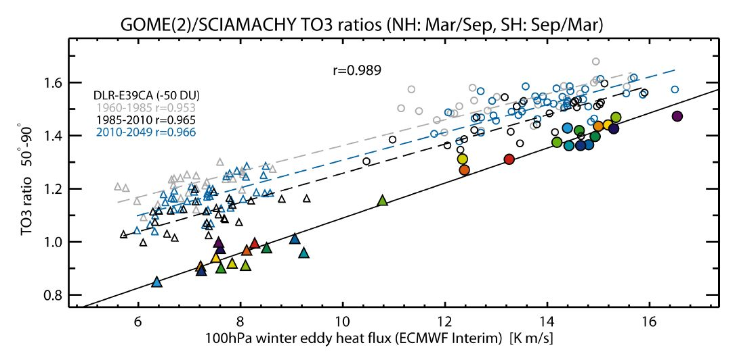
Simulations
EMAC REF-C1SD simulation for „golden year 2008“
Spring-to-fall polar ozone vs. 100hPa winter eddy heat flux
Weber et al., 2011, ACP

Slide 9
Evaluation and prediction
(free-running CCM)
Temporal evolution of total ozone column (60°S - 60°N)
Observation
(NASA)
E39C-A
„free running“
Observation
(European satellites)
Dameris and Loyola, 2011

Slide 10
Ozone trend and variability 1995-2013
Multiple linear regression model:
O₃(m) = A + B₀·m
+ C·SF(m)
+ D·QBO30(m)
+ E·QBO50(m)
+ F·MEI(m)
+ X(m)
Coldewey-Egbers et al., 2014, GRL, accepted

Slide 11
Outlook to Phase-2 (DLR)
What can be done better with improved data sets?
Process-oriented investigations, e.g. studying interactions of dynamical, chemical and radiative processes
Attribution of (natural) ozone fluctuations and detection of (anthropogenic) trends
Investigation of links between climate change and atmospheric chemistry and composition, e.g. the impact of climate change on the recovery of the ozone layer (“super-recovery”)
Evaluation of the role of the stratosphere for (surface) climate change and weather (e.g. EC project StratoClim)

Slide 12
CRG activities at UCAM/KIT (P. Braesicke)
Chemistry-Climate Model UMUKCA
Resolution: N48L60 (3.75°x2.5°, L60: 0-84 km)
Chemistry: Chemistry of the Strat. and Trop., incl. Fast-Jx)
Forcing: 6 hourly ERA-Interim with regionally varying relaxation time constants
Strategy: 1979 spin-up , 1979-2012 integration
Data: 3-hourly, daily, monthly
Scientific challenges
How good is a nudged CCM in capturing extreme ozone events? (cold events in 1997+2011, warm event in 2002)
Has meteorology determined the observed ozone anomalies, and is our chemistry doing a good job when the meteorology is correct?

Slide 13
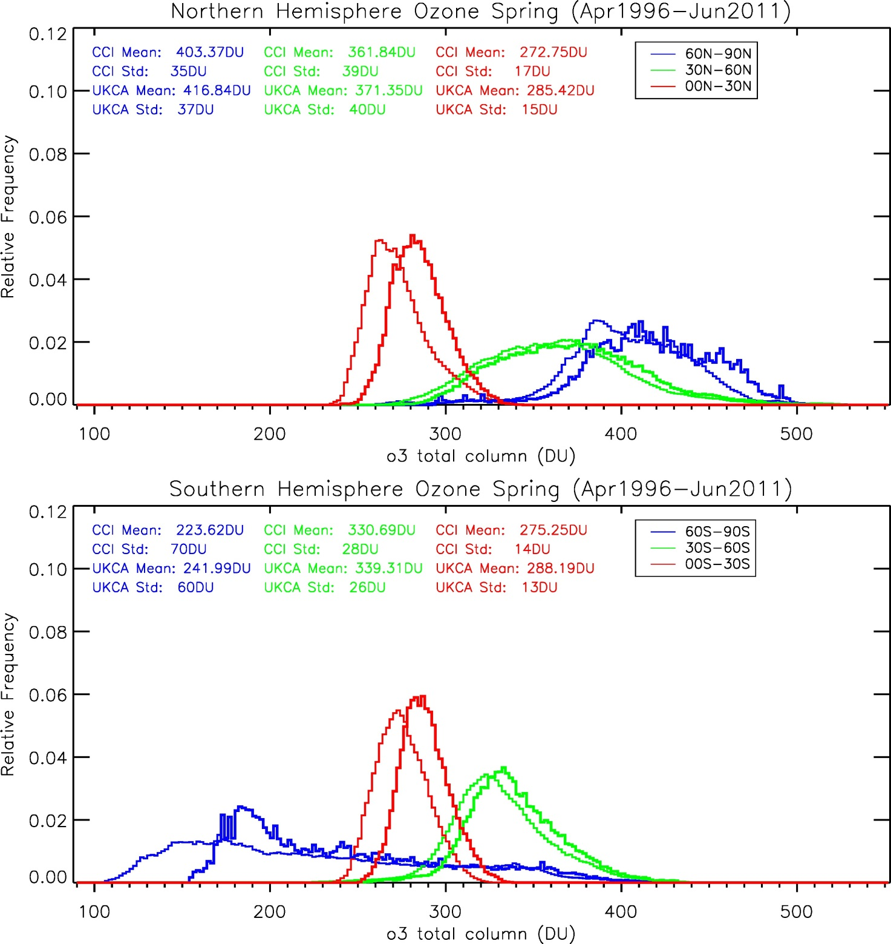
Comparison of PDFs
NH Total Ozone Spring (MAM) April 1996 – June 2011
SH Total Ozone Spring (SON) April 1996 – June 2011

Slide 14
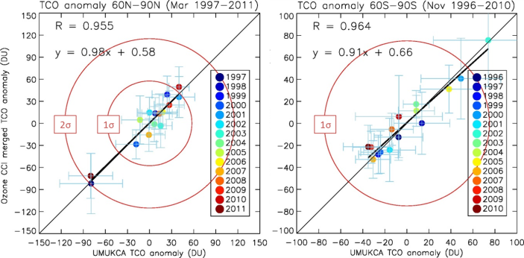
Ozone Anomaly Correlations
Tropical region: QBO control
High latitude spring: Accumulated winter impact
High latitude summer/autumn: Accumulated errors

Slide 15
Conclusions and outlook (UCAM / KIT)
The biases are not prohibitive:
Spring ozone anomalies for cold years in the NH can be modelled.
Spring ozone anomalies for the SH vortex split in 2002 are captured.
Interannual ozone variability:
The chemistry is doing well, when the meteorological biases are small (nudging with ERA-Interim).
Variability in the free running model is realistic with a small overestimate in the SH (underlying dynamical model).
Phase-2:
From total column ozone to partial column ozone and profiles
Tropopause Working Group (P. Braesicke)

Slide 16
CRG activities at KNMI (M. van Weele)
Chemistry-Transport Model TM5
Contains tropospheric gas-phase chemistry and a modal aerosol scheme (M7) which is interactive with the tropospheric oxidants
TM5 is part of EC-Earth (coupling the ECMWF IFS atmosphere model with ocean, biosphere (vegetation), cryosphere, etc.)
TM5 can be driven either off-line by ERA-Interim re-analysis data or online by the ECMWF IFS model in climate mode
TM5 ozone_cci set-up:
Resolution: Global 3°x2°, 34 vertical levels up to 0.1 hPa (>65km, transport through full stratosphere)
Strategy: 2006 spin-up, 2007-2008 integration
Output: Daily 3-D fields for data evaluations

Slide 17
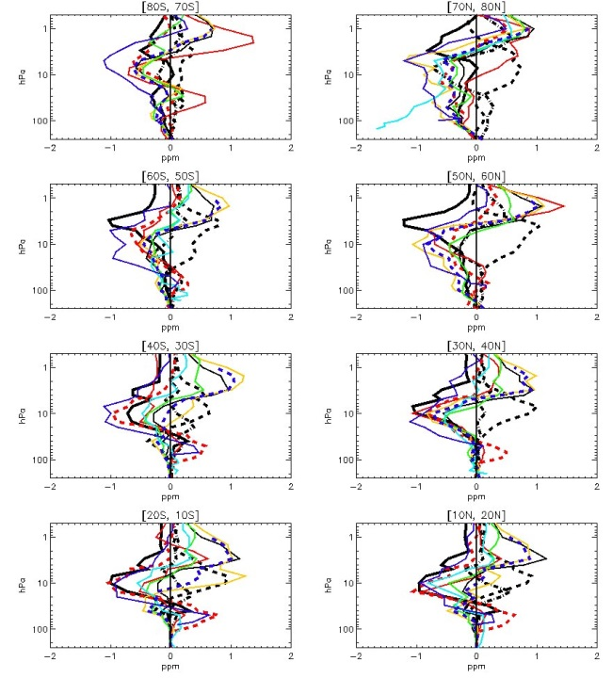
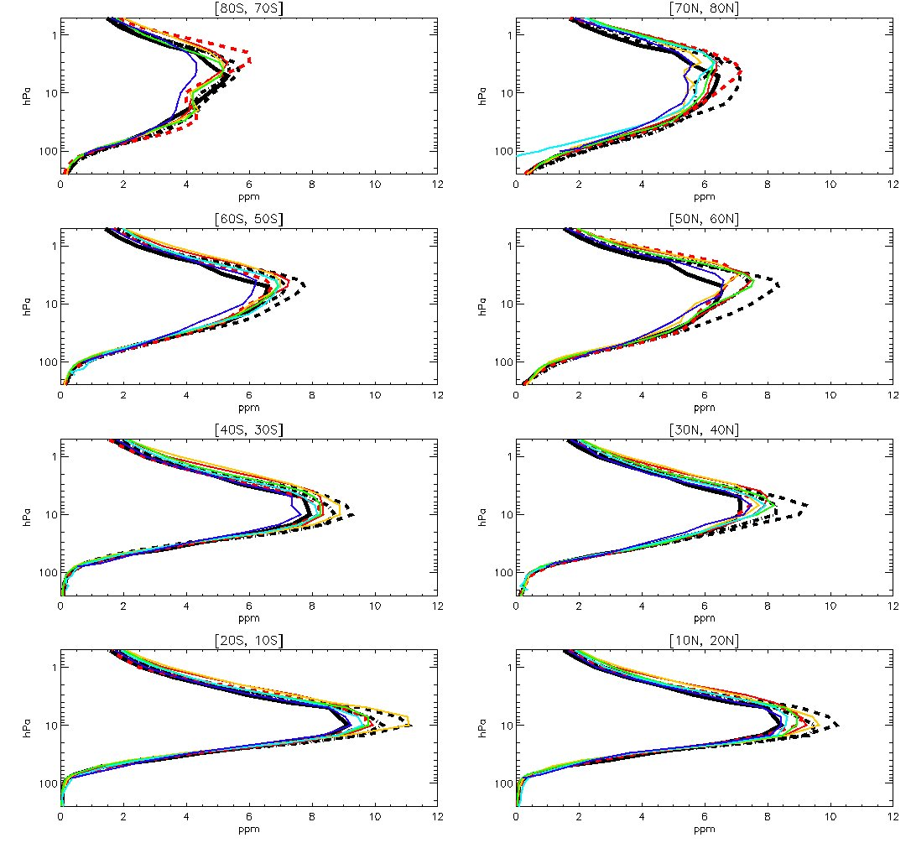
Model evaluation
Zonal monthly mean stratospheric ozone columns per 10° latitude band
Limb
MIPAS, SCIAMACHY, GOMOS
SMR, OSIRIS,
Ozone-cci merged product
Nadir
GOME-2, assimilated GOME-2
Models
EMAC, TM5, UCAM
March 2008
250 – 0.5 hPa pressure altitude ranges are used to compare nadir and limb-based stratospheric ozone columns
Monthly mean stratospheric ozone columns
(March 2008)
<1% between 30°S and 30°N
~ 5-6% in SH polar latitudes (autumn)
~ 10-13% in NH polar latitudes (spring)

Slide 18
Outlook for Phase-2 (KNMI)
Evaluation of sub-monthly UTLS processes
Validation of parameterized stratospheric ozone chemistry (optimized Cariolle parameter settings) in TM5
Combinations with a.o. FP7 SPECS interactive ozone-climate simulations with EC-Earth/TM5 on the role of stratospheric ozone for long-term weather predictions up to seasonal time scales (e.g. impact on surface climate of zonally symmetric vs. asymmetric ozone distributions)

Slide 19
Outlook for Phase-2: summary
Spectrum of variability as a constraint for models
Look at spectra of variability – are models and satellites seeing the same amount of variance at key frequencies? How are the different key frequencies linked?
Extreme ends of the spectrum
Trends: latitude and altitude dependencies.
Diurnal cycle: use models to better understand its importance for trend estimates.
Data from archive will be complemented with case studies
Links to international activities
WCRP Coupled Model Intercomparison Project Phase 5 (CMIP5)
IPCC assessment report
SPARC/IGAC Chemistry-Climate Model Initiative (CCMI)
UNEP/WMO Scientific Assessment of Ozone Depletion 2018

Slide 20
Outlook for Phase-2: summary
Contribution of CRG to establish consistent ECVs:
Provision of different, consistent ECV-data sets derived from individual model studies
Climate Models (e.g. CMIP5 activity)
Chemistry-Climate Models (e.g. CCMI)
Chemical Transport Models
Use of ECV-data products:
boundary (initial) conditions
for evaluation purposes (assessment of uncertainties)
implement CCI-ECV data in scientific projects (e.g., the EC StratoClim project; project in the EC “Aerosols and Climate” cluster)
Outreach and dissemination
Address inter-consistency between ECV-data products in broader way:
confrontation of multiple ECV parameters to the output of the models operated by the Ozone_cci CRG
study possible interlinks between ECVs connected by chemical, radiative or dynamical effects

Slide 21
Thank you !

