Slide 1


The CCI Soil Moisture Project
The objective of ESA’s CCI Soil Moisture project is to produce the most complete and most consistent global soil moisture data record based on active and passive microwave sensors.

Slide 2
Microwave missions for soil moisture
Examples of passive and active microwave missions for mapping soil moisture on a global scale
passive
active
[Dorigo, W.A., unpublished]
Can we combine these products into a single record?

Slide 3
Phase 1: Results – ECV SM v0.1 and v1.2
The ECV Soil Moisture (ECV_SM) data set version 0.1
issued in June 2012 presents:
daily surface soil moisture data
from 1978 – 2010 (2013)
in volume metric units [m³m⁻³]
with a global coverage
a spatial resolution of 0.25°
An improved ECV_SM version 1. 2 will be available in August 2014 (internal release for validation in February 2014)
Download the v 0.1 data set at
http://www.esa-soilmoisture-cci.org/dataregistration

Slide 4
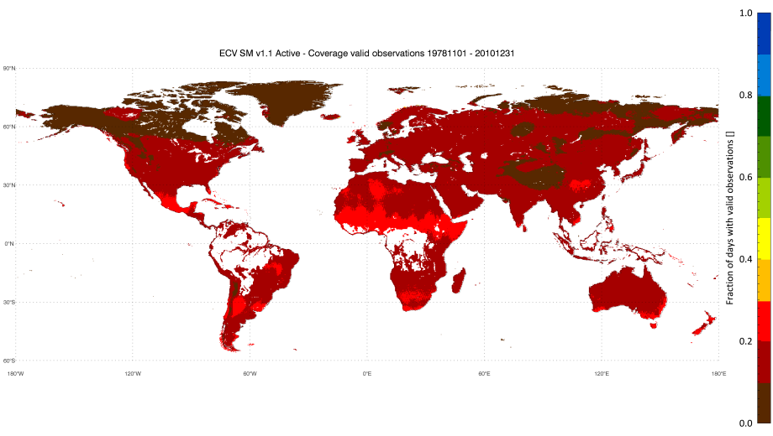
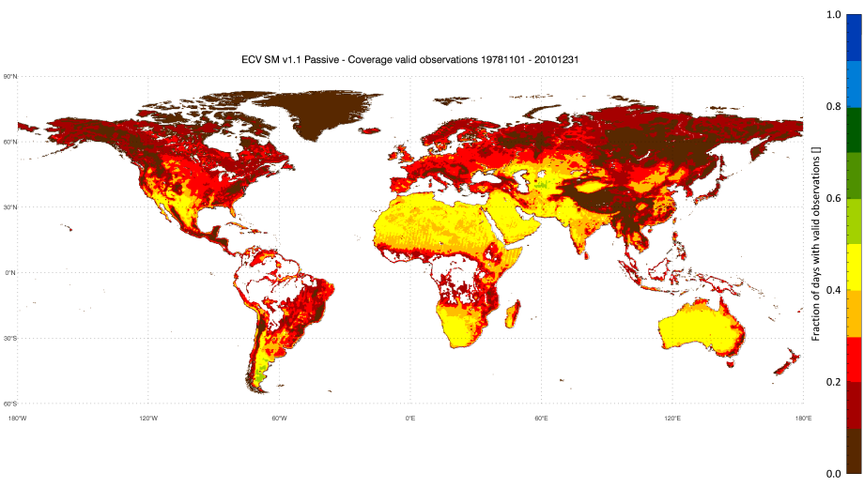
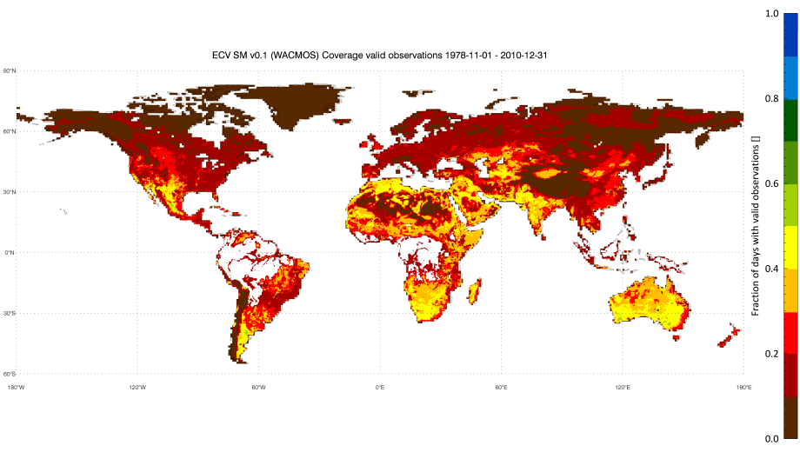
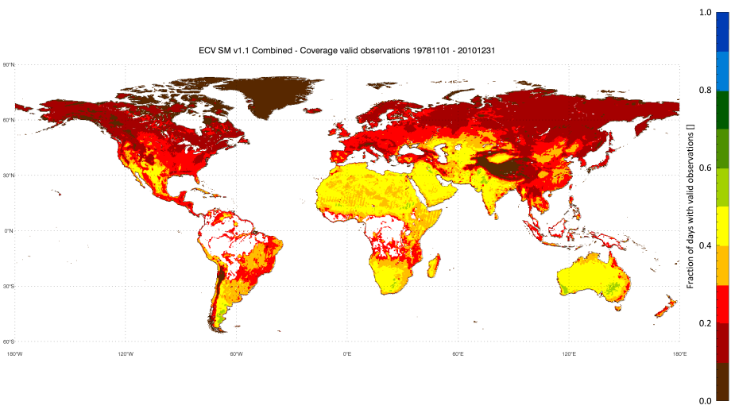
ECV improvements
Fraction of days with valid observations (i.e. masked for snow, dense vegetation, etc) over period 1978/11-2010/12
Active
Passive
ECV SM v0.1
ECV SM v1.2

Slide 5
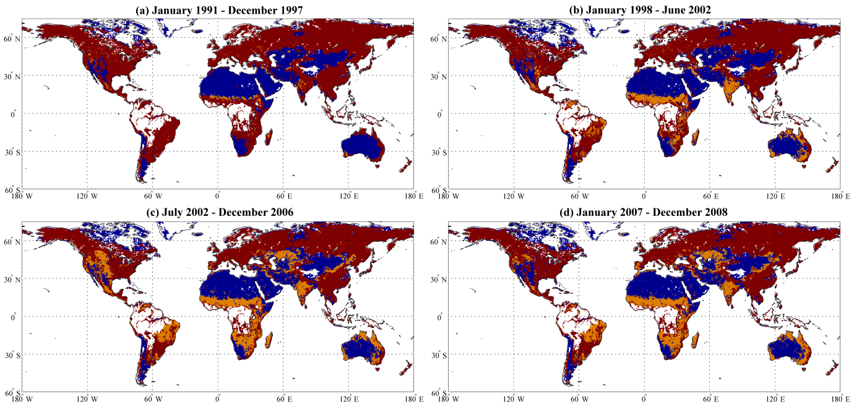
Merging active and passive observations
For areas with moderate vegetation we use active
For (semi-)arid areas we use passive
In “transition zones” we use both by averaging
Ranking maps are dynamic over time, depending on available sensors

Slide 6
Summary of ECV v1.2
Changes have been introduced since the release of version 0.1 in 2012:
Time span | 1978 – 2013
New sensors | WindSat, AMSR2
Active data | ASCAT: Warp 5.5 R2 ERS1/2: WARP 5.5 R1 (WARP 5.4 for 2001 to Feb. 2003)
Passive data | LPRM v05 for all sensors
New data attributes | Original retrieval timestamp, Satellite mode/orbit direction, frequency band
New data selection / merging scheme | Filling data gaps due to ERS sensor failure by using passive data; if data gaps exist move away from strict merging selection of best performing sensor – instead use available data for that time period
Improved scaling algorithm | Better exception handling

Slide 7
Major improvements in Phase 1
35 year harmonised soil moisture data set (1978 – 2013)
Better spatio-temporal coverage than single-sensor input products
Improved observation density w.r.t. single-sensor products
Complimentary of active and passive microwave retrievals (i.e. improved skill) over difficult areas (deserts, dense vegetation, RFI affected areas)
Improved data and metadata description (flags, international (meta-) data standards)

Slide 8
Improvement w.r.t GCOS Requirements
GCOS Target Requirements for Soil Moisture ECV:
Volumetric Surface Soil Moisture
Requirements met globally since 2002, prior to 2002 not everywhere met due to limited availability of suited EO sources
Variable | Horizontal Resolution (km) | Vertical Resolution | Temporal Resolution (h) | Accuracy (m³/m³) | Bias | Stability (m3/m3/year)
GCOS Target | 50 | N/A | 24 | 0.04 | Not Provided | 0.01
Phase 1 Merged Product | 25-150 | N/A | 24~72 | 0.05 | -0.031 | Not Determined

Slide 9
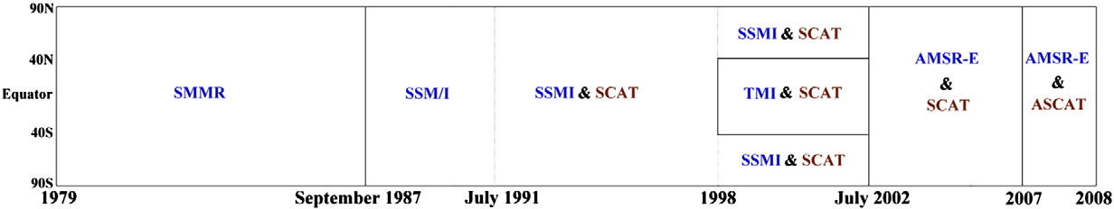
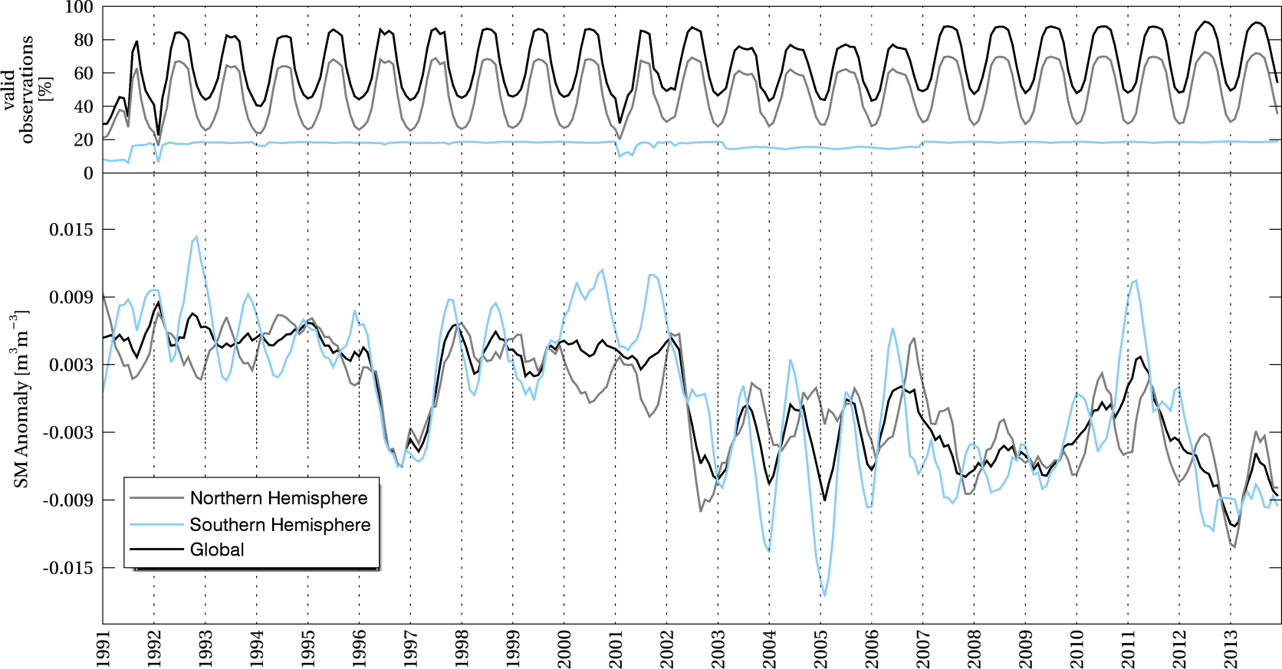
Anomalies per Hemisphere
Global/hemispheric means affected by changes in spatial coverage related to sensor changes, e.g. in 2002
1991-2013 global and hemispheric means
CCI ECV_SM v1.2
?
1997
Warmest Year of Century
July 2002
Dorigo, et al. (in rev.), BAMS

Slide 10

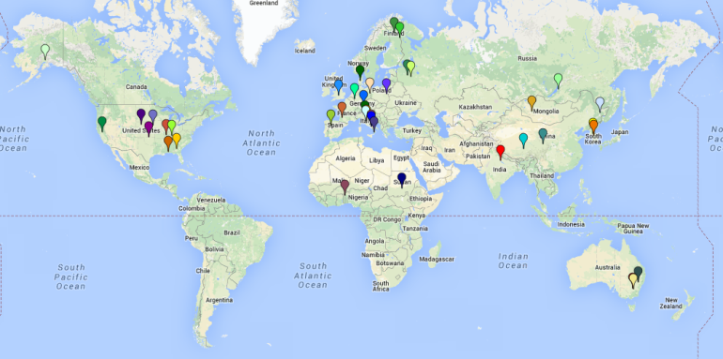
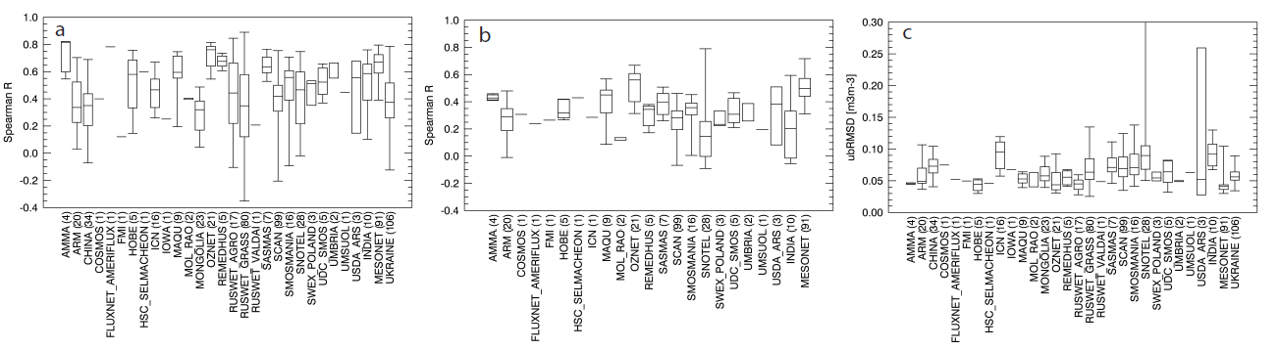
Validation
Validation of ECV SM using various independent in-situ soil moisture networks wordwide: Spearman correlation of absolute values (a) and anomalies (b), and unbiased RMSD (c).
Statistics are affected by quality, location,
and temporal coverage of networks
Dorigo, et al. (in rev.), RSE

Slide 11
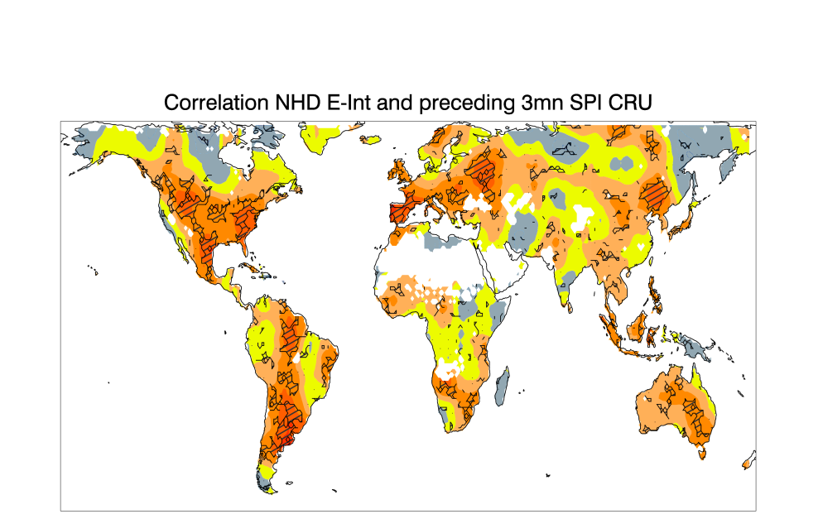
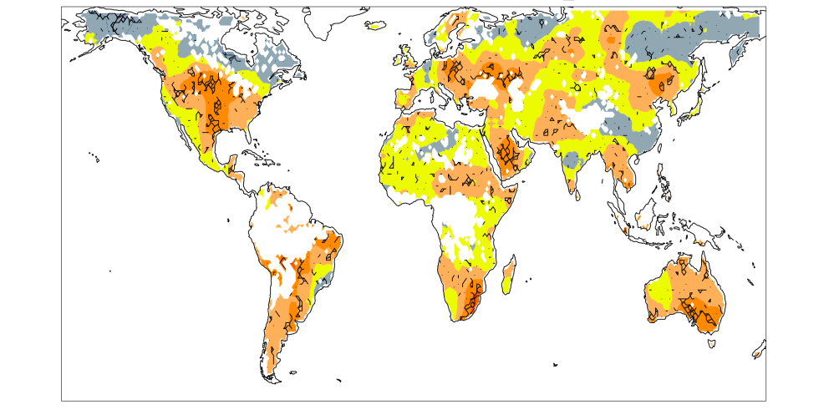
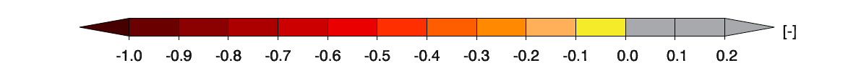
Soil moisture-temperature coupling
(CCI Climate Research Group ETH Zurich)
Standardized Precip. Index
(Mueller and Seneviratne 2012)
SSM anomaly
(ECV_SM 0.1, Hirschi et al.)
Correlation between preceding moisture availability
and number of hot days
correlation
ECV_SM data supports previous findings on soil moisture-temperature coupling regions
Notes:
Look again at correlations between NHD and preceding SPI or RS soil moisture
picture from PNAS using SPI as SM proxy
same analysis using CCI RS SSM anomalies
→ patterns comparable, but tendency for weaker neg. correlations

Slide 12
Soil moisture data assimilation products
(CCI Climate Research Group NILU)
Daily average of soil moisture analyses for July 2011
SMOSMANIA - Urgons 43.54N, 0.43W 145 masl
SMOSMANIA - France

Slide 13

Conclusions from the data assimilation results
  Self-consistency tests (O-A, O-F, obs/model error) – PASSED
  Information on satellite measurement errors - CONSISTENT
  Comparison with independent data – PATTERNS AGREE
  Useful information in assimilated products – ADDED VALUE

Slide 14
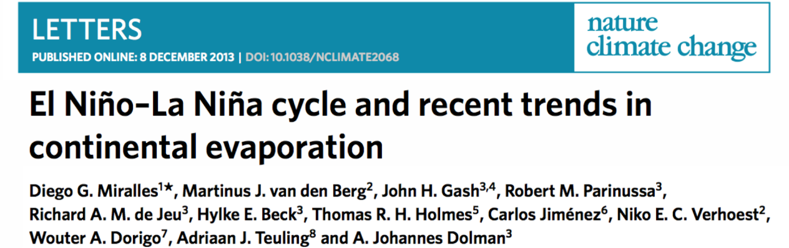
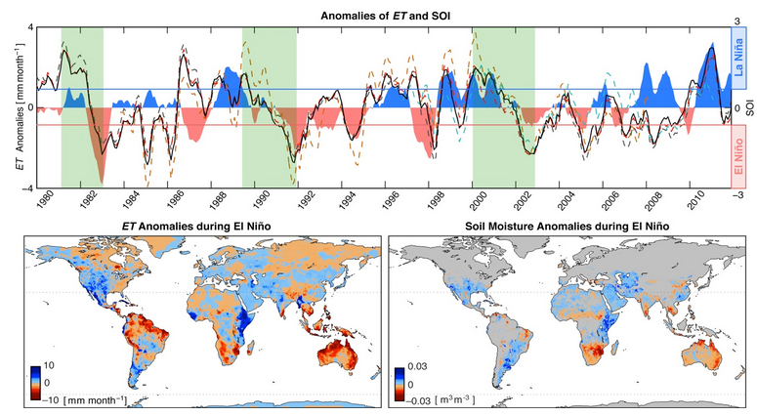
Soil moisture and the water cycle
Studying water cycle acceleration through evapotranspiration =>
a strong link between ET and the dynamics of the El Niño-La Niña cycle

Slide 15
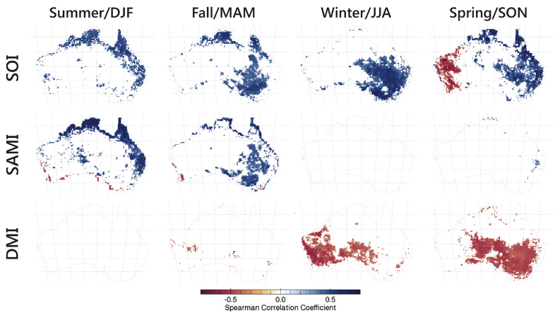
Soil moisture coupling with climate modes
ENSO
SAM
IOD
[Bauer-Marschallinger, B., Dorigo, W., Wagner, W., Van Dijk, A. (2013) Journal of Climate]

Slide 16
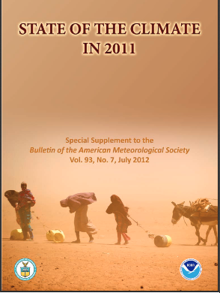


More than 28 Publications

Slide 17
Phase 2: Planned Improvement w.r.t GCOS Requirements
Improved stability characterisation
Improved uncertainty characterisation and validation of uncertainties
Obtaining full independence from model simulations (currently used as a global scaling reference)
Algorithm Development focuses on
Improving quality and consistency of ECV product for:
  individual satellites,
  across satellites, and
  across ECV’s
Ensures progress towards GCOS, and wider requirements
Developments in response to user requirements, and climate assessment of products from Phase 1
Introduction of new satellites (SMOS, Windsat, AMSR2, tested for Sentinel-1)

Slide 18
Microwave missions for soil moisture
Examples of passive and active microwave missions for mapping soil moisture on a global scale
passive
active
[Dorigo, W.A., unpublished]
Including more sensors and years….

Slide 19
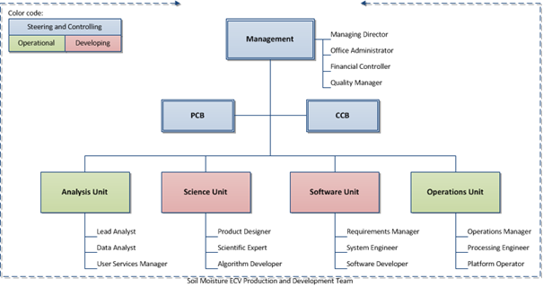
Phase 2: System- Organisational Overview
Organisational Units and Principle roles of team members
Based upon 3 core principals: (a) separation of responsibilities for steering & control, operations and development, (b) dedicated teams for the geo-science and IT domains, and (c) inclusion of control boards to steer System processes

Slide 20








Earth Observation Data Centre for Water Resources Monitoring
Sentinel -1 for water and soil moisture monitoring
An open & international Cooperation
…will help its scientific partners and users to make “better” science by allowing them to
Focus efforts on scientific problems rather than standard processing tasks
Test their algorithm on larger EO datasets
Compare algorithms to other state-of-the-art algorithms
Validate results with extensive reference data sets
Participate in benchmarking activities

Slide 21
New Paradigm in EO Data Processing is Needed
Main reasons
  Data volume and data transfer rates
  Increasing complexity of algorithms with increasing resolution
  Higher scientific standards
    Algorithms must be validated with big data sets and competing algorithms
    Algorithms ensembles needed
Solutions
  Bring software to data
  Cooperation & specialisation
IT Solutions exists
  Tools for collaboration
  Virtualisation
  Parallelisation
  Cloud Computing
  Big Data
Challenge is to change the behaviour of people & organisations!
Open-mindedness, willingness to share, transparency, and participatory decision making are probably crucial if one wants to succeed

Slide 22
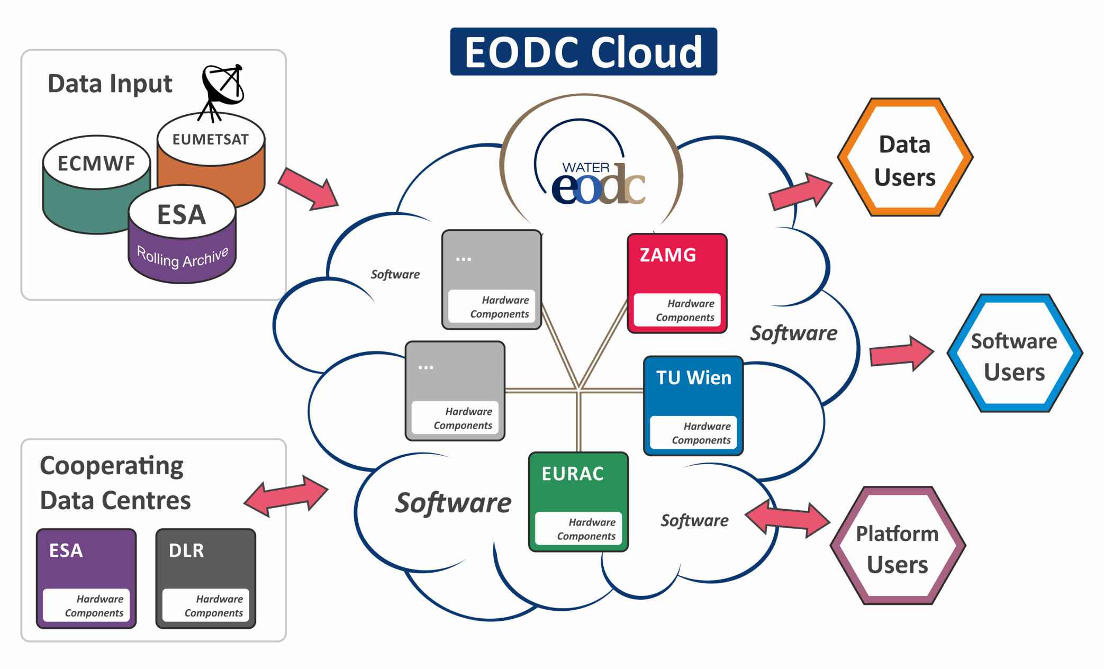
Outlook to Phase 2
CCI SM taking full advatage of a collaborative infrastructure

Slide 23

Word Cloud: Size of keywords relate to frequency of use of keyword as
provided in a free description of research interests by all data users (Feb. 2014)

