Slide 1

ESA’s Climate Change Initiative current and future
Susanne Mecklenburg
European Space Agency
Head of ESA’s Climate Office
CCI colocation and CMUG integration meeting | ESRIN 7-9 Nov 2023

Slide 2
Since last colocation in autumn 2022 …
The new climate initiative CLIMATE-SPACE
  Was (over) subscribed to by the ESA Ministerial Council 2022
  Implementation & procurement plans approved by PBEO and IPC respectively (Feb/ May 2022)
  Since then ITTs in preparation (first released, GHG emissions)
Note: We will keep the brand name “Climate Change Initiative”
Finalising last expenditure under CCI+
  Extension of existing ECV contracts – ongoing
  Several new ECVs/ activities
    SLBC-2 – KO Q1
    River discharge – KO January
    Anthropogenic water use – KO October
    Long-lived Green-House-Gases –KO November
    Research Fellowships awarded – September

Slide 3
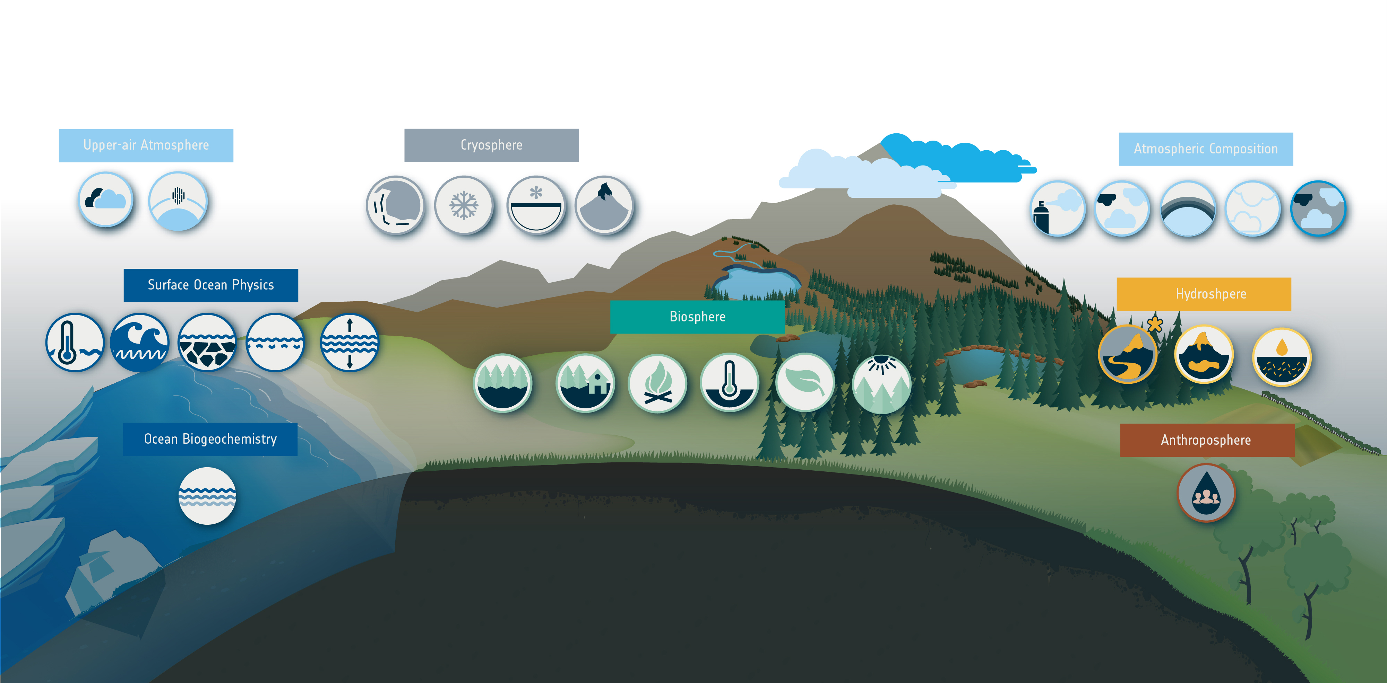
ESA’s Climate Change Initiative
Newly added ECVs
2022-2023
(+ further 2-3 ECVs in 2024)
GCOS defined 55 Essential Climate Variables | 36 benefit from space observations | 27 generated by ESA’s Climate Programme
Glaciers
Clouds
Upper Atmosphere Water Vapour
Ice Sheets
Snow
Permafrost
Aerosol
GHGs
Ozone
Precursors
Other
Long-lived GHGs
SST
Sea State
Salinity
Sea Level
Sea Ice
River
Discharge
Lakes
Soil
Moisture
Above-ground Biomass
Land
Cover
Fire
LST
LAI
FAPAR
+ CMUG
+ RECCAP-2
+ SLBC
+ IMBIE and AMPAC
+ Research Fellows
Ocean Colour
Total Anthropogenic
Water Use

Slide 4










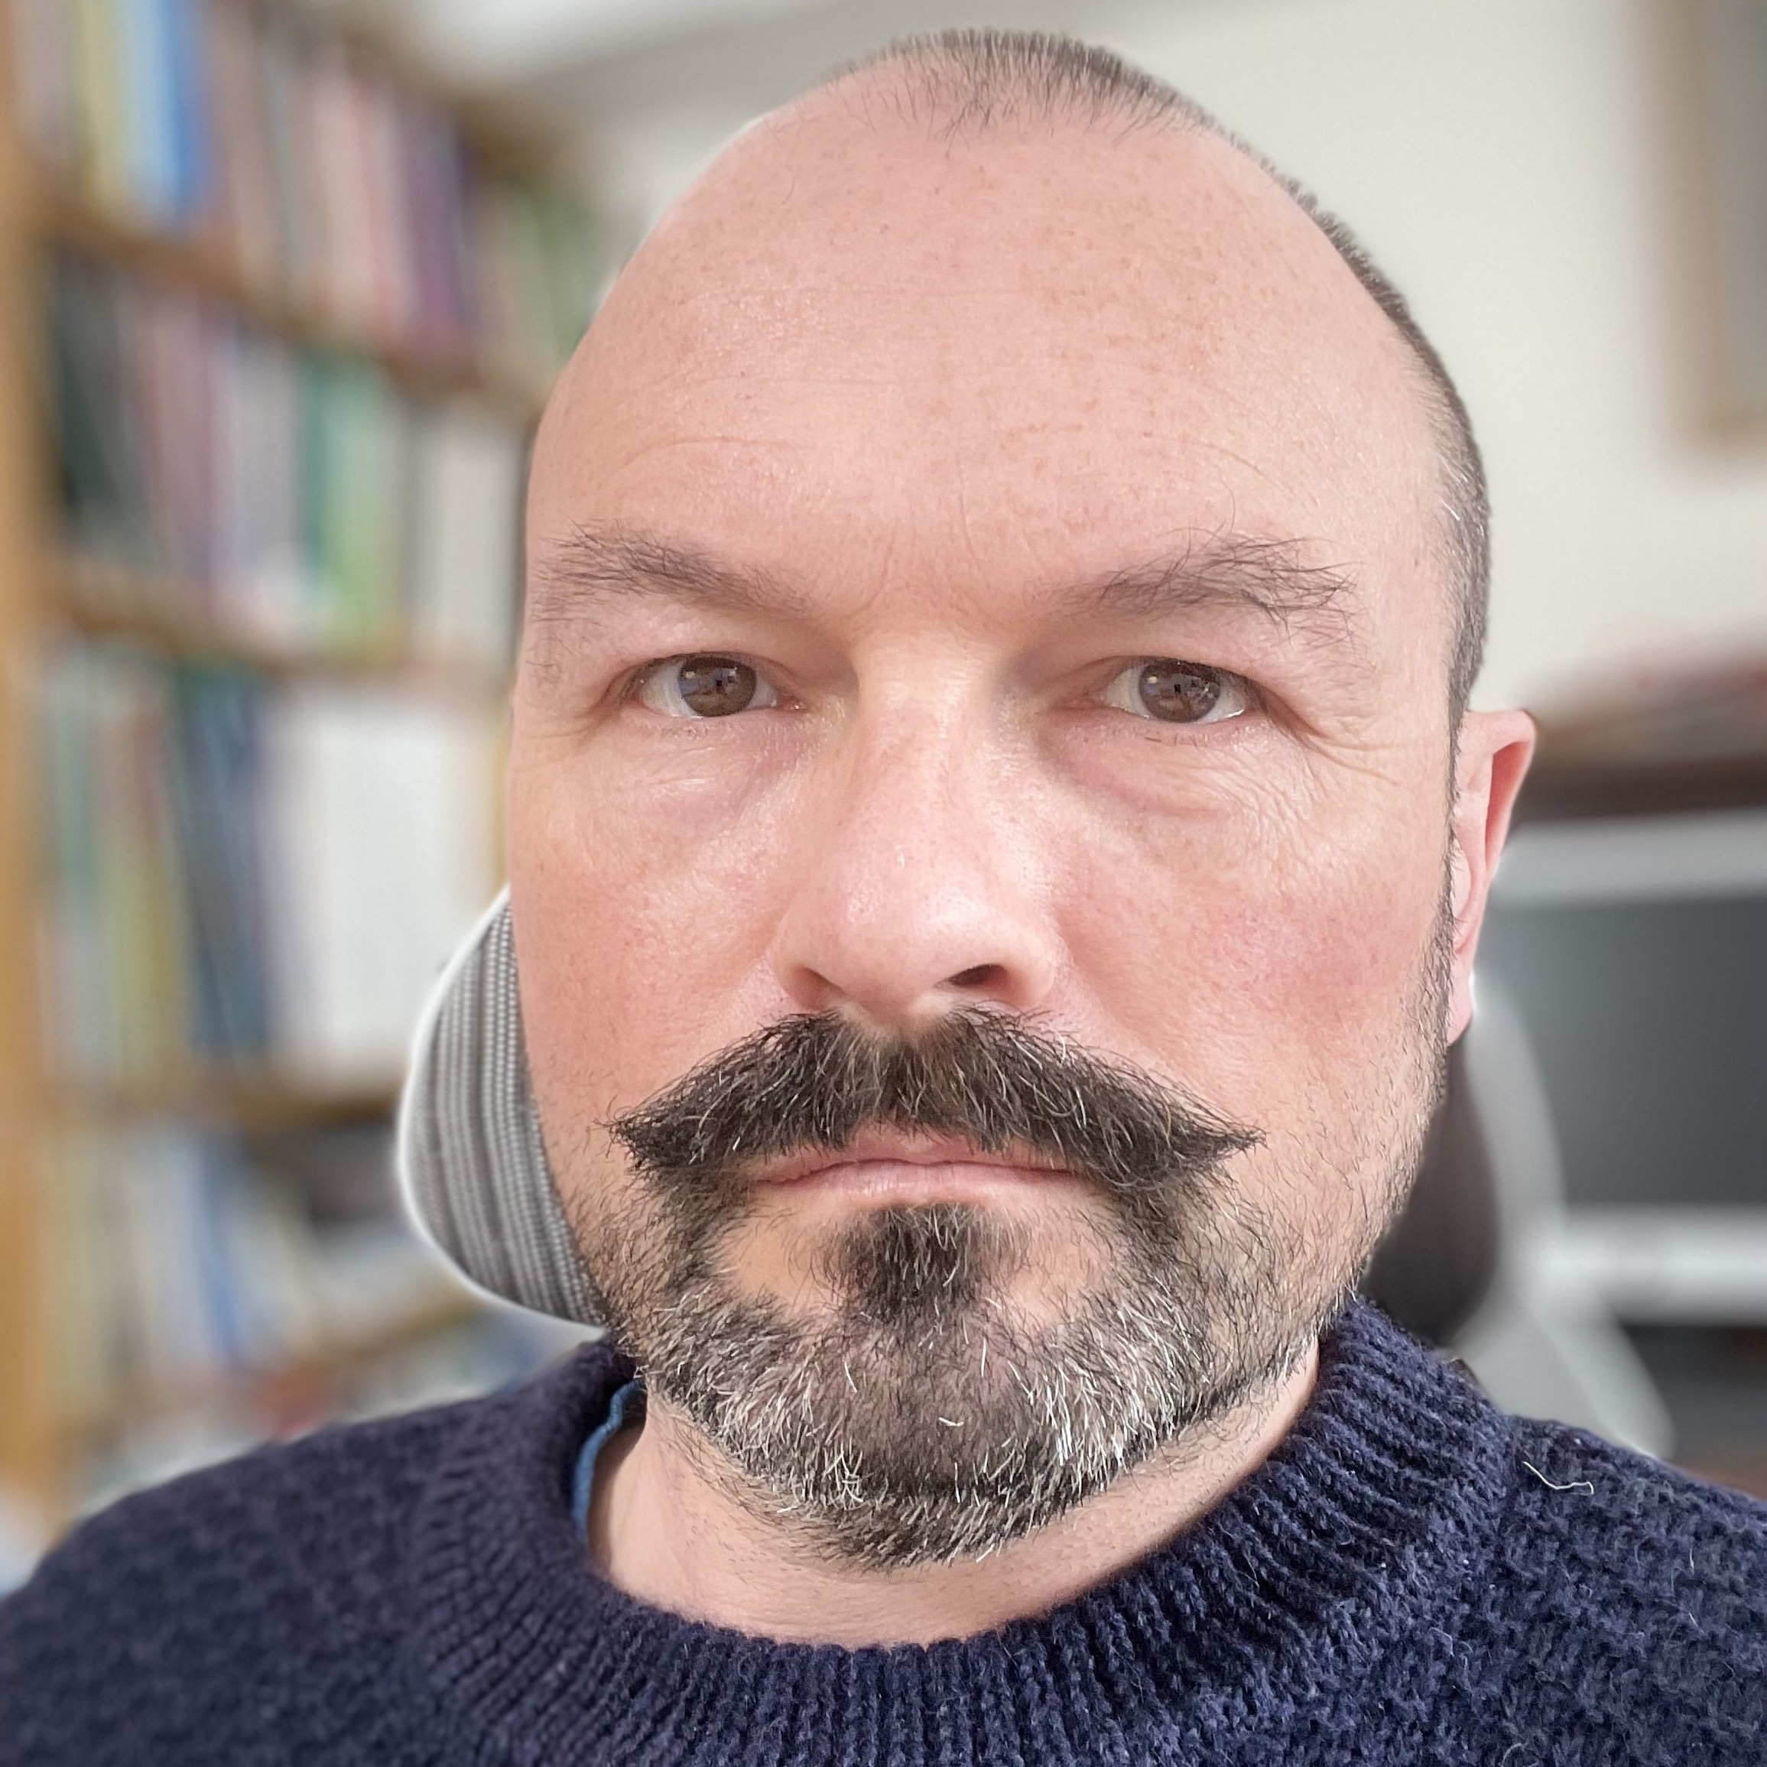







ESA CLIMATE OFFICE & CMIP-IPO TEAM
ESA CLIMATE OFFICE
CMIP IPO
Eleanor O’Rouke
Director
Susanne Mecklenburg Head of Climate Office
Clement Albergel
Applications Engineer
Anna Maria Trofaier
Applications Engineer
Simon Pinnock Applications Engineer
Michael Eisinger
Applications Engineer
Claire Macintosh
Applications Engineer
Briony Turner
Project Manager
Sarah Connors
Application Engineer
Ed Pechorro
Data Engineer
Paul Fisher
Communications
    Sophie Hebden
    Future Earth
Victoria Ayala
PA to Climate Office
Alice Kolesnikov
PA CMIP IPO
Beth Dingley
Communications Manager
Daniel Ellis
Technical Officer
ESA UNCLASSIFIED - For Official Use
Amina Maroini Graduate Trainee
Anna Jungbluth Research Fellow

Slide 5




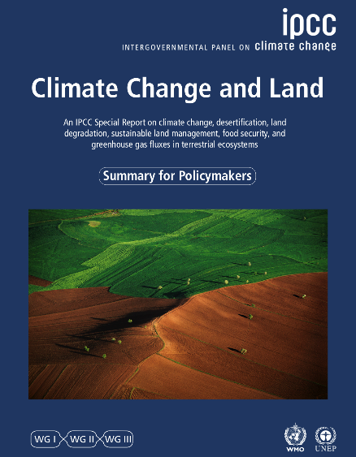

The GOLD STANDARD
of state of climate assessments
IPCC SYNTHESIS REPORT
Release date: 20 March 2023
Re-emphasise the call for action in terms of taking measures for adaptation and mitigation and identifies opportunities for both.
The report warns that
  “Currently insufficient action to limit warming to even 2deg C”
  “Global GHG emissions must half by 2030, to stay below 1.5”
  “For any given future warming level, many climate-related risks are higher than assessed in AR5 and projected long-term impacts are up to multiple times higher than currently observed (high confidence)”
  “Some future changes are unavoidable and/or irreversible but can be limited by deep, rapid and sustained global greenhouse gas emissions reduction.”
Note: Increased use of satellite data and new methodology in AR6
Notes:
CCI is a significant contributor to the results as put forward by IPCC

Slide 6
ESA CCI CONTRIBUTION TO IPCC AR6
ESA CCI contribution to IPCC assessments is growing
AR6 contribution
  7 Lead authors
  15 contributing authors
  10 expert reviewers
  130 research papers
  410 in-text citations

Slide 7
Where we stand
Technical dialogue of the first global stocktake, September 2023
Synthesis report by the co-facilitators on the technical dialogue
Historical emissions from 1950, projected emissions in 2030 based on nationally determined contributions ) 2022 NDC synthesis report for 1990–2020;), and emission reductions required by the Sixth Assessment Report of the Intergovernmental Panel on Climate Change
Notes:
Sources: Upper panel: Historical data from the IPCC for 1950–1989 and from the 2022 NDC synthesis report for 1990–2020; 2030 projections from NDCs; and the reduction scenarios from the AR6 Synthesis Report (IPCC. 2023. Climate Change 2023: Synthesis Report. Contribution of Working Groups I, II and III to the Sixth Assessment Report of the Intergovernmental Panel on Climate Change. Core Writing Team, H Lee, and J Romero (eds.). Geneva: IPCC. Available at https://www.ipcc.ch/report/ar6/syr/). Lower panel: table SPM.5 in the AR6 Synthesis Report.
Abbreviati
New and updated NDCs submitted before COP 26 indicate an increase in mitigation ambition compared with previous INDCs; however, this increase only partly offsets emissions growth and is not yet in line with global modelled mitigation pathways that limit warming to 1.5 or 2 °C. These NDCs close the emissions gaps only partially, by 15–33 per cent. A total of 169 Parties updated 142 NDCs, and 74 per cent of these Parties strengthened commitments to reduce or limit emissions for 2025 and/or 2030. Parties were requested to revisit and strengthen the 2030 targets in the NDCs as necessary to align with the Paris Agreement temperature goal, taking into account different national circumstances.27
100. The 2022 NDC synthesis report provides updated information based on the latest available NDCs, up to 23 September 2022.28 The report indicates the median emissions gap to 1.5 °C (>50 per cent probability) in 2030 is 23.9 Gt CO2 eq without conditional elements and 20.3 Gt CO2 eq with the implementation of conditional elements underpinned by support.29 For a median emissions gap of 2 °C (>67 per cent probability), the respective emissions gaps in 2030 are 16.0 and 12.5 Gt CO2 eq, without and with conditional elements and support respectively. Analysis of these emissions gaps assumes mitigation actions in NDCs will be fully implemented and supported, and if either is not the case, the gaps would be even larger.
on: LULUCF = land use, land-use change and forestry.

Slide 8
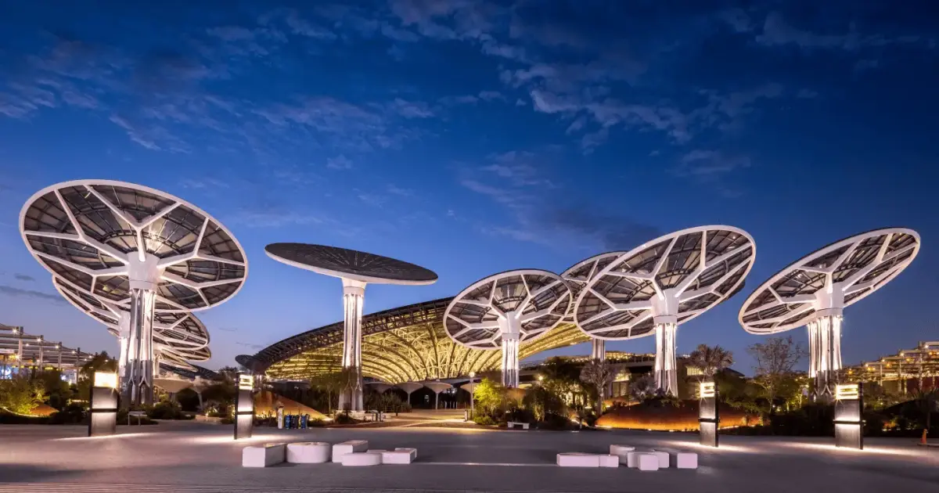
ESA @ COP 28
Dubai, 30 November – 12 December 2023
Pavilion in the blue zone
Events x2 per day on topical issues and theme of the day (in person/hybrid)
Space Leader Summit
Earth Information Day
→ Please let us know
if you are going

Slide 9
The next phase of the Climate Change Initiative

Slide 10


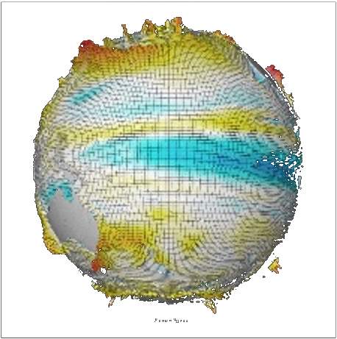
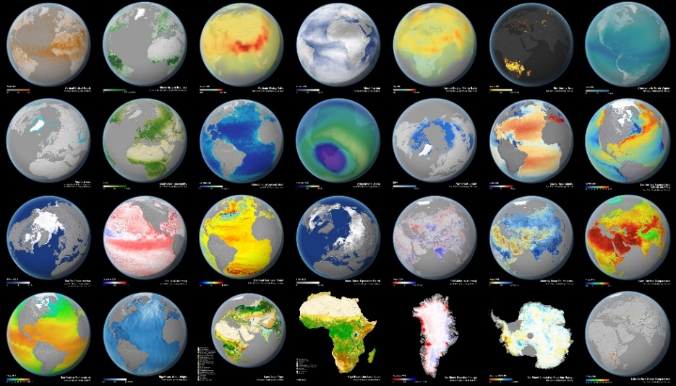
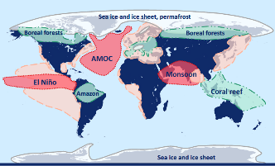


EXPANDING ESA’s CLIMATE CHANGE INITIATIVE
Duration: 2023-2029 | Funding: phase 1 ~87 Meuro ; phase 2 – TBD at CMIN 2025
Providing physical evidence for a changing climate, R&D for operational climate services
Earth observation data support and verify the UNFCCC Paris Agreement pledges
Linking observations with modelling provides trustworthy climate predictions and projections
Cross-ECVs and Tipping Points
Knowledge Exchange
Further information on upcoming opportunities
https://climate.esa.int/en/esa-climate/climate-space-information-day-10-may-2023/

Slide 11
THEMATIC STRUCTURE OF CLIMATE-SPACE
  Theme I – The excellence base – ECVs
  Theme II - Cross-ECV applications
    Support to climate policy needs: UNFCCC Paris Agreement
    Cross-ECVs
    Tipping Points
  Theme III - Linking climate observations & modelling
  Theme IV - Knowledge Exchange
Implementation approach (in a nutshell)
Maintain and extend the existing Excellence Base T-I
Focus on establishing new activities under T-II/ III
Evolve and adapt T-IV

Slide 12
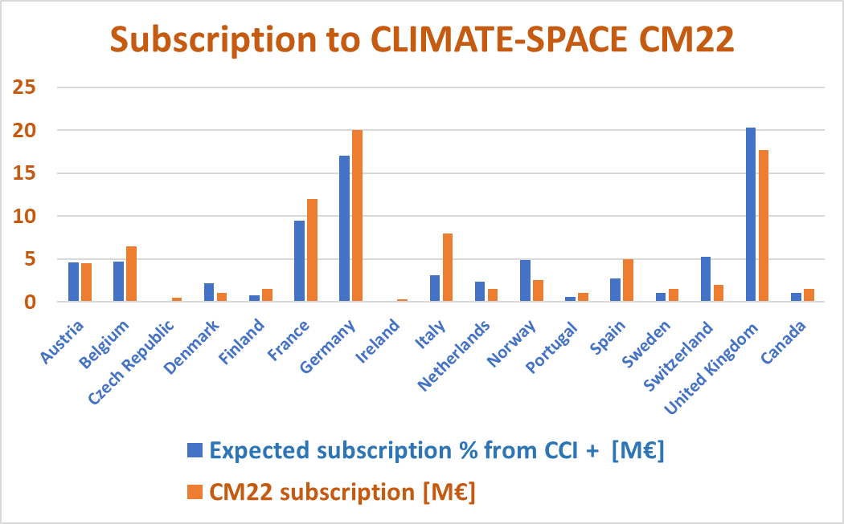
CLIMATE-SPACE - EXTENDED & EXPANDED SUPPORT
A few observations
Over-subscription additional ~ 6 M€ (total ~87 M€)
Larger financial envelop CCI+ ~8 M€ /y → CLIMATE-SPACE 14 M€ /y
National funding distribution largely maintained
Funding Member States
  Main F, DE, UK
  New CZ, IE
  More BE, FI, F, DE, I, E, S
  Less DK, N, NO, CH, UK

Slide 13
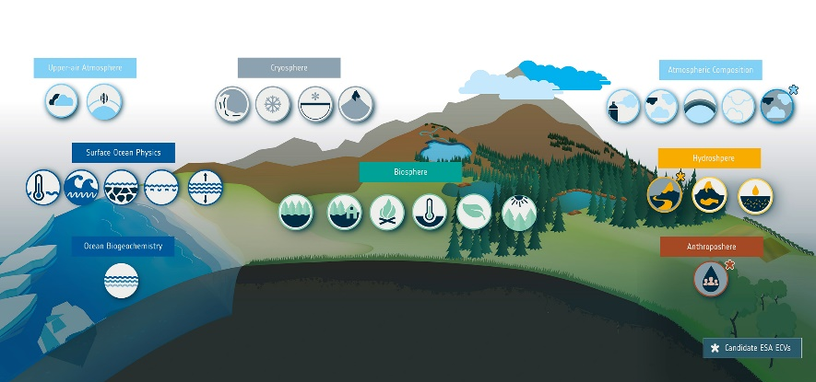
THEME I – THE EXCELLENCE BASE
Two objectives
Extending the existing portfolio of 28 Essential Climate Variables projects based on evolving user requirements (e.g., GCOS, IPCC, UNFCCC, Paris Agreement, CMIP-7, R&D for operational services etc) as well as exploiting ESA's new satellite missions until end of 2026.
Expanding the existing portfolio of Essential Climate Variables responding to new requirements (e.g. evapotranspiration, turbulent fluxes-ocean, fluorescence, lightning etc); new additions to the ECV portfolio to be chosen according to pre-defined selection criteria (defined in implementation plan)
Anticipated CCNs: 28
RFQ released starting Q1 2024 | 0.5-2 M€
Procurement mechanism: Direct negotiation
Anticipated Contracts: 3
ITT to be released in Q2 2024 | 0.5-2 M€
Procurement mechanism: Open competitive tender
Notes:
SP removed obs4MIPs from #1, as it comes up in Theme III later.

Slide 14


New activities in response to UNFCCC Paris Agreement
Expanding on results from RECCAP-2 and working with operational climate services
1. ITT on GHG Emission
Anticipated Contracts: 1
Release Q3 2023 | 2-3M€ | 3 years
Open competitive tender
2. ITT on Global land carbon budget and its attribution to regional drivers
Anticipated Contracts: 1
Release Q4 2023 | 2-3 M€ | 3 years
Open competitive tender
Bastos, A., Ciais, P., Sitch, S. et al. On the use of Earth Observation to support estimates of national greenhouse gas emissions and sinks for the Global stocktake process: lessons learned from ESA-CCI RECCAP2. Carbon Balance Manage 17, 15 (2022). https://doi.org/10.1186/s13021-022-00214-w
Notes:
The two most important anthropogenic GHGs (CO₂, CH₄) are associated with sizeable natural land sources and sinks. The net land CO₂ flux is a key sink component of the global carbon budget and is made of regionally different carbon sources and sinks that are sensitive to climate variability and human activities related to land use and land use change. Regional attribution of the loss and regrowth fluxes to land use change, degradation, and natural fires is crucial to evaluate the stability of the net land CO2 flux.
Quantifying and attributing natural sources and sinks of GHGs on the land (1) to support atmospheric inversions seeking to quantify the anthropogenic component of emissions (2) to monitor the impacts of climate change on the behaviour of natural sources and sinks
Top-down monitoring of atmospheric GHG concentrations and their inversion to estimate anthropogenic emission fluxes;
Bottom-up estimation of anthropogenic GHG sources and sinks arising from managed change in land use
Providing information to support national scale emission inventory verification activities
Tracking progress at global level of the cumulative effect of national mitigation efforts

Slide 15
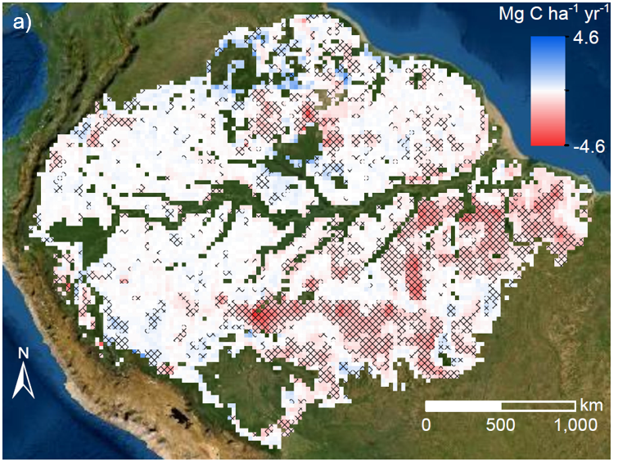
Scoping an Amazon field campaign
Trends in Amazon AGC 2011-2019 using satellite L-VOD
CEOS strategy to support GST under Paris Agreement recommended campaigns in focal areas on the globe where there is greater modelling uncertainty, e.g. Amazon Basin and the Siberian tundra.
Better understand the spatio-temporal variation in carbon stocks and fluxes (CO2, CH4) associated with different land cover types and changes (fires, deforestation, forest degradation etc)
Set up a field experiment covering local to regional scales with long-term ground-based (proximal sensing + in-situ) and air- and space borne observations.
The activity will be performed in cooperation with Brazilian partners, NASA and selected Partners from Europe
Location: Tapajos (Para state)
Status: in definition phase
Fawcett et al., GCB, Amazon biomass in decline due to deforestation and degradation (esa.int)
Notes:
Location: Tapajos (Para state)
Land cover: Full range of land cover types (degraded, agriculture, secondary and intact forests)
Climate Risk: This area was massively impacted by the last El Nino in 2015/16 leading to increased burning.

Slide 16
Joint GCOS-WCRP Workshop on the Energy, Carbon and Water cycle
Issues identified
Uncertainties associated with the terms of the budget,
The possibility and need to look at regional instead of global budgets, particularly the Arctic,
The important role of the ocean in all cycles (particularly ocean-air fluxes and storage),
The important role of atmospheric circulation.
Energy, the role of clouds,
Water,
  determining regional budgets,
  the estimation of evaporation (both on land and ocean)
Carbon,
  determining the role of the CO₂-fertilisation effect on land
  the uptake of anthropogenic CO₂ by the ocean
(from workshop summary presentation by Han Dolman, personal communication)
ESA ITT on cross-ECV
Anticipated Contracts: 2-4 | 0.5-2 M€ per contract
Release in Q4 2023
Open competitive tender

Slide 17
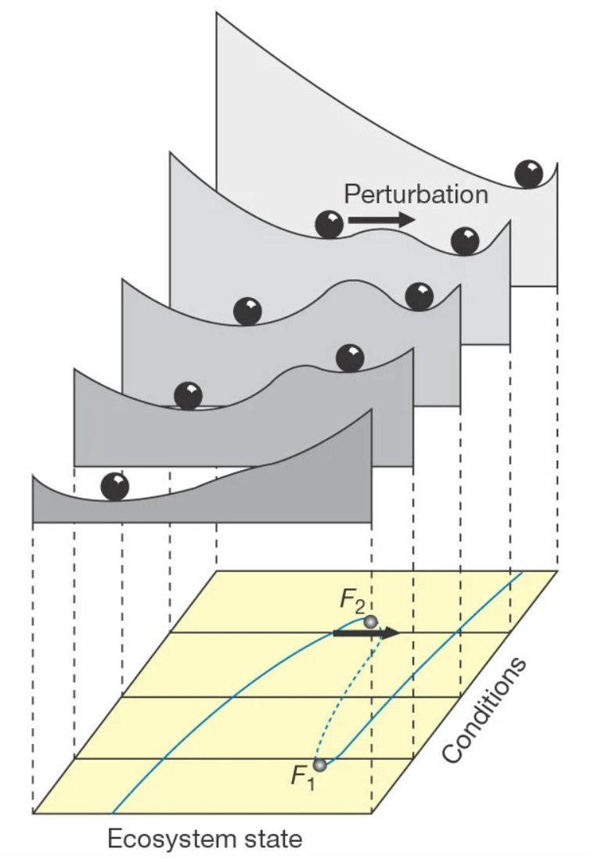
Use of EO for Tipping Points research
Tipping elements in Earth’s climate system are an important source of ambiguity regarding climate prediction and global climate sensitivity, with implications for carbon budgets and adaptation. Narrowing these knowledge gaps is important to inform policy decisions.
With this ITT we aim to improve the observational evidence in support of IPCC science to address uncertainties relating to potential tipping points in the climate system, their interactions and impacts.
Anticipated Contracts: 2-4
ITT to be released in Q1 2024 | 0.5-2 M€ per contract
Procurement mechanism: Open competitive tender
Scheffer et al., 2001
Notes:
Figure: When systems approach a tipping point, the dynamics change because the resilience, the “pull” of the old stable state tends to decrease. In the ball-in-basin metaphor when the basin gets shallower, two things happen: (1) because of the gentler slope the ball may move further away from the lowest point after a small stochastic perturbation and (2) because of this gentler slope the return time after disturbance is longer. In this simple metaphor, an early warning signal for the collapse of the basin would be e.g. the increased variation (in ball position, due to the first mechanism described above) and the increased autocorrelation (of the position between adjacent time steps, because of the second mechanism). The former, increased amplitudes, can announce a critical point but they can also be a direct consequence of increased fluctuations in the external forcing. The latter is called “critical slowing down” in tipping point literature and is supposed to be the most important sign that resilience is deteriorating and an abrupt change (a critical transition across a tipping point) could happen.

Slide 18
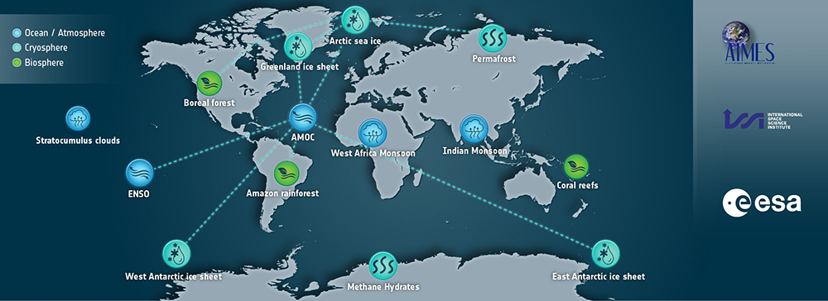
EO for Tipping Points & TIPMIP workshop
October 10-14 2022; Workshop International Space Science Institute (ISSI) ; co-convened with ESA, WCRP & Future Earth AIMES
Brought together a diverse community: EO experts, climate modelling and tipping points theorists, covering terrestrial biosphere, ocean bio, ocean physical, atmosphere and cryosphere.
35 in-person participants about 10 online, including 9 from ESA / ESA CCI projects and fellows, IPCC authors, 10% early careers.
Participatory breakouts and plenary discussions every day, working on recommendations for funders/ESA – a white paper in a few weeks, plus ~ 12 journal papers in prep, to form an ISSI Springer series book.

Slide 19
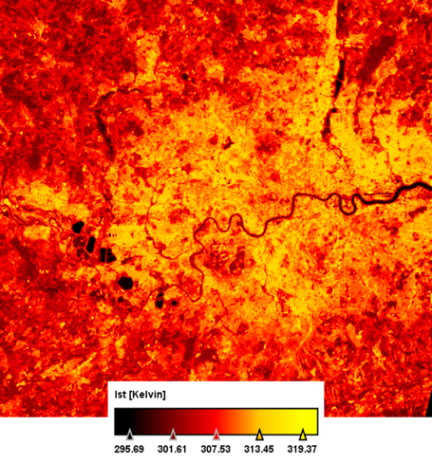
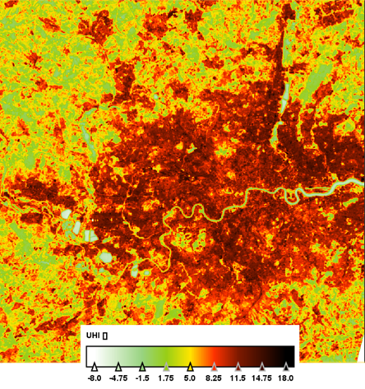
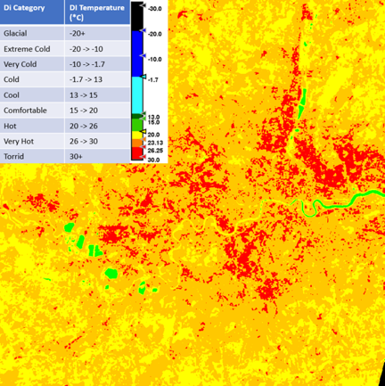
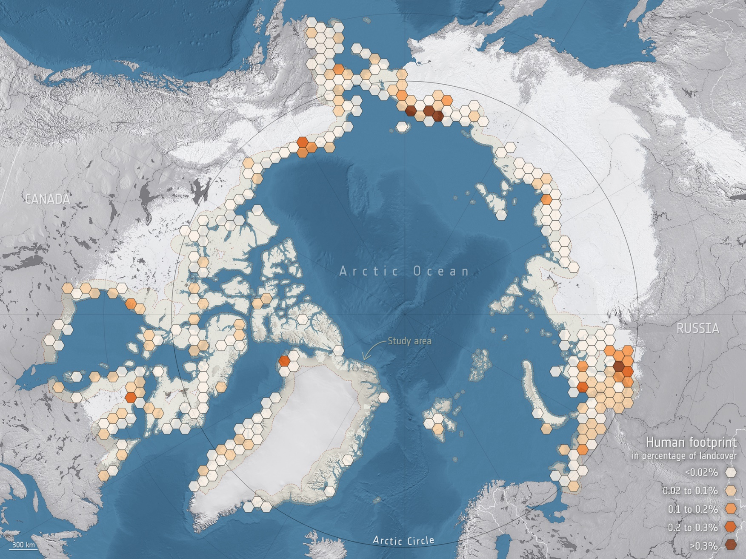
Adaptation activities under CCI
A major gap: Adaptation has no global target and common indicators are lacking since it is dependent on location-specific economic, social, and environmental conditions.
EO data can help address this question by providing information on observable adaptation measures (e.g. urban greening) over time.
London, UK
By 2050, 55% of communities located along the Arctic coastline are likely to be impacted by thawing permafrost.
Courtesy Darren Ghent
Urban heat island effect and implications for human wellbeing
ESA CCI high resolution LST observations
Bartsch A et al (2021) Expanding infrastructure and growing anthropogenic impacts along Arctic coasts. Environ. Res. Lett.

Slide 20
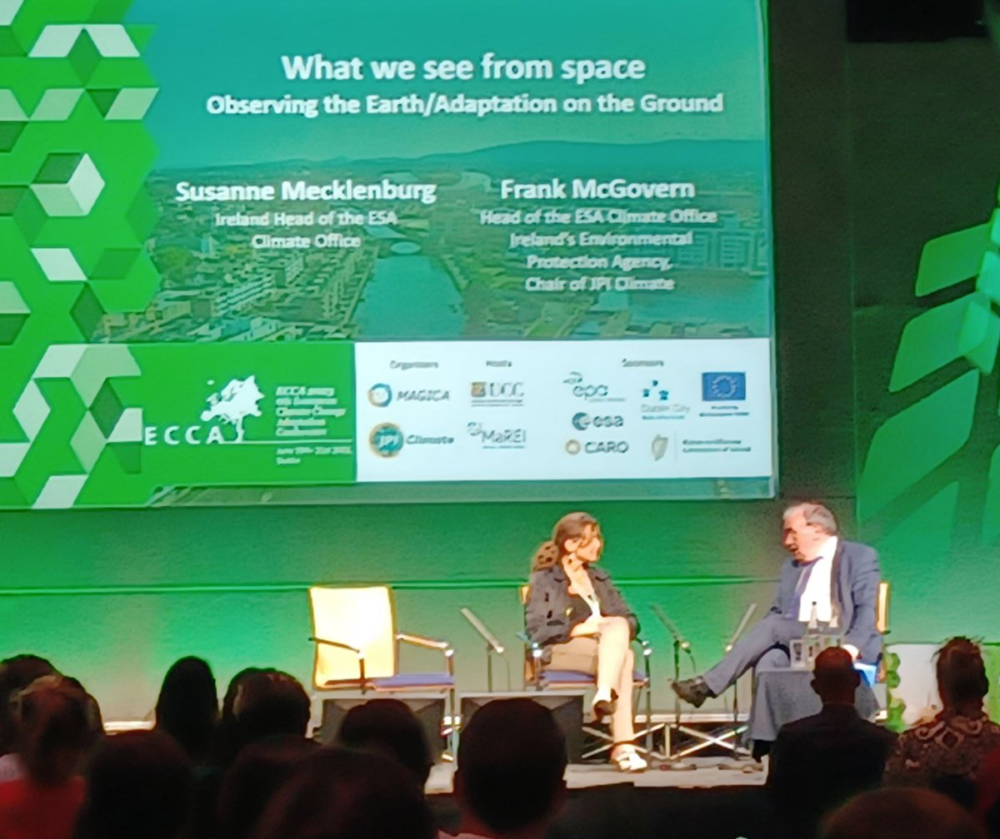
Adaptation activities under CCI – focus on health
Exploitation of Earth observation to support adaptation and resilience-building, capacity building, loss and damage aspects to support climate policy needs
Focus on health and biodiversity
Health
  Will focus initially on heatwaves and infectious diseases
  Expert meetings to collate requirements ongoing
  Complimentary and synergistic to
    Copernicus health hub Copernicus Health Hub - Official Launch | Copernicus
    EU’s adaptation mission Mission Projects (europa.eu)
    GCOS adaptation task team (GCOS_GATT (amazonaws.com))
    ECCA ECCA2023 JPI Climate led
  Mid 2024: Call for (up to 3) pilot projects
ECCA 2023, Dublin, Ireland
Notes:
Adaptation and resilience-building, capacity building, loss and damage, addressing new user communities, in particular focussing on health and biodiversity, building on the work performed under EOP’s FutureEO programme, expanding R&D activities into the climate area. For biodiversity, this will be based on the on-going discussion about the definition of Essential Biodiversity Variables (EBVs) and the recognition that spatial remote sensing is a key tool for providing data at the spatial and temporal scales necessary for EBVs to be useful for decision-making. It will respond to a request for support for R&D and pre-operational development from C3S.
Health
up to 3 contracts
0.2-1.0
Biodiversity
up to 3 contracts
0.2-1.0
ITT for pilot projects planned for mid 2024

Slide 21
Summary of tender opportunities & timescales: 2023-24
Further information on upcoming opportunities
https://climate.esa.int/en/esa-climate/climate-space-information-day-10-may-2023/
Further opportunities for project working with new user communities to be announced in the course of 2023/24

