Slide 1
LST_cci Products: Low Earth Orbit Infrared
KAREN VEAL, mike perry, Darren Ghent

Slide 2
Phase-1 Products Available on CCI Open Data Portal
Key features:
  Implementation of common Calibration and Validation Database
  Optimised pipelines for end-to-end (L1B -> L1C -> L2P -> L3U -> L3C) processing
  Implementation of common uncertainty approach in processing chains
  New dynamic land cover mapping consistent with wider CCI
  Derivation of intercalibration LUTs and time correction LUTs
  Remove averaging of multiple orbits at high latitudes
  Metadata compliant with CCI Data Standards
  All products with DOIs

Slide 3
Calibration Dataset
Building on the Round Robin work the Calibration Database is a much expanded database of surfaces and atmospheres designed to be the principle environment in which algorithms are trained and tested.
  ERA 5 atmospheric data
  Camel emissivity
  ESACCI LC biome information
  RTTOV v12.3 forward modelling
ERA 5 Profiles
CAMEL dataset
Simulation Truth dataset (SIM-TRUTH)
RTTOV
Simulated Channel TOA BTs (SIM-OBS)

Slide 4
Calibration Dataset
This database is critical for providing a consistent platform in which algorithms for multiple sensors can be trained and tested.
This allows the algorithms to be applied without bias towards a particular instrument as normal coefficient generation is sensor specific.
ERA 5 Profiles
CAMEL dataset
Simulation Truth dataset (SIM-TRUTH)
RTTOV
Simulated Channel TOA BTs (SIM-OBS)

Slide 5
Calibration Dataset
The profiles utilise the new ESACCI-ALB2 hybrid Biome map. This is key as the sub classes of the bare soil biomes provide greater LSE range than the standard Land Cover CCI providing algorithms with the ability to test extremes.
In addition to the geographical match-ups from ERA5 each file was reviewed to ensure that there was at least 1 pixel per biome in both the day and night scenarios.
Furthermore diagnostics were run to ensure that the range of LSTs present were representative of a full range of expected values.
ERA 5 Profiles
CAMEL dataset
Simulation Truth dataset (SIM-TRUTH)
RTTOV
Simulated Channel TOA BTs (SIM-OBS)

Slide 6
Biome Update
Biome number | Definition
0 | No data
10 | cropland rainfed
11 | cropland rainfed herbaceous cover
12 | cropland rainfed tree or shrub cover
20 | cropland irrigated
30 | mosaic cropland
40 | mosaic natural vegetation
50 | tree broadleaved evergreen closed to open
60 | tree broadleaved deciduous closed to open
61 | tree broadleaved deciduous closed
62 | tree broadleaved deciduous open
70 | tree needleleaved evergreen closed to open
71 | tree needleleaved evergreen closed
72 | tree needleleaved evergreen open
80 | tree needleleaved deciduous closed to open
81 | tree needleleaved deciduous closed
82 | tree needleleaved deciduous open
90 | tree mixed
100 | mosaic tree and shrub
110 | mosaic herbaceous
120 | shrubland
121 | shrubland evergreen
122 | shrubland deciduous
130 | grassland
140 | lichens and mosses
150 | sparse vegetation
151 | sparse tree
152 | sparse shrub
153 | sparse herbaceous
160 | tree cover flooded fresh or brakish water
170 | tree cover flooded saline water
180 | shrub or herbaceous cover flooded
190 | Urban
200 | bare areas of soil types not contained in biomes 203 to 207
201 | unconsolidated bare areas of soil types not contained in biomes 203 to 207
202 | consolidated bare areas of soil types not contained in biomes 203 to 207
203 | bare areas of soil type Entisols Orthents
204 | bare areas of soil type Shifting sand
205 | bare areas of soil type Aridisols Calcids
206 | bare areas of soil type Aridisols Cambids
207 | bare areas of soil type Gelisols Orthels
210 | Water
220 | Snow and ice
The Land Cover CCI data have been re-gridded from a 1/360 grid to a 1/120 grid to match the existing ALB-2.
The bare soil classes were then isolated and replaced with the ALB-2.
Important note: the presence of bare soil is still determined by the Land Cover CCI, but the sub-classification is used from ALB-2 instead.
This map has been re-gridded to 0.01 and 0.05 degree for use in the retrievals and datasets.

Slide 7
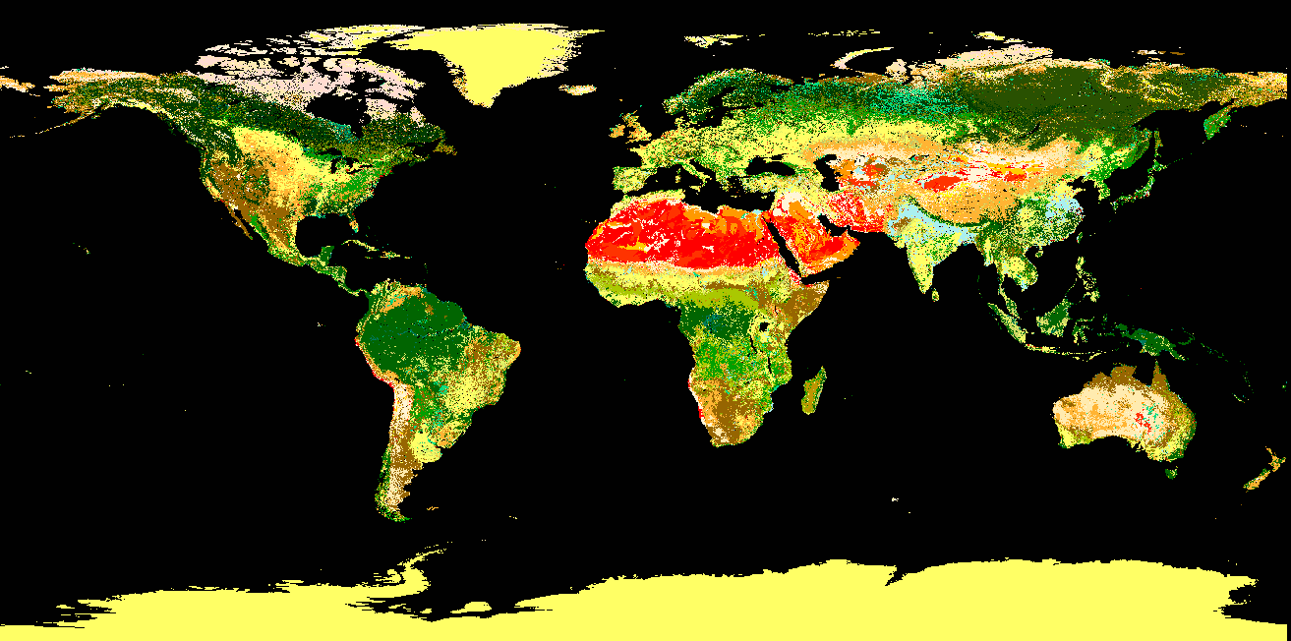
Biome Update

Slide 8
Harmonization
Motivation:
  CDR (from ATSR-2, AATSR, Terra MODIS, and SLSTR), Merged GEO / LEO products
  LST is retrieved from the different instruments using the same algorithm. However, need to account for:
    Inter-instrument calibration differences
    Observation time differences (e.g. ATSR-2 and Terra MODIS 10.30; AATSR and SLSTR 10.00)
Inter-calibration using IASI BTs as a calibration reference
  Heritage: GSICS used IASI as the reference sensor in a calibration of SEVIRI radiances
Align LSTs to a common reference time
  In GlobTemperature ATSR-2 was aligned with AATSR using LST matchups during the overlap period (~ 1yr): monthly average corrections for each month, for each land cover class were calculated where there were sufficient matchups and global values used elsewhere.
  In CCI we use MODIS Terra as the reference sensor; making use of the longer overlap periods

Slide 9
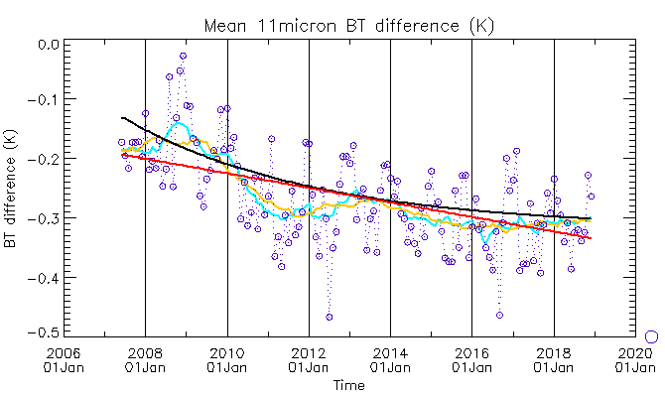
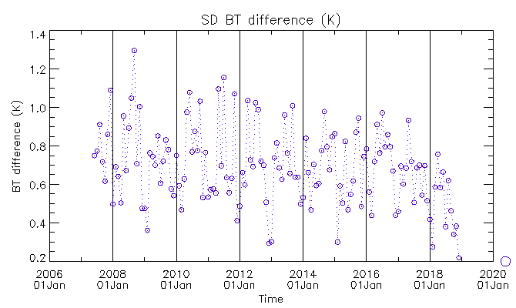
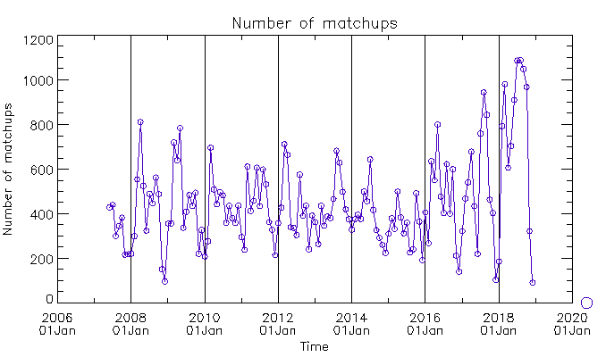
Aqua MODIS, 11 micron
Aqua MODIS, 11 micron, 90° S to 60° S
  Fit straight line to all data.
    Slope: - 0.0112 K per year
Straight line fit: red
Exponential fit: black
Smoothing 11 month window: blue
Smoothing 23 month window: yellow

Slide 10
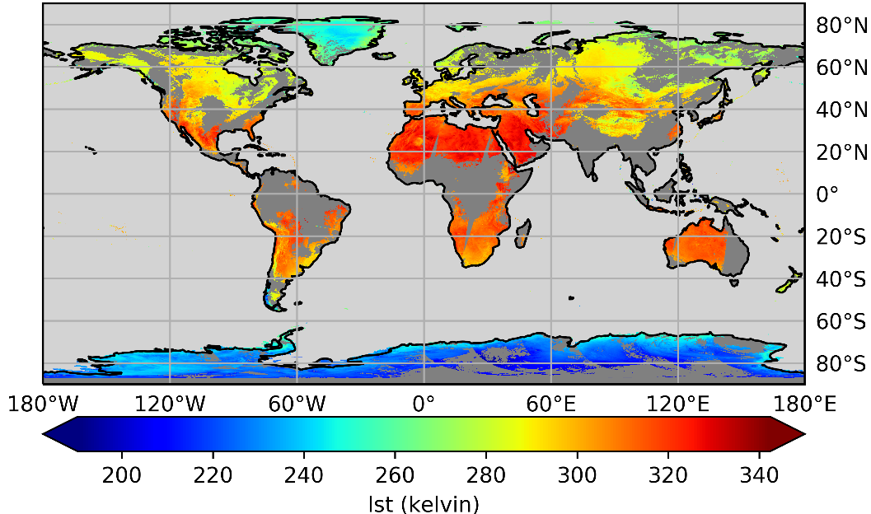
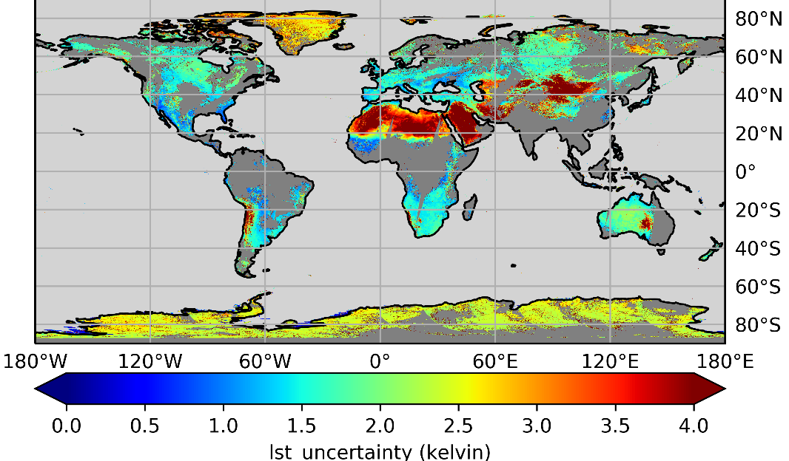
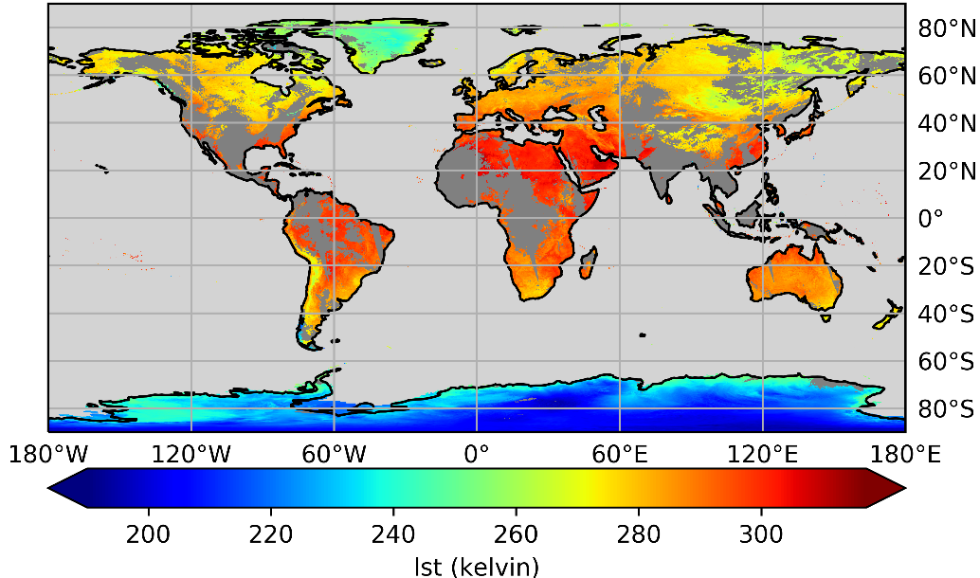
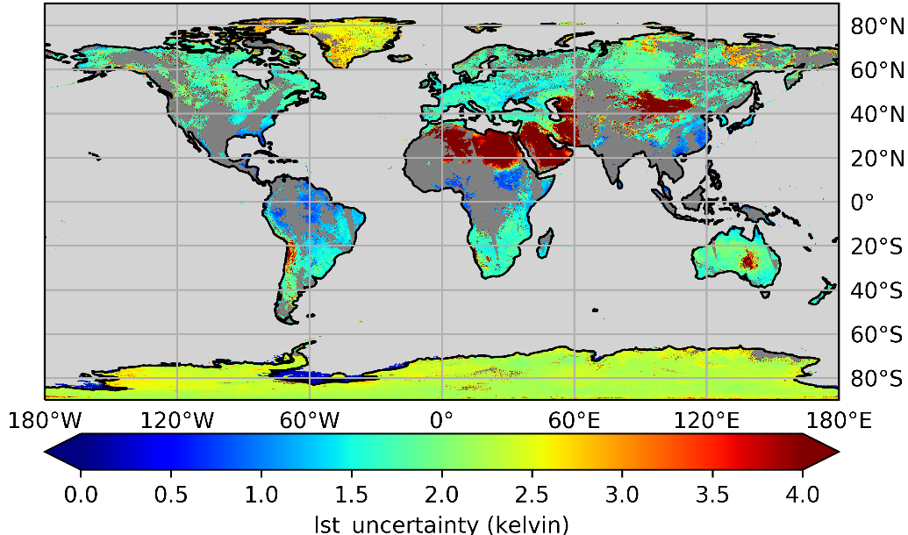
Example: L3C Plots – MODIST (2011/09/15)
Day
Day
Night
Night

Slide 11
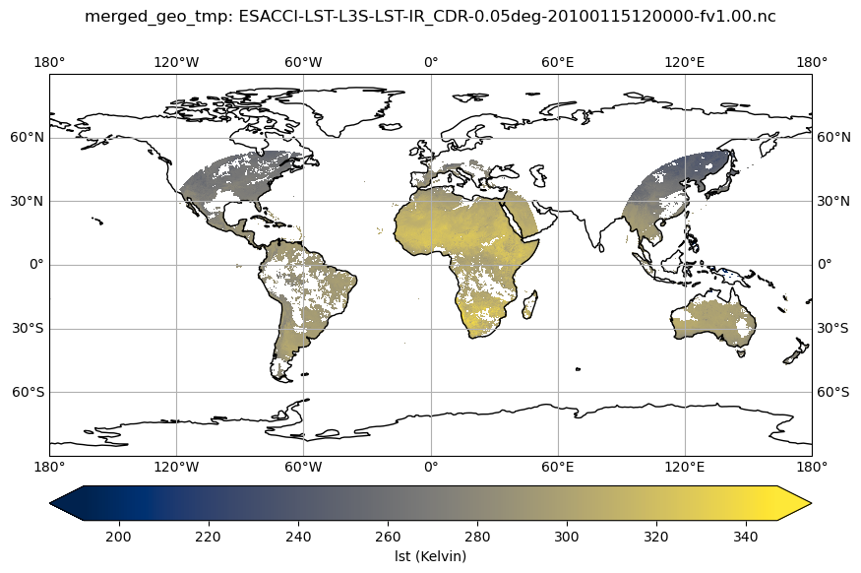
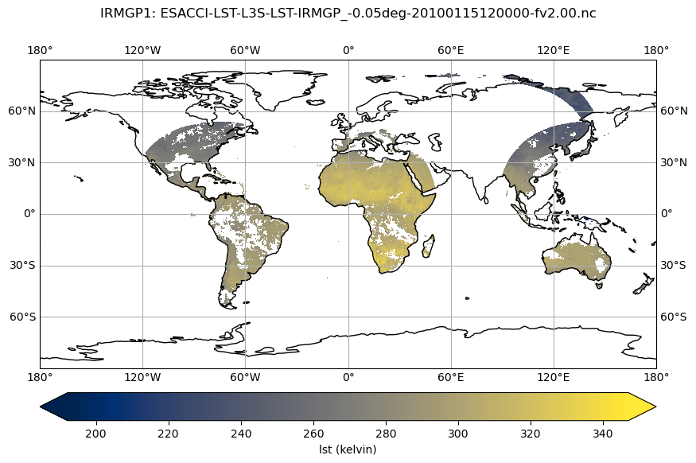
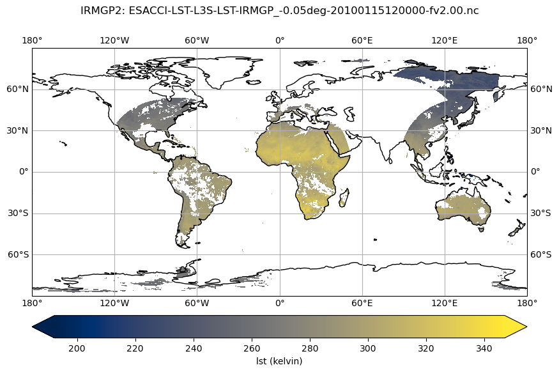
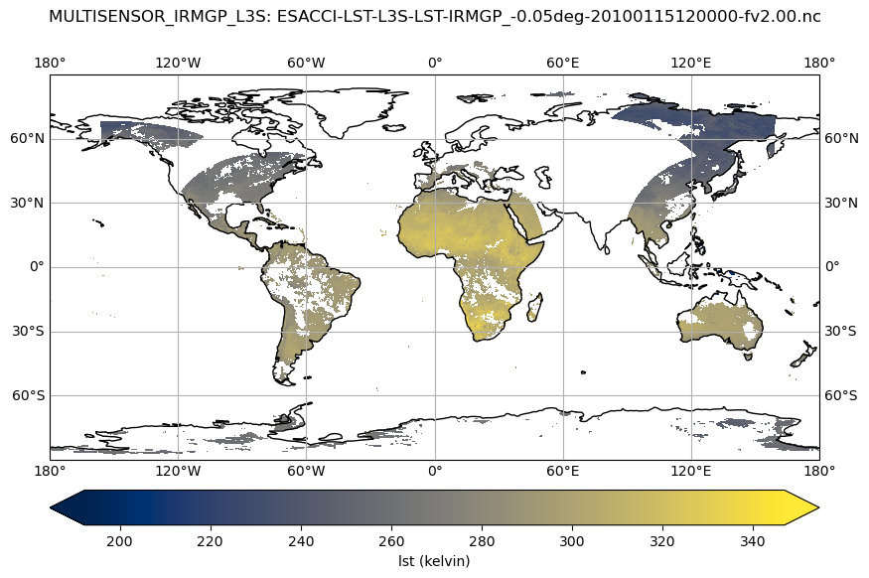
Phase-1 Merged Product V1.00
Merged GEO
Merged GEO+AATSR
2010/01/15 12:00
Merged GEO+AATSR+MODIST
Merged GEO+AATSR+MODIST+MODISA

Slide 12
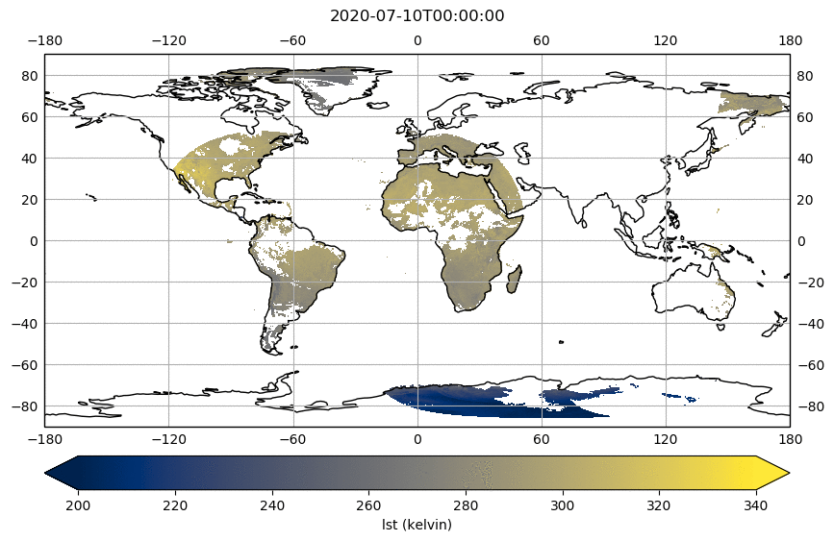
Phase-1 Merged Product V1.00
Merged GEO + SLSTA + SLSTRB
2020/07/10

Slide 13
LEO IR Products – Phase 2
  Expanding temporal coverage of existing datasets:
    Starting with Aqua-MODIS, Terra-MODIS, Sentinel-3A and –B for first release next Spring
    Has required change in profile data for consistency in cloud masking (ERA-Interim -> ERA5)
  Improved snow masking:
    Investigation suggests IMS daily data is the most useful for our products
    Potential to exploit Snow_cci data
  Sea ice surface temperature:
    First results from increasing the LST domain to include sea ice
  Cloud masking:
    Better temporal representation of expected brightness temperatures to determine clear sky probabilities
  AVHRR processing:
    Initial investigation with regards to an orbital drift correction

Slide 14
Sea-Ice 1
Sea-ice ST ‘missing’ from CCI programme so far
  Importance of sea-ice ST
    Influences energy and water fluxes
    Surface temperature changes in Polar Regions are predicted to be more rapid than either global averages or responses in lower latitudes.
  The Polar Regions are well-served by polar orbiting satellite instruments
    Phase 2 work
  Extend coverage of ATSR-S3 CDR to include sea-ice
    ATSR-2, AATSR, Terra MODIS, SLSTRs
    Aqua MODIS
    By implication merged GEO LEO product
  Develop IST retrieval algorithm based on selection from Phase 1 RRAI
  Validation by validation team using dedicated in situ source (Georg-von-Neumayer–Station on Antarctica)

Slide 15
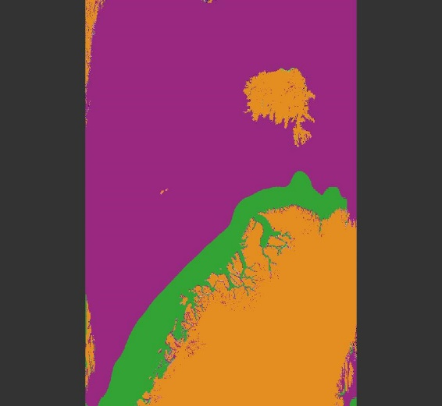
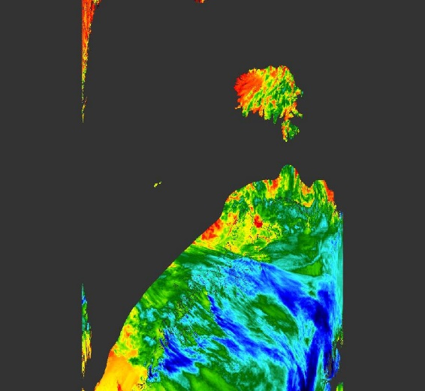
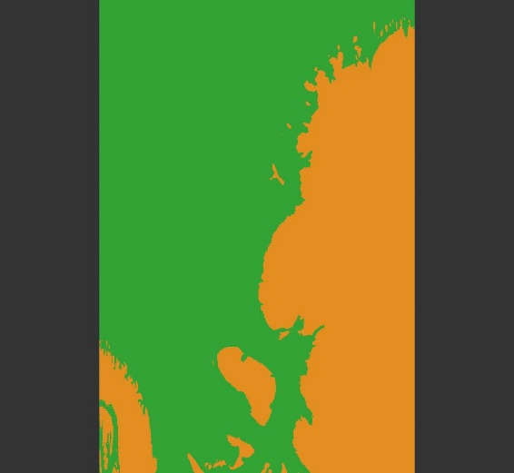
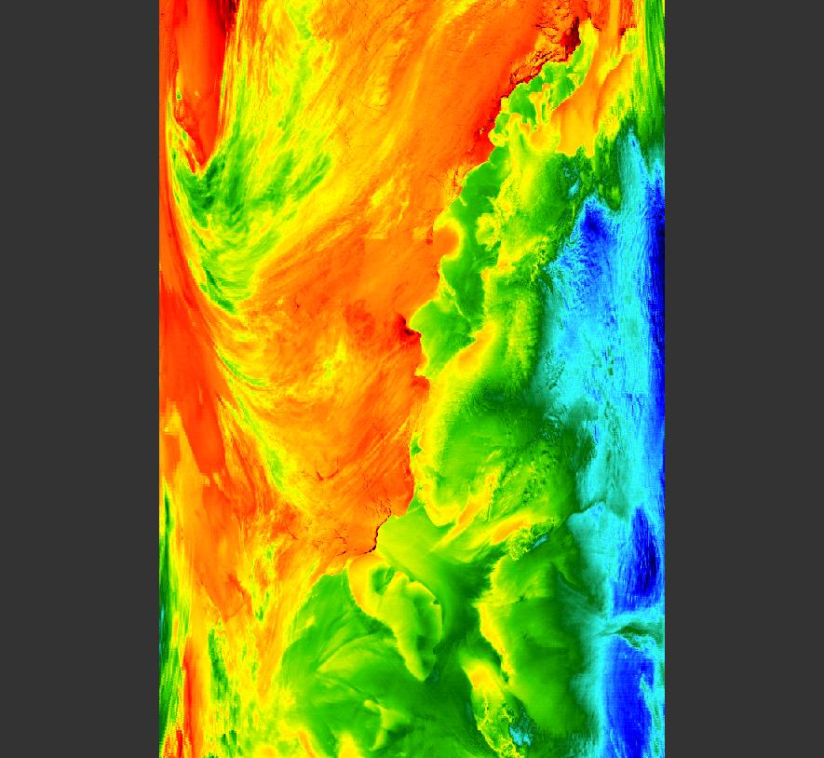
Sea-Ice 2
  Surface classification
    OSTIA daily sea-ice analysis will be used to identify snow/ice pixels
  Surface emissivity
    Ice emissivity information from the ECOSTRESS Spectral Library
  Cloud detection
    Difficult over ice due to similar surface temperatures and visible brightness of ice surface
    Threshold methods typically flag much of the sea-ice surface as cloud
    Probabilistic method will be used
      Draws on heritage of cloud detection for AATSR from GlobTemperature and operational SLSTR
    Make use of improved profile data from other cloud detection work
  Arctic example: Aqua-MODIS 09-01-2020 13:05
  Antarctic example: Aqua-MODIS 16-08-2020 01:10
  L2P granules: Biome (left panels) where orange is snow/ice, purple is sea, and green is sea-ice; LST (right panels) not cloud masked

Slide 16
Probabilistic Cloud Masking
In Phase-2 we are focussing on two specific improvements to the probabilistic scheme:
  Improved cloud-clearing of infrared data, especially over difficult surfaces such as snow and ice surfaces including new implementation over the sea-ice domain
  Moving to ERA5 data, which will minimise any non-linearity between adjacent time steps since the profiles are only 1-hour apart. The higher spatial resolution of ERA5 is also expected to improve the outputs of the bilinear interpolation onto each sensors tie-point grid

Slide 17
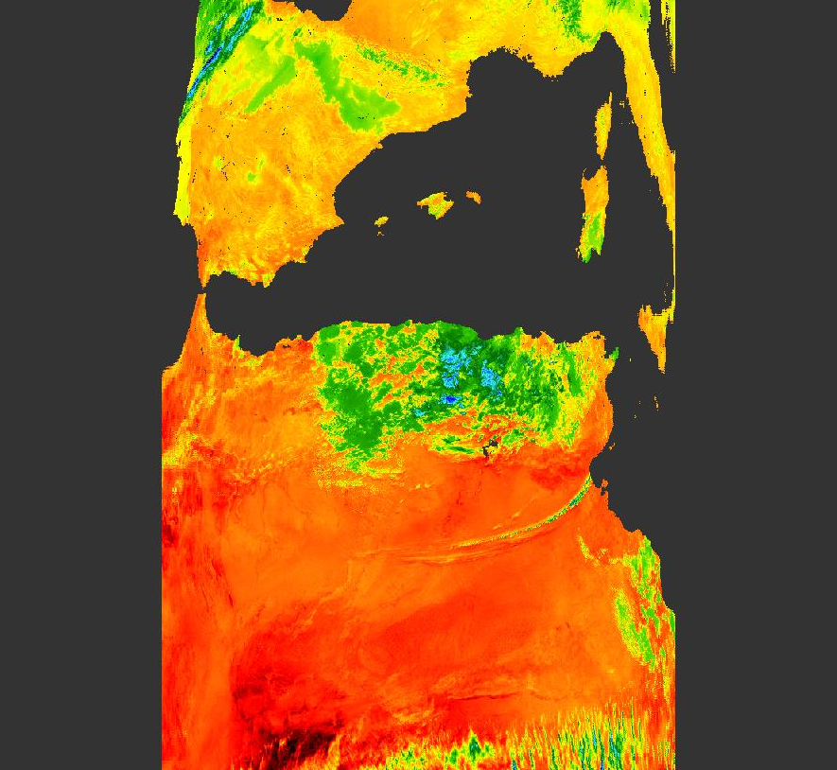
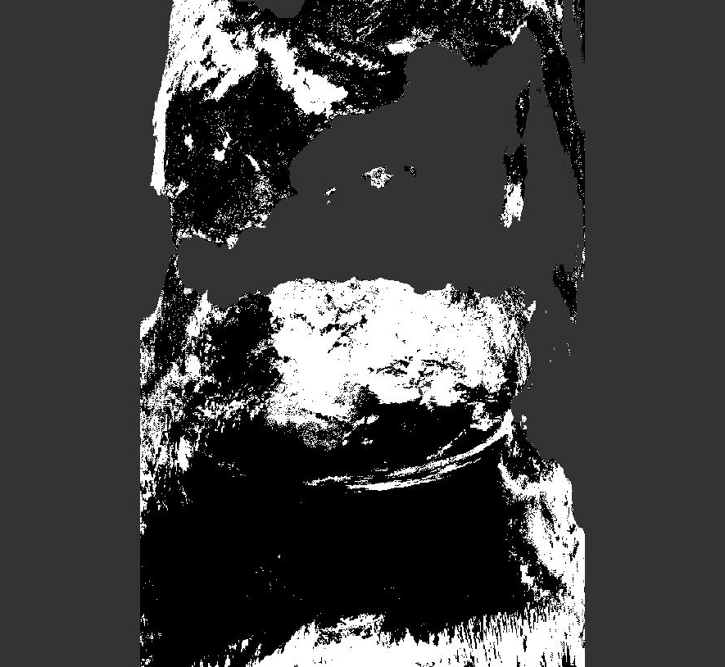
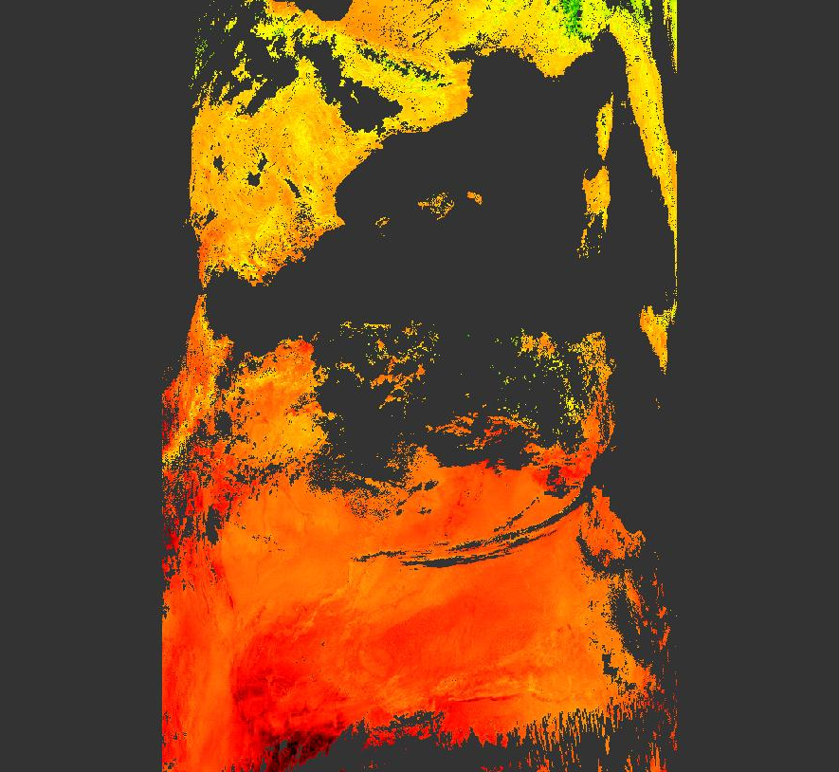
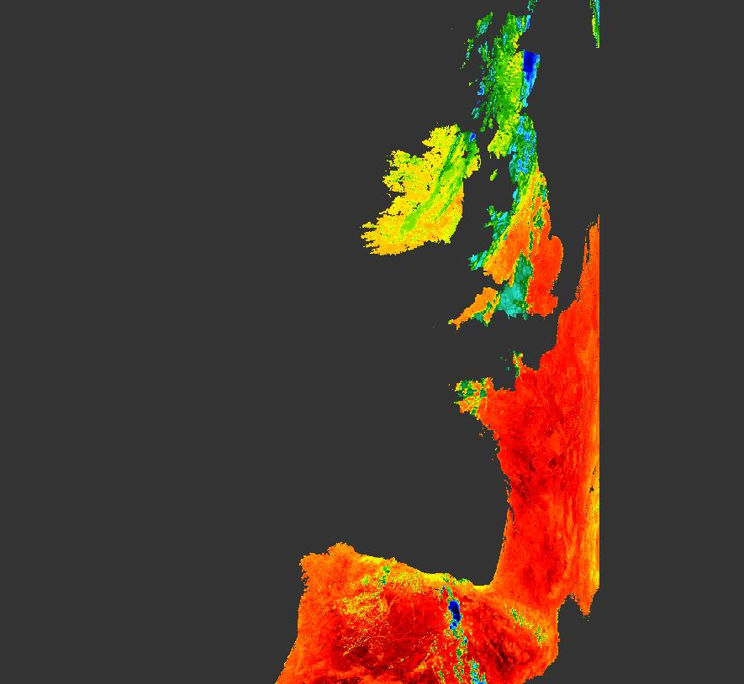
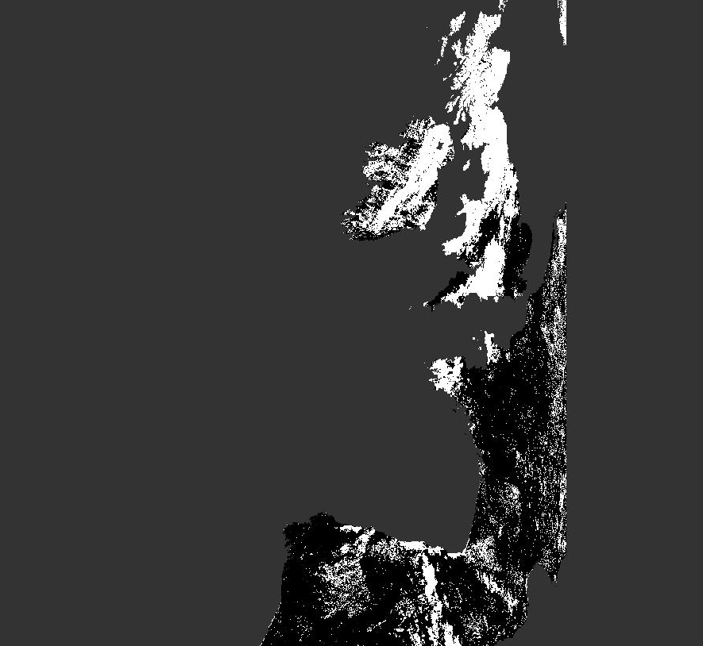
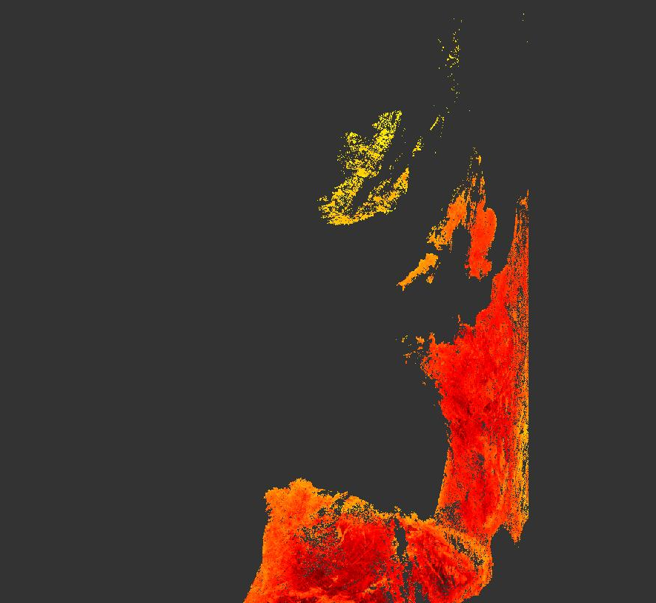
Examples – Aqua MODIS
  L2P LST field (unmasked)
  Probabilistic cloud mask field
  Cloud mask applied

Slide 18
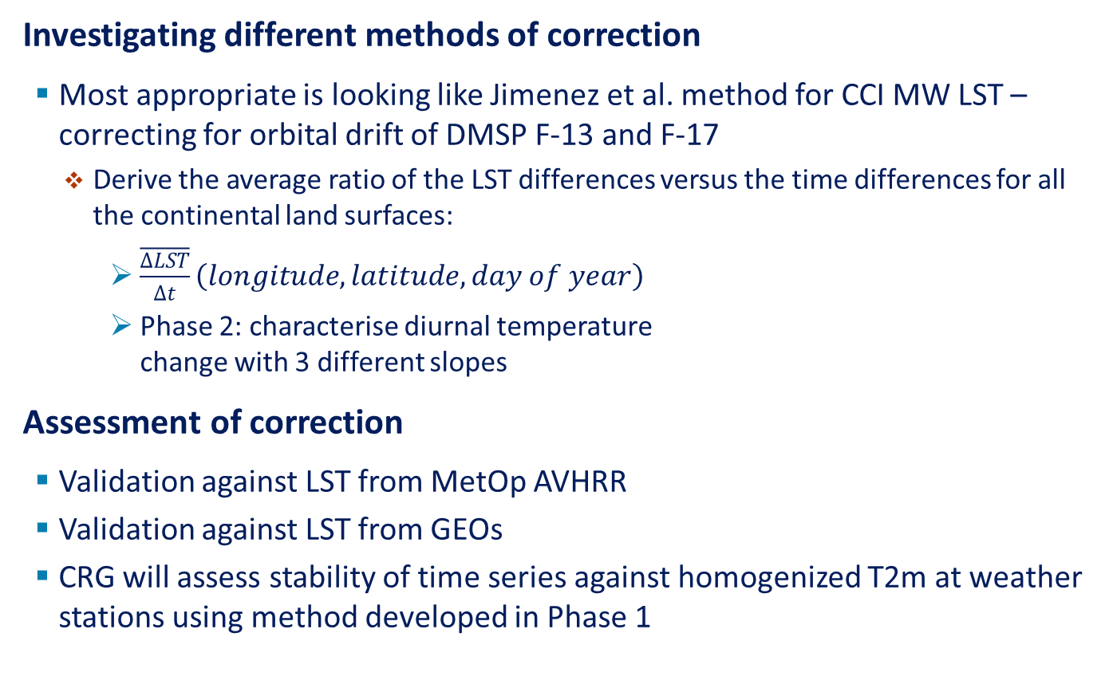
AVHRR Orbital Drift Correction
Investigating different methods of correction
  Most appropriate is looking like Jimenez et al. method for CCI MW LST – correcting for orbital drift of DMSP F-13 and F-17
    Derive the average ratio of the LST differences versus the time differences for all the continental land surfaces:
      $\overline{\frac{∆LST}{∆t}}\left(longitude, latitude, day of year\right)$
      Phase 2: characterise diurnal temperature
      change with 3 different slopes
Assessment of correction
  Validation against LST from MetOp AVHRR
  Validation against LST from GEOs
  CRG will assess stability of time series against homogenized T2m at weather stations using method developed in Phase 1

